Slide 1




…….enabling an enterprise culture with a social conscience
The Momentic
‘Grow Your Own Business’ Programme
Session 1:
BUSINESS APPRAISAL
Session 18:
Celebration/Recap

Slide 2

Ways of Working (WOW)
100% confidentiality - Respect
No multi-tasking – be fully present
Arrive on time and stay for the whole meeting
Commit to asking questions, listening & being non-judgmental
Sharing the air space
Implement agreed actions (Do what you say you will do)
Feedback at the following session
Complete all participant surveys at the end of each session
Our philosophy…
“The knowledge is in the room, let’s learn from each other & share”
Notes:
Logistics
3

Slide 3
Grow your own business programme
Business Appraisal
Relationship Building & Networking
Budgeting & Finance for Business
Market Research
Sales
Marketing
Social Media
Digital Marketing
A.I Integrations
Risk Mitigation & Legals
HMRC
Websites
Web Design
Business Skills
Sector Specific Support
Growth & Diversification
Health & Wellbeing
Celebration/Recap
Bi Weekly Workshops on a Thursday morning (3 hours) followed by refreshments provided by Momentic
1-2-1 business meetings available virtually in between
Dedicated Business Adviser throughout,
plus Guest Speakers will attend the programme
On-going access to our Business Support Team
Notes:
Pause and ask for all to read/sign their Client Mentoring Agreement
4

Slide 4
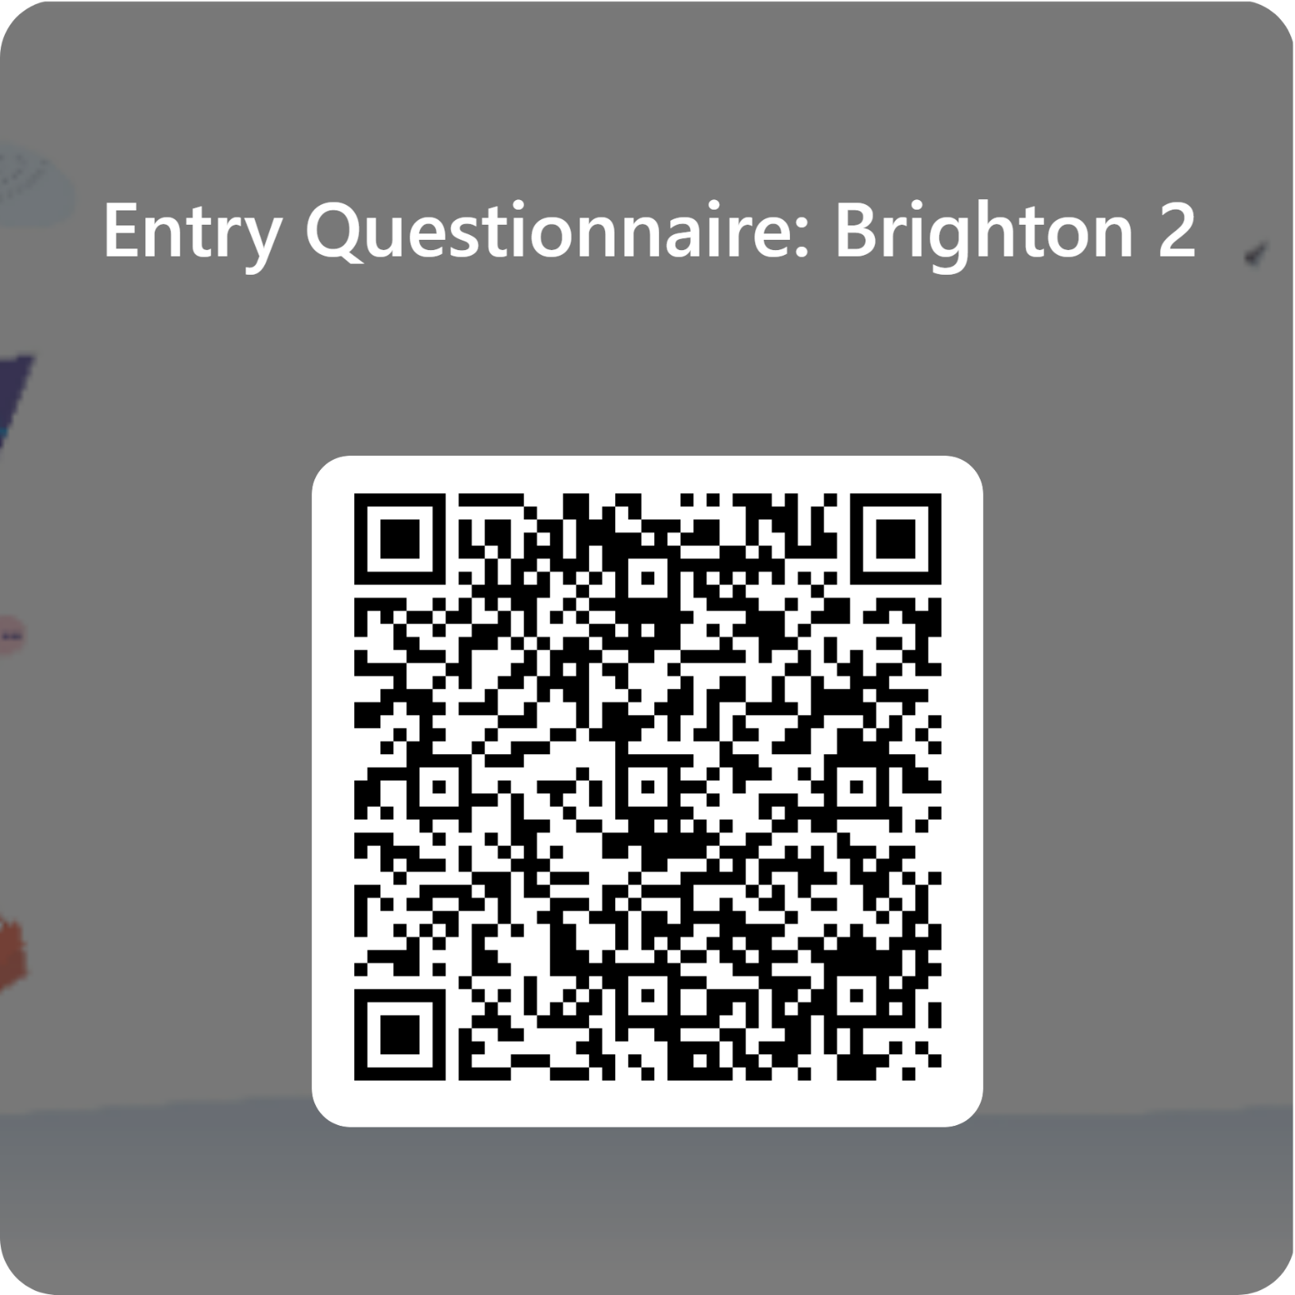
Self-Reflection
Self-Reflection Form to complete
Scan your smart phone camera over the QR code to bring up a short, confidential questionnaire or go to:
https://forms.office.com/e/RunBkKSx7x
Answer honestly about the way you feel NOW
We will use this to compare from when you originally did this as the first session.
Notes:
10

Slide 5
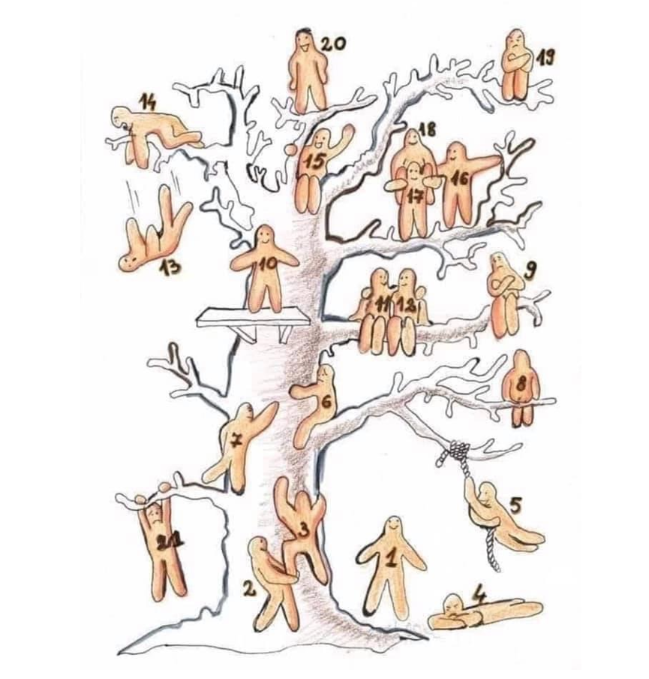
Getting to know you... Getting to know yourself!
Task 1: Where were you?..... 1,2 tree
Where were you on the tree?
Do you remember WHY:
You selected that character?
What that represented to you?
Which number you wanted to reach by the end of this programme & why?
Task 2: Where ARE you on the tree now?
Take some time to reflect…..
Share with us
Notes:
So for this exercise I want you to tell us who you are and what your business is. Find a character on the tree which represents where you are at arriving here today. One question you’d like to answer
Share with us…​
Who you​ are?
What does​ your business do?
What you hope to get from the programme​?
7

Slide 6
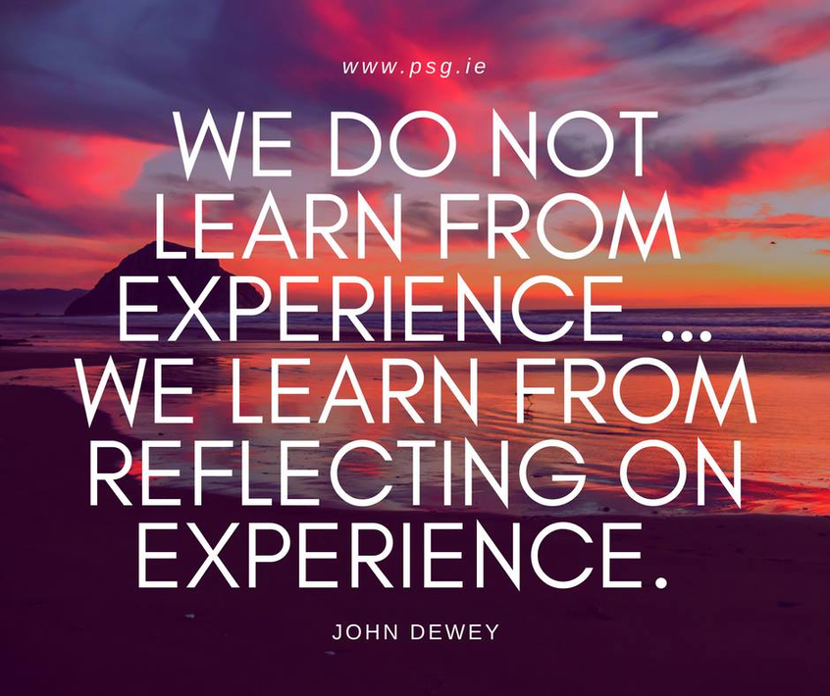
Self-Reflection
Why is self-reflection important?
It is about questioning, in a positive way, what you do and why you do it.
In any role, whether at home or at work, reflection is an important part of learning
Use today’s reflections as an opportunity to celebrate your journey this last 12 months
Notes:
9

Slide 7

Self-Reflection
Shall we take a look back at some of your ‘Small Wins’
Notes:
11

Slide 8


The floor
is lava yours

Slide 9

When will I see you…… again
121’s still available from myself and Frankie
There will be ‘Catchup Sessions’ available for those of you who have a couple of sessions to catchup on
Brighton Momentic Portal:
Ongoing digital access to all workshops
Workbooks also there for review, study and completion
Notes:
13

Slide 10
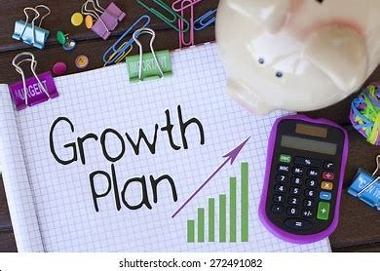
Business Development & Growth Plan
“BDGP”
Each of you will have one of these to take away
A look to the future
It will look at key marketing, financial and growth for your business.
There to compliment all the workshops, workbooks and 121s
Notes:
Pull up the growth plan on screen/ talk through the purpose and the way in which this will be completed
Online copy to be shared via email
12

Slide 11
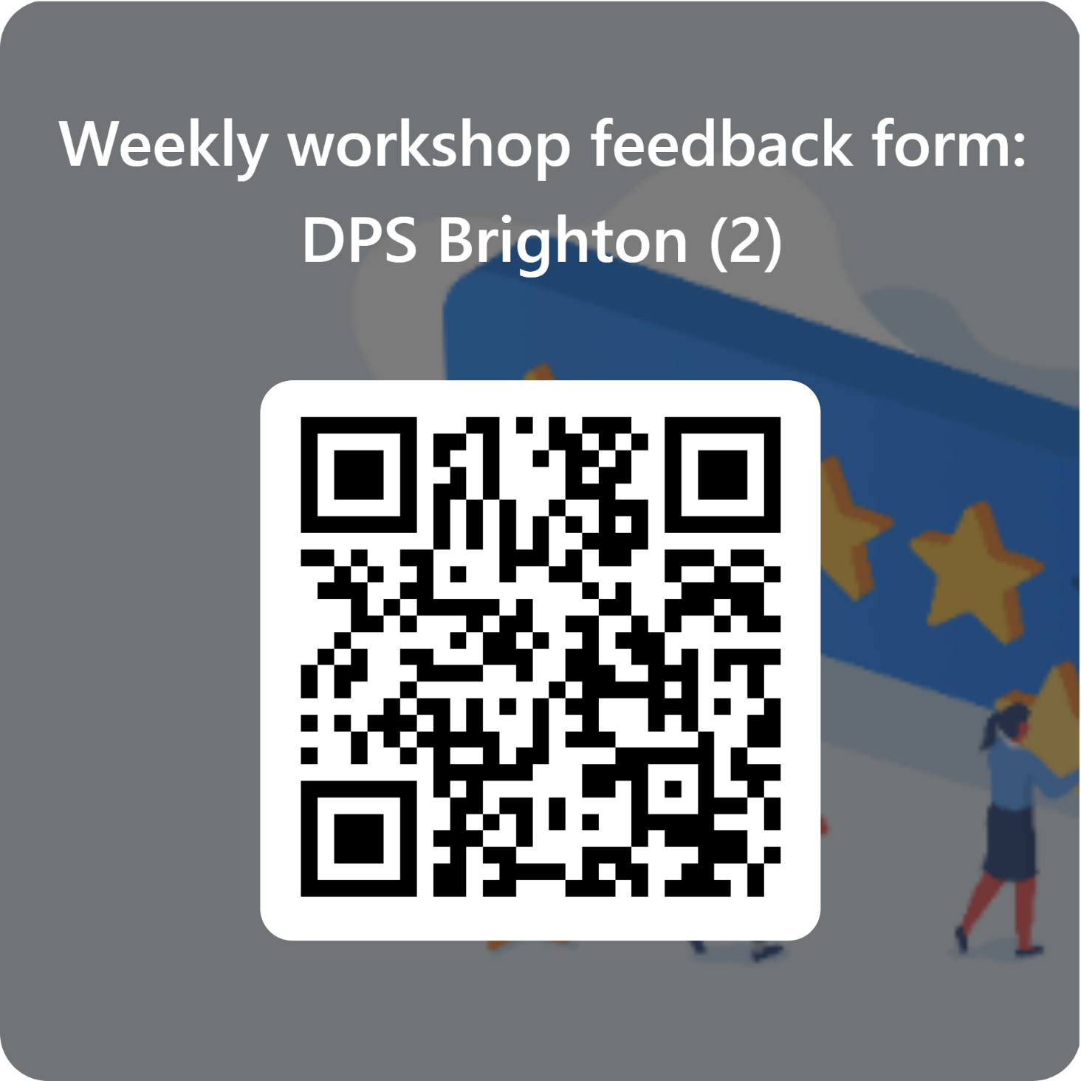
Feedback and next steps
We want your feedback on these sessions so that we can continue to adapt our plans to suit your needs. Please complete the short feedback form on the QR code to the right.
If you cannot use the QR code – you can go to this website:
https://forms.office.com/e/rh1x3nbFXy
Notes:
14

Slide 12
…enabling an enterprise culture with a social conscience
Thank you… really
THANK YOU!!!

