Slide 1


AI for Business
Notes:
“Welcome everyone. Thank you for making the time to be here. I know that as small business owners, you’re often wearing 10 hats at once — you’re the sales team, the admin department, the social media manager, and sometimes even the cleaner. Today we’re talking about Artificial Intelligence — or AI for short. Now, when people hear AI, some think of robots taking over the world, others think of futuristic films. But what we’re looking at is far simpler, and far more practical: tools that can help you save time, reduce costs, and get back some headspace in your business.
This session is designed with you in mind — small teams, limited budgets, and often limited time. We’re not talking about big corporate AI systems that cost thousands. We’re talking about free or very low-cost tools you can use right now, without needing to be technical.
And I want to make one promise at the start: we’ll keep this grounded. No jargon, no overwhelming detail, and no assumption of prior knowledge. My job is to make sure you leave today confident enough to try at least one tool safely in your business this week.”
Engagement Prompt: “Quick show of hands — who here has already used something like ChatGPT, or Canva’s AI design tool, or even Netflix recommendations? Brilliant — and for those who haven’t, don’t worry. You’re in exactly the right place.”

Slide 2



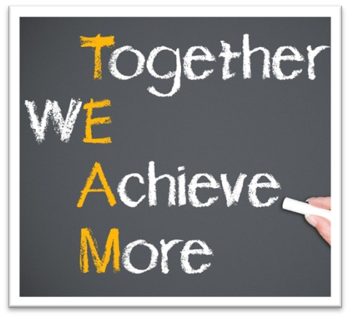
Ways of Working
100% confidentiality
No multi-tasking – be fully present
Arrive on time and stay for the whole meeting
Commit to asking questions, listening & being non-judgemental
Sharing the air space
Implement agreed actions (Do what you say you will do)
Feedback at the following session
Complete all participant surveys at the end of each session
Philosophy –
“The knowledge is in the room, let’s learn from others and share”
Notes:
Before we dive into AI itself, let’s agree a few ways of working.
This is a safe and confidential space. That means we can all feel comfortable asking what we might think are ‘silly’ questions — because if you’re wondering, the chances are someone else is too.
Let’s also agree to be present. Running a business is busy, but the more focused we are now, the more value you’ll get. So if you can, resist checking emails or thinking about your to-do list — those things will still be there after, but this is three hours just for you and your business.
I also want to stress that the knowledge is in the room. I can bring you tools and ideas, but you all bring your own business experience. Some of you are running cafés, some are tradespeople, some are online service providers. You’ll hear examples today, but please also share your own — because another SME in this room might learn just as much from your story as from mine.
And finally, action and accountability. AI is one of those topics where it’s easy to get inspired but then do nothing. So part of today is about committing to trying at least one thing after you leave. Small steps — but real ones.”
Engagement Prompt: “Turn to the person next to you and share one thing you’d love AI to take off your plate if it could. Admin? Social media? Customer emails? Take 30 seconds each. Go!”
(Bring back to group: “What did people say? Let’s hear 2–3 examples.”)

Slide 3


Disclaimer
The information provided in this presentation is based on our own knowledge and research from various sources on the internet. While we have made every effort to ensure that the information presented is accurate and up-to-date, we cannot guarantee that it is completely error-free or that it will remain accurate over time. Therefore, we cannot be held liable for any errors, omissions, or inaccuracies in the information presented in this presentation. We encourage you to do your own research and verify the information presented before making any decisions based on it.
We are business advisers, not AI specialists. The content we share today is for educational and demonstration purposes only. Information is drawn from personal experience, anecdotal insights, and publicly available sources. While we aim to provide useful guidance, the AI landscape evolves rapidly, and details may change quickly. Some examples or tools shown may already be out of date, altered, or discontinued. Certain features we mention may only be available in paid versions of software, or may later become restricted. Free tools and services can also change their terms, pricing, or availability without notice. Nothing in this workshop should be taken as absolute fact, legal advice, or technical instruction. We encourage all participants to conduct their own research and verify information independently. Before making decisions for your business, always double-check details with trusted, up-to-date sources. The aim of this workshop is to spark ideas, build awareness, and encourage exploration—not to provide final answers. Responsibility for how you apply these insights rests with you as the business owner or decision-maker.
Notes:
The information provided in this presentation is based on our own knowledge and research from various sources on the internet. While we have made every effort to ensure that the information presented is accurate and up-to-date, we cannot guarantee that it is completely error-free or that it will remain accurate over time. Therefore, we cannot be held liable for any errors, omissions, or inaccuracies in the information presented in this presentation. We encourage you to do your own research and verify the information presented before making any decisions based on it.
We are business advisers, not AI specialists. The content we share today is for educational and demonstration purposes only. Information is drawn from personal experience, anecdotal insights, and publicly available sources. While we aim to provide useful guidance, the AI landscape evolves rapidly, and details may change quickly. Some examples or tools shown may already be out of date, altered, or discontinued. Certain features we mention may only be available in paid versions of software, or may later become restricted. Free tools and services can also change their terms, pricing, or availability without notice. Nothing in this workshop should be taken as absolute fact, legal advice, or technical instruction. We encourage all participants to conduct their own research and verify information independently. Before making decisions for your business, always double-check details with trusted, up-to-date sources. The aim of this workshop is to spark ideas, build awareness, and encourage exploration—not to provide final answers. Responsibility for how you apply these insights rests with you as the business owner or decision-maker.

Slide 4
What we will cover? Our Aims
What is A.I?
Why should you as a business, care about A.I?
Look at some A.I tools/apps
Undertake some live demonstrations
Learn how ‘prompts’ positively impact AI output
Complete a group exercise using AI
Better understand, the GDPR implications of AI
To consider how AI can impact the 18 modules we will cover
To leave with an open-mind and hopefully an enthusiasm to see how AI can help you and your business moving forward
​
Notes:
“Here’s our roadmap for today.
First, we’ll look at what AI actually is, in simple terms — no jargon, just clear examples.
Second, we’ll explore some of the most accessible AI tools — things like ChatGPT, Canva, Otter.ai, Google’s tools, and Zapier. These are either free or have very low-cost versions, and they can be game-changers for saving time.
Third, we’ll spend time on the legal and ethical side — because I know many of you will be nervous about this. GDPR, data protection, copyright, intellectual property — we’ll cover when you can safely use AI outputs, and when you need to stop and think. This is about building confidence, not fear.
Fourth, we’ll show how AI can link into all the different areas of running a business — from sales and marketing, to finance, to customer service.
And finally, we’ll do some practical demos and group activities. You’ll get to see tools in action, and even have a go yourself.
The idea is that by the end, you’re not just inspired but also confident and informed — you’ll know what’s safe, what’s risky, and what’s worth trying in your own business.”

Slide 5
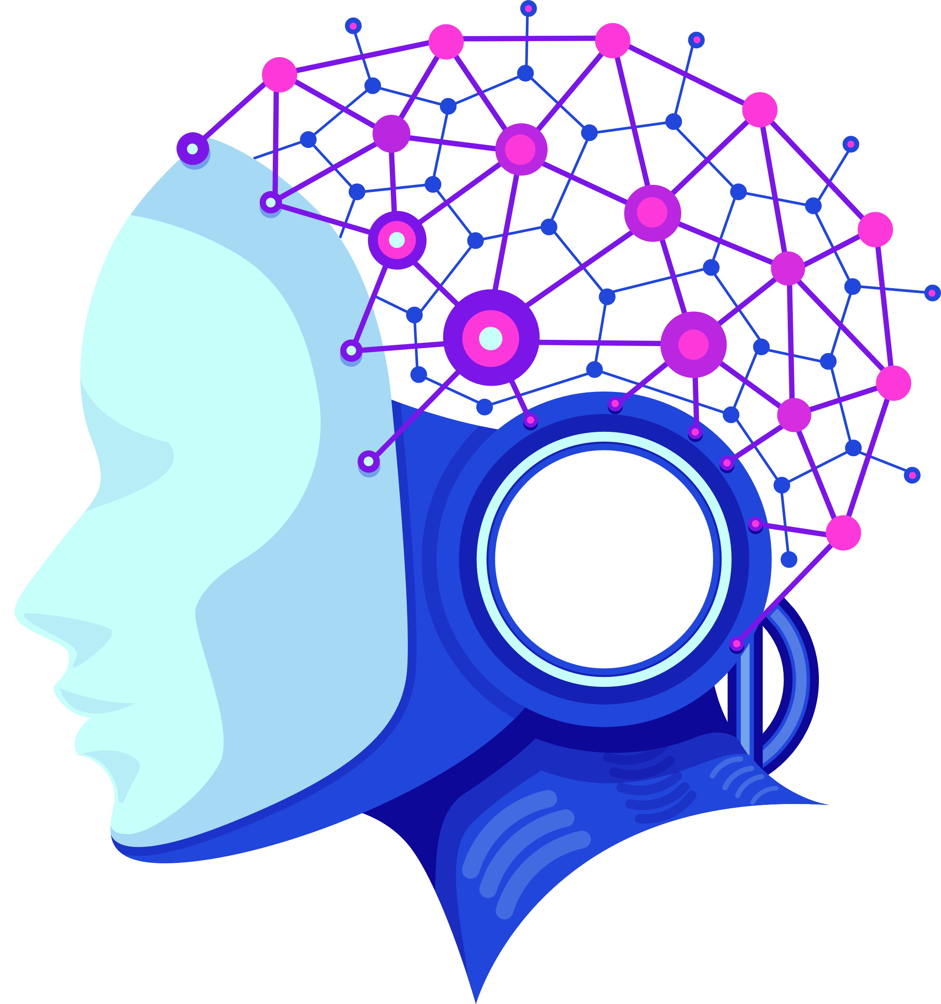
What is AI?
AI = Artificial Intelligence = machines simulating human intelligence
Text generation (ChatGPT)
Image creation (Canva, DALL·E)
Voice and transcription (Otter.ai
Prediction (Google Sheets AI)
Already used in: Netflix, Gmail, Google Maps, Instagram
Notes:
“So what actually is AI? At its simplest, it’s machines simulating human intelligence — spotting patterns, learning from data, and making predictions or generating outputs.
But let’s keep it grounded. You’re already using AI without realising it. When Netflix recommends a new show, that’s AI. When Gmail finishes your sentence with predictive text, that’s AI. When Google Maps reroutes you around traffic — again, AI.
In the small business world, that translates into tools like:
ChatGPT — writing emails, blogs, product descriptions.
Canva and DALL·E — creating graphics, logos, or marketing materials.
Otter.ai — transcribing a meeting or interview so you don’t have to take notes.
Google Sheets AI — predicting sales or spotting trends in your numbers.
Now, here’s where we need to pause and think about GDPR and copyright. AI doesn’t replace your responsibility. If you put personal data — like a client’s name, health details, or email — into a free AI tool, you could be breaching GDPR. The rule of thumb is: only use anonymised or business-safe data. Instead of saying ‘Jane Smith from Brighton with diabetes,’ you’d say ‘a customer in Brighton with a health condition.’
And from a copyright perspective — AI can generate amazing outputs, but not all of them are legally yours. For example, if Canva’s AI generates a logo, you might not be able to trademark it, because someone else could generate something similar. We’ll unpack this more later, but the big takeaway for now is: AI is brilliant for drafts, ideas, and inspiration — but you should always add your human input and double-check before publishing or trademarking.
So — everyday tool, powerful potential, but with boundaries we’ll learn to respect.”
Engagement Prompt: “Quick question for the group: who’s realised that you’ve already been using AI without knowing it? Netflix? Maps? Gmail? [Take a few hands.] That’s exactly the point — AI isn’t just futuristic, it’s already part of your daily life.”

Slide 6
Why Should Small Businesses Care?
Your challenges:
•Time pressure, small team, limited budget
AI can help with:
•Content creation, admin reduction, customer engagement
•Cost-effective growth and automation
Notes:
“So why should you, as a small business owner, even care about AI?
Because the very challenges you face — time, money, small teams — are exactly the areas where AI shines.
Think about time. How many hours have you lost staring at a blank page trying to write a blog, or drafting a polite payment reminder email, or putting together a social media post? AI can reduce that from an hour to five minutes.
Think about budget. Most of you can’t afford a marketing agency, a graphic designer, and an admin assistant. AI can’t replace those people entirely, but it can give you 70% of the way there, for free. That’s massive leverage.
Think about customer engagement. A café could ask ChatGPT for three content ideas about their new seasonal menu. A dog walker could use Canva to auto-generate a month of social posts. A tradesperson could use Google Sheets AI to forecast busy periods and plan staffing.
Now, here’s the balancing point: yes, AI is powerful, but it must be used responsibly. GDPR means you cannot enter client names, addresses, or sensitive data into public AI tools. IPO guidance means that logos or images generated by AI may not always be legally protectable.
So AI is fantastic for speed, drafts, and inspiration — but don’t think of it as a magic wand that replaces your judgement or legal obligations.
The real message is this: AI gives small businesses a way to punch above their weight — but only if it’s used safely, ethically, and with human oversight.”
Engagement Prompt: “By show of hands — who here feels time-poor in their business? Who feels budget-poor? Who feels idea-poor sometimes? Great. AI can help with each of those — and we’ll show you how.”

Slide 7
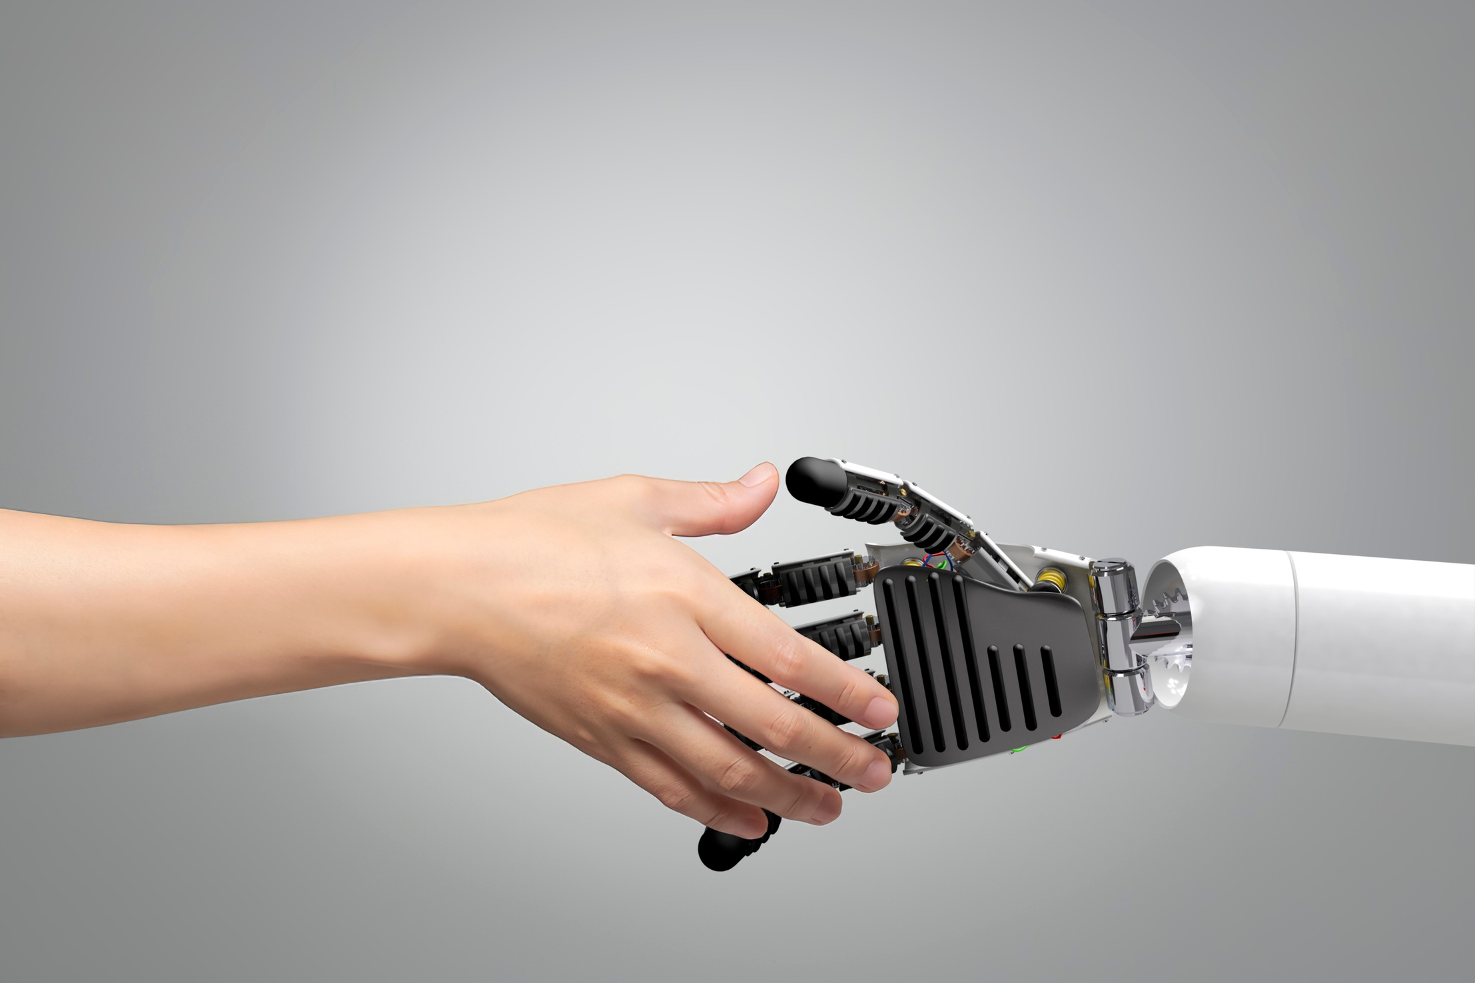
AI Tools
Notes:
Let’s have a look at a few of the many, many AI tools that are out there and available

Slide 8
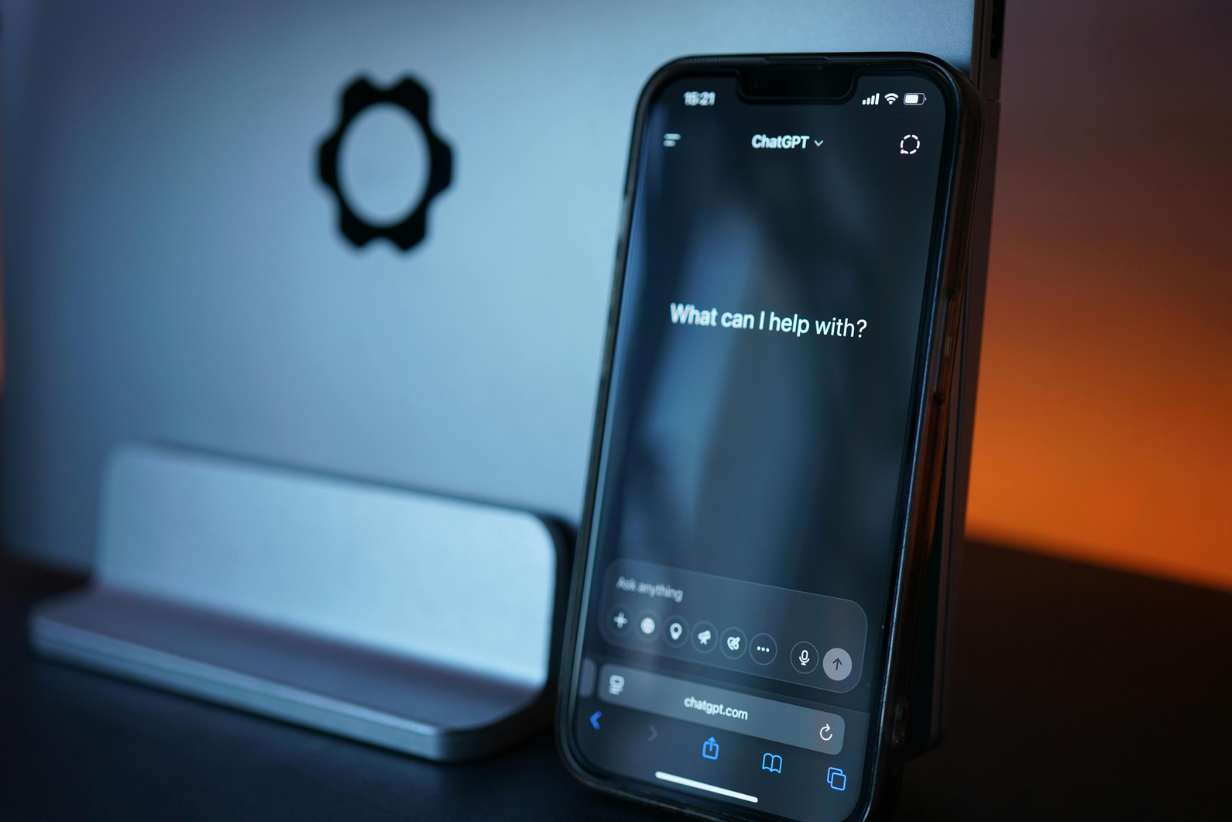
Tool 1- ChatGPT
What it does:
Writes text (emails, blogs, bios, FAQs, summaries), answers questions, generates ideas, creates code, and helps with learning or problem-solving.
How to use:
•Type clear prompts with context, format, and tone you want
•Tip: Always review/edit output. Avoid personal data
Notes:
“Let’s start with ChatGPT — probably the most famous AI tool right now. At its simplest, it’s a text generator. You type in a request — known as a prompt — and it produces text for you.
Now, what does that actually mean for a small business? It means you can ask ChatGPT to:
Write a draft blog post about your product or service.
Create a polite but firm late-payment reminder email.
Summarise a long article into five bullet points.
Generate FAQs for your website.
Here’s the golden rule: the quality of what you get depends on the quality of the prompt you give. If you say, ‘Write me something about dog walking,’ you’ll get something generic. If you say, ‘Write a warm, friendly Instagram caption for a Brighton-based dog walker who wants to encourage repeat bookings,’ you’ll get something much closer to what you can actually use.
Now let’s address the GDPR angle. You must never enter personal client data into ChatGPT. That means no names, email addresses, or sensitive details. Instead, use anonymised prompts. For example, rather than ‘Write an email to John Smith in Brighton,’ say ‘Write a polite reminder email to a customer in Brighton.’
From an IPO/copyright perspective, ChatGPT’s text outputs are generally considered ‘unprotected’ — you can use them, but they don’t have strong copyright protection because they’re generated by a machine. The safest approach is always to edit and personalise the text so you’ve added your own human authorship. That way, you can more confidently claim ownership.
So think of ChatGPT as your junior copywriter — quick, affordable, but needing supervision.”
Engagement Prompt: “Turn to the person next to you and share: what’s one piece of writing in your business that you’d love ChatGPT to help with? Emails? Blogs? Social posts? Invoices? [Allow sharing for 2 minutes.]”

Slide 9

Tool 2- Canva and Magic Design
What it does:
Creates logos, flyers, social posts, presentations
Magic Design = AI-driven templates
Tip: Start with brand colours and style guide
Notes:
“Next, Canva — many of you may already use it. Canva is an easy design platform for things like logos, flyers, presentations, and social posts. The AI feature within Canva is called Magic Design. You type in a few keywords, and Canva suggests ready-made designs.
For example, you could type: ‘Brighton café promoting a new vegan menu’ — and instantly get suggested poster designs, social graphics, and even templates for Instagram stories. You can then customise these with your brand colours and fonts.
Now, here’s the important bit on copyright and IPO rules:
If you generate a logo using Canva’s AI, you may not be able to trademark it, because someone else could generate something very similar.
Many Canva templates and AI outputs are licensed for reuse, but you should always double-check their licensing terms.
If you want something unique and protectable, use Canva’s AI as inspiration, then tweak and add your own creative elements.
From a GDPR perspective, Canva is generally safe for business use because you’re not putting personal data into it. Just be mindful if you upload photos of clients — make sure you have their consent before publishing.
So the rule of thumb with Canva: fantastic for marketing content and speed, less suitable for unique logos or things you want to own legally.”
Engagement Prompt: “Show of hands — who here spends too much time making graphics or social media posts? Canva can reduce hours of fiddling into minutes. Imagine having four weeks of social posts lined up by the end of today.”

Slide 10

Tool 3- Otter.ai
What it does:
Live transcribes meetings, voice memos
Summarises content into key points
Great for:
• Online meetings, interviews, coaching calls
Notes:
“Otter.ai is a transcription tool — it takes spoken words and turns them into text. You can use it in real time during a meeting, or upload an audio file and have it transcribed automatically.
Why is this useful for SMEs?
Because many of you are in meetings, coaching calls, interviews, or even networking events where note-taking is a pain. Otter does that for you. It even produces summaries and highlights of the main points.
From a GDPR perspective, you must be transparent. If you’re recording or transcribing a meeting with others, you need to let them know. And you should avoid transcribing anything that contains sensitive personal data unless you have explicit consent.
From a copyright/IP perspective, the transcription itself is factual, so not usually protectable — but the ownership of the recording still belongs to whoever created it. Always keep a record of consent if you’re recording others.
Otter is a brilliant way to make your business more efficient without spending a penny — it has a free tier that covers most needs.”
Engagement Prompt: “Hands up — who here has ever finished a call or meeting and thought, ‘I wish I’d written that down’? That’s where Otter steps in.”

Slide 11

Tool 4- Google Tools (Docs, Sheets and Gemini)
What it Does:
Generates text, images, and code, answers questions, summarises information, and integrates with Google tools
How to use:
• Sign in with a Google account and ask questions or give creative/work-related prompts
• Tip: Use it directly inside Google apps for drafting, brainstorming. Always review/edit
Notes:
“Google has been quietly building AI into the tools many of you already use — Docs, Sheets, Gmail.
In Google Docs, AI can summarise, rewrite, and check tone. So if you draft an email or policy, you can ask AI to make it clearer or more formal.
In Google Sheets, AI can help predict sales trends, build formulas, or even generate charts without you knowing the formulas. For example, you could ask it to ‘spot the quietest months over the past year’ and it will highlight them.
And now there’s Google Gemini — their AI assistant — which can brainstorm, draft, and automate tasks across Google Workspace.
On the GDPR side, Google is generally compliant, but you still need to be cautious about the data you enter. If you’re using Sheets for customer details, make sure your account has the right privacy settings and isn’t shared publicly.
From a copyright/IP view, anything you generate in Docs or Sheets is your own work — because you’re guiding it with your data. The main thing to be mindful of is if you’re asking it to rewrite or rephrase existing copyrighted text. That’s a grey area, so always check you’re not essentially copying a competitor’s work.
For small businesses, Google’s AI is brilliant because most of you already have access to it through a free Gmail account.”
Engagement Prompt: “Think about this: what’s one spreadsheet or document in your business that frustrates you? Could AI help you automate or simplify it? Jot down one idea now.”

Slide 12
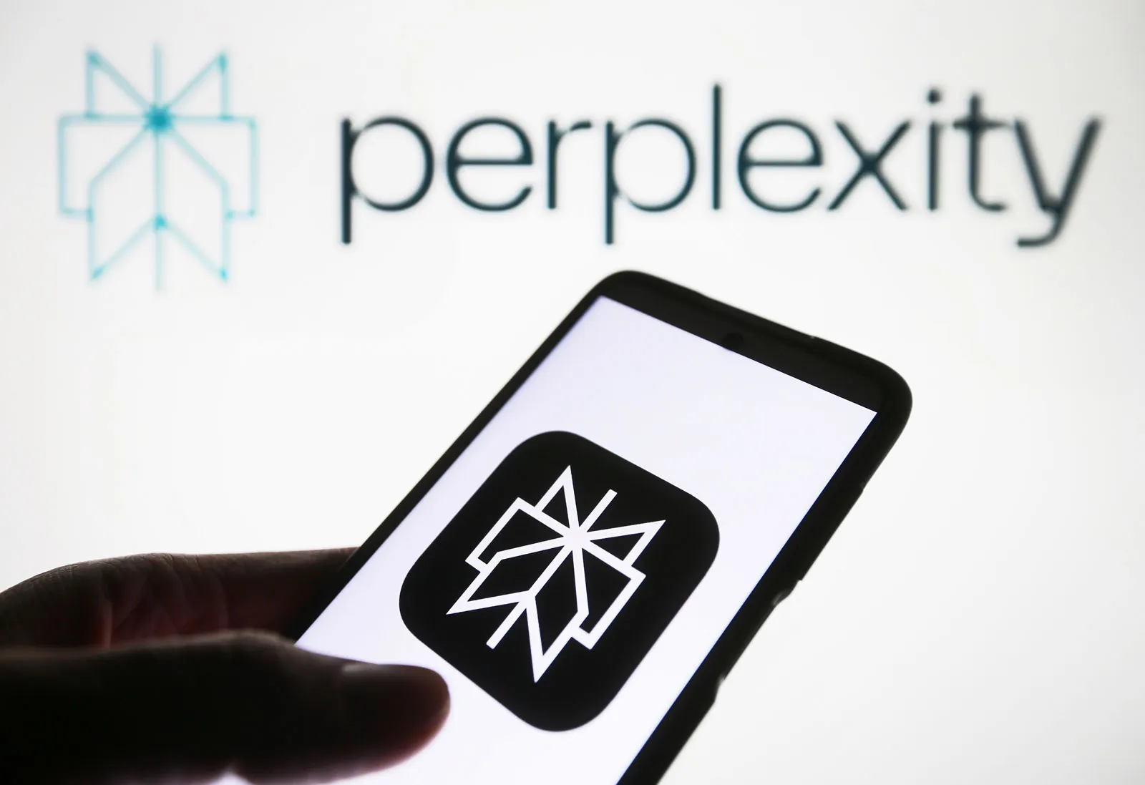
Tool 5- Perplexity.ai
What it Does:
Answers questions using real-time web searches with citations, summarises complex topics, provides quick fact-checks, and helps with research by showing sources.
How to use:
• Type your question in natural language and it will generate a clear answer with references
• Tip: Use follow-up questions to refine results and always check the cited sources for accuracy

Slide 13
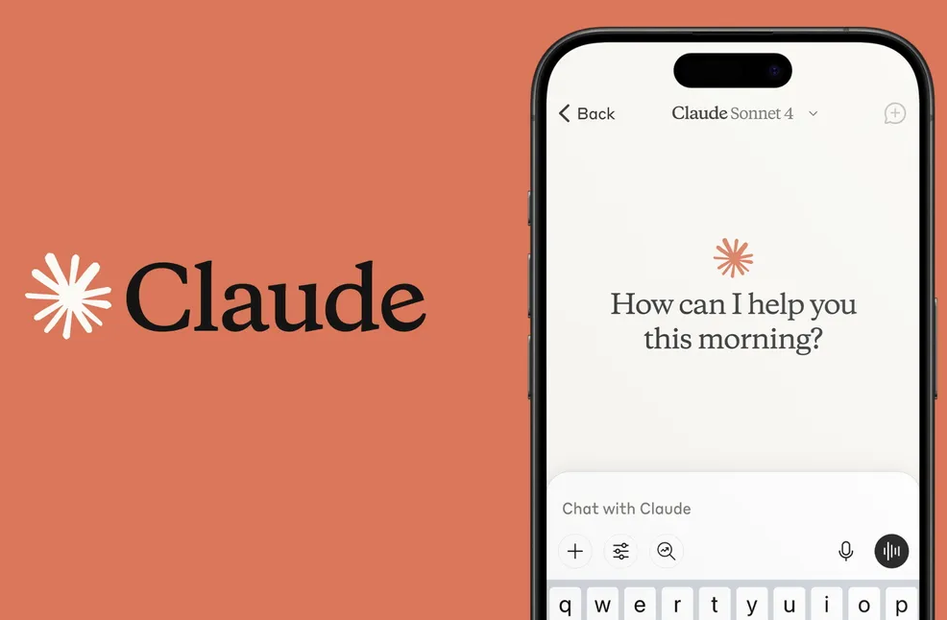
Tool 6- Claude.ai
What is it?:
Conversational AI platform built by Anthropic. Claude, offers natural, reliable, and ethically-aligned interactions
Powerful assistant for writing, research, coding, and math
Example: Great alternative to ChatGPT

Slide 14
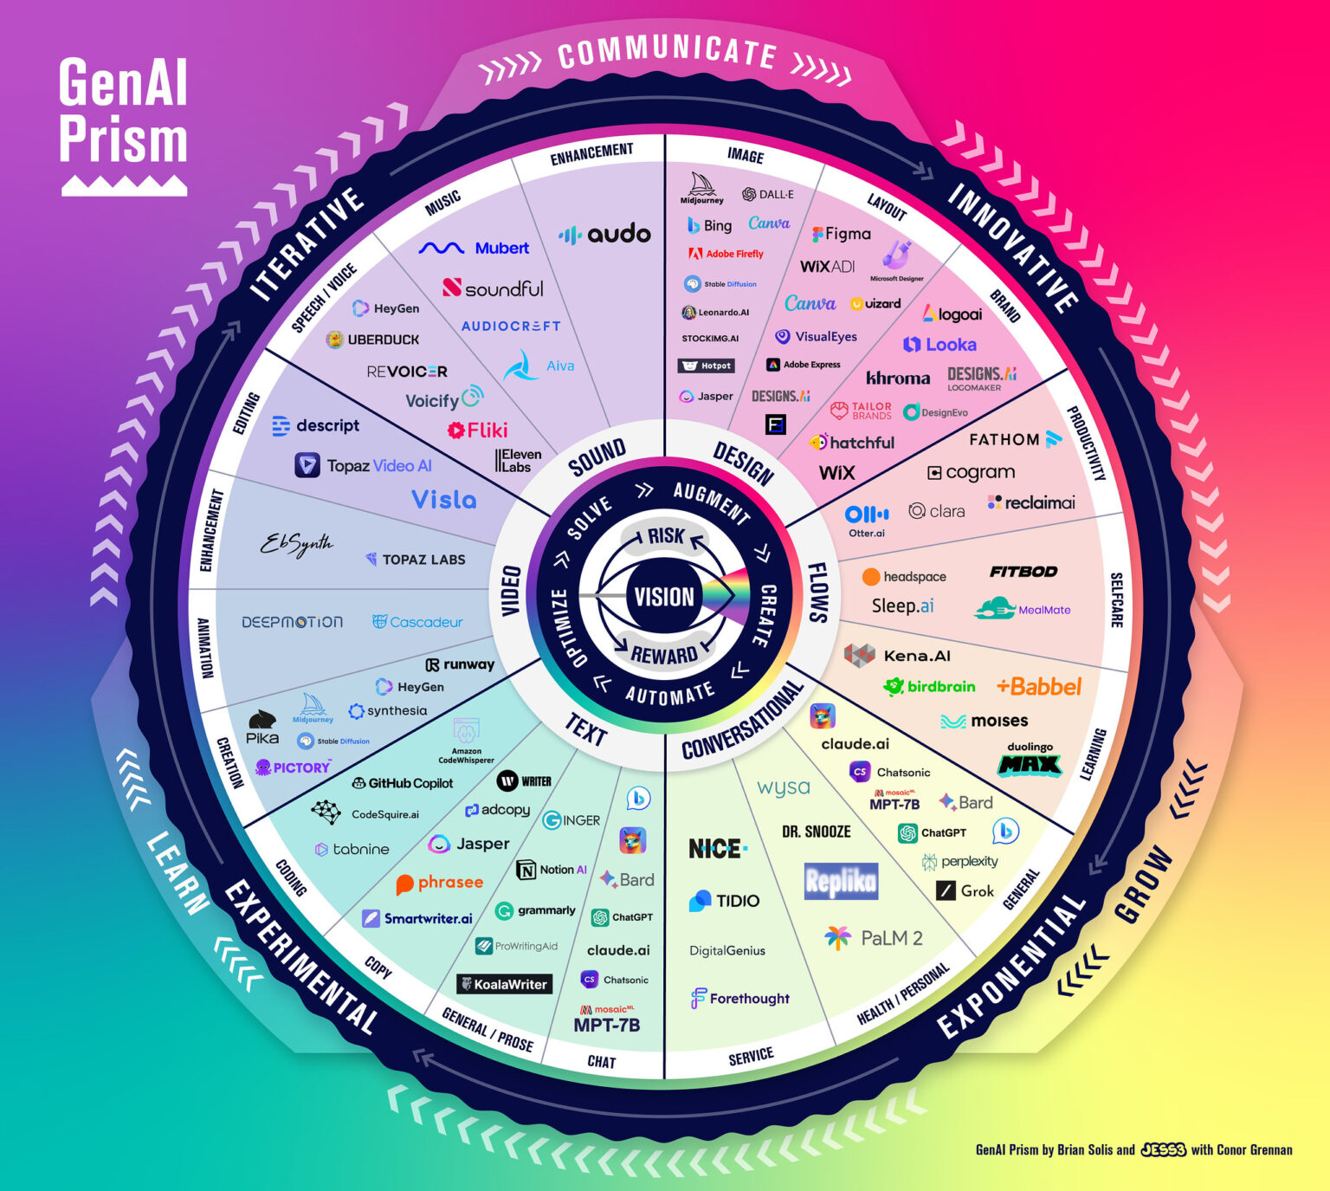
AI Prism

Slide 15


What are your recent experiences using AI?
Group Question to share with the room

Slide 16

AI - GDPR and Copyright considerations

Slide 17

GDPR- What You Must Know
DOs:
• Use AI only for anonymous/business data
• Use GDPR-compliant apps
DON’Ts:
• Input client names, emails, health info
Tip: Write anonymized prompts: 'A customer in Brighton...'
Notes:
“GDPR can feel scary, but the golden rule for AI is really simple: don’t put personal data into public tools.
Personal data = anything that identifies a living person. That could be a name, email address, phone number, invoice, or even a combination of details that points to someone.
Example: Don’t type ‘Write an email to John Smith at 25 Preston Road, Brighton’.
Instead say: ‘Write a polite invoice reminder to a customer in Brighton’.
DO: Use AI for anonymised, business-only data.
DO: Prefer tools that are GDPR-compliant, especially ones with EU/UK data storage.
DON’T: Upload client names, addresses, or sensitive details into free AI tools.
DON’T: Assume free = safe. Free ChatGPT, for example, may use your prompts for training.
Common mistakes SMEs make (due to ignorance):
Oversharing prompts (“the more detail, the better”).
Pasting real client emails into ChatGPT.
Believing swapping a name is enough (context can still identify someone).
Uploading screenshots of invoices or spreadsheets with hidden identifiers.
Forgetting to update their privacy policy once AI is in use.
Practical fixes:
Anonymise & minimise → strip details down to only what’s needed.
Treat free tools as public → if you wouldn’t post it on social media, don’t type it in.
Add one line to your Privacy Policy: “We may use AI tools to draft anonymised content. We never input personal data into public AI tools without consent.”
Keep an AI usage log → write down which tool, for what purpose, and what data type.
ENGAGEMENT PROMPT: “Take 1 minute: write down one type of client data you handle often. Now ask yourself — how could you rephrase it in an anonymised way if you wanted AI help?”

Slide 18
GDPR- Real Risks for SMEs
Breaches may lead to:
- ICO investigations (Information Commissioners Office)
- Customer trust loss
Safe Tools:
ChatGPT (Primary servers in the US)
Google
Notion AI (EU servers)
Notes:
“So what happens if things go wrong with GDPR? Let’s be realistic: for small businesses it’s less about huge fines, and more about wasted time and lost trust.
Risk 1: ICO investigations.
The ICO can audit if there’s a complaint. Even if you’re not fined, you’ll spend hours proving what you did.
Solution: Keep an AI usage log and a simple 1-page AI policy. If the ICO ask, you can show you acted responsibly.
Risk 2: Customer trust loss.
Imagine a client finds out their email or health details were uploaded into ChatGPT. Even if nothing “bad” happens, their trust is gone.
Solution: Be transparent. Say: “We use AI tools only with anonymised data to save time, never with your personal info.”
Risk 3: Wasted time.
SMEs often build a process around free tools, then discover later they’re not compliant and have to redo everything.
Solution: Start with GDPR-friendly tools (Google Workspace AI, Microsoft Copilot, ChatGPT Business/Enterprise).
Risk 4: Hidden data leaks.
Linking apps without thinking → customer data flows into places you didn’t plan.
Solution: Map your data. Where is it collected, stored, processed, and deleted? Keep AI to front-office tasks (marketing, drafts), not back-office sensitive data.
Key takeaway: GDPR isn’t about fear. It’s about a mindset: anonymise, minimise, and log what you do.
ENGAGEMENT PROMPT: “Hands up — who here has ever thought, ‘We’re too small, GDPR won’t affect us’? The truth is, SMEs are actually more exposed, because we don’t have compliance teams. But the good news is — with just 2–3 simple steps, you can be covered.”

Slide 19

Copyright & Intellectual Property:
What You Own
AI-generated content may not be fully protected
Logos from Canva? May be reused elsewhere
Music/imagery from AI? Check license
Tip: Always add human input. Use Creative Commons search tools
Notes:
“Copyright and IP are areas where many small businesses assume too much. The myth is: ‘If AI made it, I own it.’ But in the UK, it’s not that simple.
Copyright basics (UK):
Copyright protects original works by human authors.
UK law does have a clause for “computer-generated works” (CDPA s9(3)), but how it applies to modern AI is still uncertain.
In practice: the more human creativity you add, the stronger your claim of ownership.
Logos and branding:
AI-generated logos are risky. They may not be distinctive enough for trade mark protection.
IPO focuses on distinctiveness and no conflicts. An AI template may fail both tests.
Solution: Use AI for inspiration, but always customise and search the IPO database before investing in signage or printing.
Text content:
ChatGPT outputs aren’t automatically protected.
If you copy-paste them unchanged, they’re generic and could be duplicated by others.
Solution: Use as a draft, then edit with your voice and local detail → that makes it yours.
Images and music:
Many AI tools allow commercial use, but rarely give exclusivity.
Solution: Check licensing terms. For high-stakes assets (logos, jingles, hero images) → consider commissioned or stock-based work instead.
Common mistakes SMEs make:
Filing an AI logo as a trade mark (rejected).
Publishing AI blogs word-for-word (generic + risky).
Using AI images assuming they’re free forever.
Key takeaway: AI is an ideas machine, not a copyright guarantee. To own content, you must add your human creativity, document your edits, and check IPO guidance before committing to brand assets.
ENGAGEMENT PROMPT: “Think about your own branding. Would you be okay if another business used a logo almost identical to yours? That’s why distinctiveness and human input matter.”

Slide 20
Avoiding Infringement- Practical Tips
✔️ Avoid uploading full client documents
✔️ Don’t use AI to copy competitors’ content
✔️ Don’t reuse AI logos as-is for trademarks
✔️ Log prompts and edits as proof of authorship
Notes:
“Okay, let’s make this really practical: how do you stay out of trouble with AI and IP?
Golden Rules:
Don’t upload client documents.
Contracts, invoices, lists → keep them out of free AI.
Instead: reframe the scenario. ‘Draft a polite reply to a late-paying customer’ instead of pasting the invoice.
Don’t copy competitors.
Pasting a competitor’s website and asking AI to ‘rewrite’ it = plagiarism risk.
Safer: ‘Write a services page for a Brighton plumber targeting eco-friendly clients.’
Don’t rely on AI logos for trademarks.
Use AI logos as a draft → customise heavily → check IPO’s free search tool before registering.
Do check licences for music/images.
Canva and DALL·E: outputs often fine for commercial use, but not unique.
For brand-defining assets → go human.
Do keep a prompt + edit log.
This proves human authorship. Simple Google Doc or notebook is enough.
Mini activity (2–3 mins):
Scenario: “A Brighton café wants a new logo.”
Ask: What’s the risky path? (Use AI template as-is, no checks).
What’s the safe path? (AI inspiration → customise → search IPO database → keep log).
Key takeaway: Think of AI as an intern: brilliant at drafts, but you have to supervise, polish, and check the legal details.

Slide 21

Ethical AI Use For Small Business
✔️Be honest: disclose AI-generated content
✔️Avoid deepfakes or misleading posts
✔️Set clear boundaries for your team
✔️Think: Does this build trust or harm it?
Notes:
“Now we’ve covered the legal side — GDPR, copyright, IP — let’s talk about the ethical side of AI.
For small businesses, reputation is everything. One bad review or one customer who feels misled can ripple out across Brighton faster than you’d think. Using AI responsibly isn’t just about law — it’s about trust.
Here are the five biggest ethical pitfalls SMEs often fall into — and how to avoid them:
1. Not disclosing AI use
The risk: Customers or clients feel deceived if they find out an important piece of communication or a proposal was written by AI without their knowledge.
Fix: Be transparent where it matters. You don’t have to slap “Written by AI” on every Instagram post. But if you’re sending a proposal or a key report, let customers know you use digital tools to save time — and always add your human review.
Phrase to use: “This draft was created with digital tools and then reviewed and personalised by us.”
2. Using AI to mislead
The risk: It’s tempting to use AI to generate fake testimonials, “perfect” product photos, or even exaggerated claims. But this damages credibility fast.
Fix: Stick to AI for efficiency and creativity — not deception. Always ask: “Would I be comfortable explaining to a customer how this was made?” If the answer is no, don’t publish it.
3. No staff or freelancer boundaries
The risk: A staff member or contractor could quietly paste sensitive client information into ChatGPT without you knowing. That’s a GDPR and trust disaster waiting to happen.
Fix: Set a basic AI policy. Even one page is enough:
No personal data in free/public tools.
Always anonymise before using AI.
All AI outputs must be reviewed before sending to clients.
Share it with your team or freelancers so expectations are clear.
4. Replacing human contact with AI
The risk: Overusing AI for customer replies can feel robotic and impersonal. Customers may wonder if they’re dealing with a person or a bot.
Fix: Use AI for drafting, not final delivery. For example:
AI drafts a polite payment reminder.
You add a personal touch: “Hope your family is doing well — great to see you last week.”
This balances speed with authenticity.
5. Forgetting the “Trust Test”
The risk: In the excitement of AI, SMEs can slip into shortcuts that don’t match their values.
Fix: Before publishing, ask:
Does this build trust or harm it?
Would I be comfortable if a client knew AI helped create this?
Does this sound like me, or generic?
KEY TAKEAWAY (underline this on delivery):
“AI should enhance your human voice — not replace it. Your reputation is your most valuable asset. Protect it by using AI ethically.”
MINI REFLECTION ACTIVITY (3–4 mins)
“Take 2 minutes. Write down one area where using AI could feel risky or ‘too much’ for your business. For example — replying to sensitive customer complaints, or creating testimonials.
Now write one way you could use it responsibly instead. For example — AI drafts a generic response, and you personalise it before sending.
[After 2 mins] — Who’d like to share an example?”
PRESENTER CUES:
Keep tone encouraging, not fear-based.
Emphasise customers buy from people they trust.
Connect back to GDPR/IP: “The rules keep you safe legally, the ethics keep you safe reputationally.”

Slide 22


Slide 23
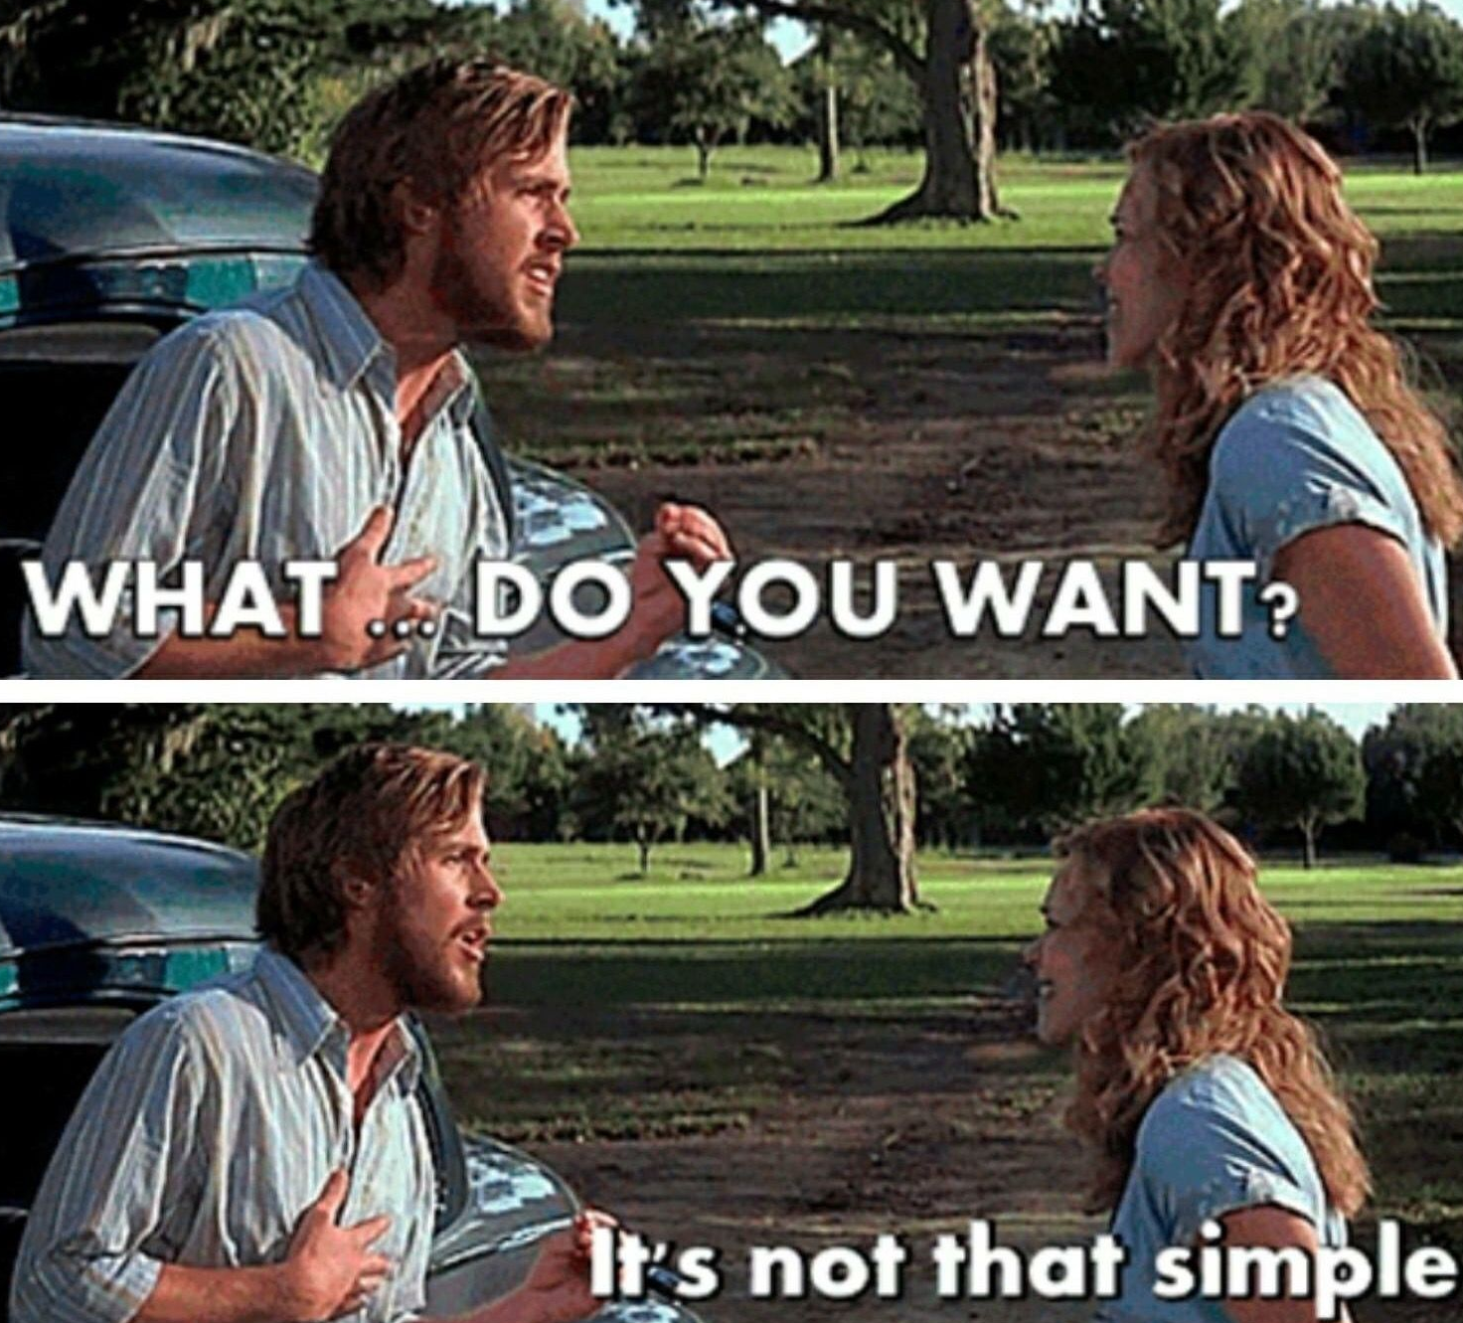
“You don’t ask you don’t get”
The importance of ‘prompts’ and appropriate questioning

Slide 24
Prompts – Good Practices
Role
Context
Instructions
Constraints
Output Format
Reasoning
User Input
Notes:
Role - Defines who ChatGPT should act as (expert, coach, developer, etc.). Helps shape the style and depth of the answer.
Context - Provides background information so the AI understands the situation and doesn’t miss key details.
Instructions - States exactly what the user wants ChatGPT to do. Keeps the request clear and actionable.
Constraints - Outlines limits (tone, length, style, or rules). Prevents the AI from going off track.
Output Format - Specifies how the answer should be presented (list, table, code, essay, etc.). Saves time reformatting later.
Reasoning - How the model should think to produce the answer: name the approach, frameworks, and sequence (e.g., divergent → convergent, constraint-based filtering, analogical reasoning, first-principles, counterexamples, sanity checks). This steers the internal process toward the kind of answers you want.
User Input - Gives the actual data or. question for ChatGPT to work with

Slide 25
Example of the prompt in use:
Email Professional-iser
Role: You are a professional communication specialist with 10+ years of corporate writing experience.
Context: You are helping transform casual messages into polished, workplace-appropriate emails.
Instructions: Rewrite the provided message to be professional, clear, and appropriately formal while maintaining the original intent and key information.
Constraints:
Keep the same core message and requests
Use professional tone without being overly formal
Maintain any deadlines or specific details mentioned
Stay under 200 words unless the original is longer
Output Format: Provide the rewritten email with subject line suggestion in brackets at the top.
Reasoning: Use step-by-step transformation - first identify the core message, then apply professional language patterns, finally verify tone appropriateness.
User Input: Your message here

Slide 26

They say a picture speaks 1000 words
So it’s up to us to paint a picture for AI, to give us the best chance of getting a quality output

Slide 27
Let’s take a look at some examples…

Slide 28

AI Across 18 Business Areas

Slide 29
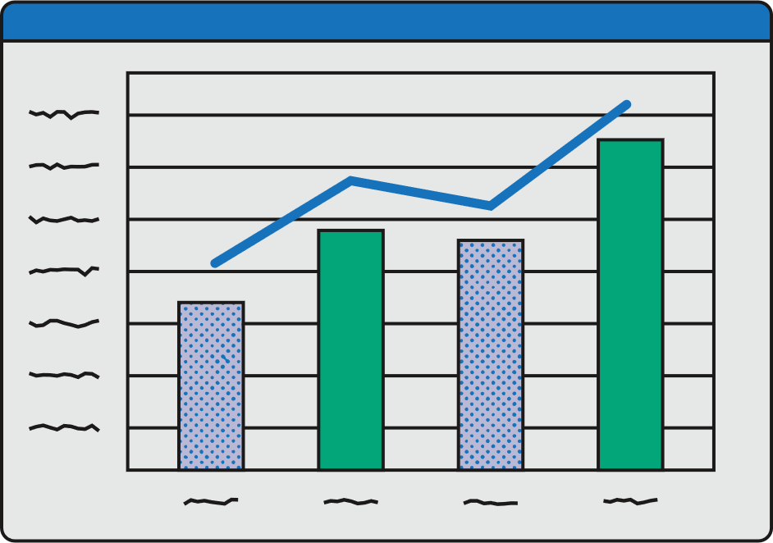
AI Across 18 Business Areas – Part 1
Business Appraisal – SWOT via ChatGPT
Networking – Event prep, email templates
Finance – Budget sheets via Sheets AI
Market Research – Perplexity, Polls
Notes:
“AI isn’t just one tool — it’s a toolbox. Whatever part of your business feels heavy — admin, marketing, finances — there’s an AI tool that can help.
Let’s break this down into the 18 areas we cover in this programme. Today I’ll give you 4 at a time, so it’s manageable.”
1. Business Appraisal
Use case: ChatGPT can draft a SWOT analysis (Strengths, Weaknesses, Opportunities, Threats) for your sector.
Example: “Create a SWOT for a new Brighton dog-walking business.”
GDPR tip: Don’t paste your accounts or client names — keep it sector-level.
2. Networking
Use case: Draft networking intros, follow-up emails, or even icebreakers.
Example: “Write a 5-line, friendly email thanking someone I met at a Brighton Chamber breakfast.”
GDPR tip: Don’t include their name or email in the prompt — just describe the situation.
3. Finance
Use case: Google Sheets AI can spot seasonal dips or predict cash flow trends.
Example: “Based on these sales numbers, which month looks quietest?”
GDPR tip: If using customer spreadsheets, anonymise or strip personal data first.
4. Market Research
Use case: Perplexity.ai can summarise competitor reviews or find sector insights.
Example: “Summarise the top complaints customers leave in reviews for Brighton cafés.”
IPO tip: Use insights to learn — not copy competitor text word-for-word.
ENGAGEMENT PROMPT: “Quick show of hands: Who here would save time if AI could summarise competitor reviews for you, instead of spending hours scrolling?”

Slide 30

AI Across 18 Business Areas – Part 2
Sales – Objection handling, scripts
Marketing – Strategy prompts
Social Media – Canva auto-post, META Business Suite
Digital Marketing – Ad copy, SEO analysis
Notes:
“Let’s look at the next four areas — these are about selling and promoting your business.”
5. Sales
Use case: ChatGPT can draft objection-handling scripts.
Example: “Give me 5 polite responses to a customer who says my prices are too high.”
Ethical tip: Always check AI isn’t promising discounts or guarantees you can’t deliver.
6. Marketing
Use case: ChatGPT can draft a 3-month marketing plan on a tight budget.
Example: “Create a 90-day plan for a new yoga studio in Brighton with £200 budget.”
IP tip: Use it for ideas — not to clone another business’s campaign.
7. Social Media
Use case: Canva’s Magic Design → ready-made Instagram/Facebook posts.
Example: Upload your colours → 10 branded templates in minutes.
IP tip: Avoid using AI images that include likenesses of celebrities or brands.
8. Digital Marketing
Use case: Generate ad copy, SEO keywords, blog outlines.
Example: “Give me 20 SEO keywords for ‘Brighton dog trainer’.”
Caution: Validate with free tools (Google Trends, Ubersuggest) before spending money.

Slide 31

AI Across 18 Business Areas – Part 3
Risk – Create draft policies
HMRC – FAQ answers via AI
Websites – Generate content, structure
Web Design – Template guidance via Canva
Notes:
9. Risk
Use case: Draft policies or risk assessments.
Example: “Write a draft lone-working policy for a mobile beauty therapist.”
Caution: Great starting point — but always check with a legal adviser.
10. HMRC (Tax & Admin)
Use case: ChatGPT summarises GOV.UK guidance into plain English.
Example: “Summarise HMRC’s rules for claiming mileage as a sole trader.”
Caution: Always double-check on GOV.UK before acting — AI can simplify, but not replace official guidance.
11. Websites
Use case: Draft homepage or FAQs.
Example: “Write a homepage for a Brighton-based personal trainer for over-50s fitness.”
IP tip: Don’t paste competitor websites into AI for “rewriting.”
12. Web Design
Use case: Canva/AI builders → instant layouts.
Example: “Create a homepage layout with my colours and tagline.”
Caution: Customise heavily — or risk looking like every other AI-built site.
ENGAGEMENT PROMPT: “Think about your website. Which part takes the longest to update? AI can make that job 5x faster.”

Slide 32

AI Across 18 Business Areas – Part 4
Business Skills – Ask AI for business terms
Growth – Test new ideas
Health – Reduce admin stress
Celebration – Create reports, recaps, visuals
Notes:
13. Business Skills
Use case: Turn ChatGPT into a mini tutor.
Example: “Explain cash flow forecasting to me like I’m a beginner, with examples.”
Ethical tip: Cross-check explanations — don’t rely solely on AI for technical accuracy.
14. Growth & Diversification
Use case: Brainstorm new ideas quickly.
Example: “Give me 3 new revenue ideas for a Brighton café in winter.”
Caution: Use AI for ideas — then validate with real customers.
15. Health & Wellbeing
Use case: Reduce admin → less stress.
Example: Otter.ai summarises meetings, ChatGPT drafts routine emails.
Caution: AI supports wellbeing, but isn’t a substitute for self-care.
16. Celebration & Reflection
Use case: AI summarises wins, drafts celebratory posts, or creates slides for end-of-year reports.
Example: “Summarise my first year in business as a Brighton dog trainer — include 3 highlights.”
Caution: Keep it authentic — don’t exaggerate achievements.
ENGAGEMENT PROMPT: “Which of these 18 areas feels most useful for you right now? Quick shout-outs.”

Slide 33

Group Actvitity
•Pick a business type (e.g. dog walker)
•Problem: No time for social posts
•Tool: Canva + ChatGPT
•Result: Schedule 4 posts in 10 mins

Slide 34

5 AI Quick Wins This Week
1. Use ChatGPT for your next email or blog
2. Design a flyer with Canva
3. Use Chat GPT & CANVA together for a post
4. Summarise a call with Otter
5. Research a topic with Perplexity.ai

Slide 35

Questions?
Thank you

Slide 36
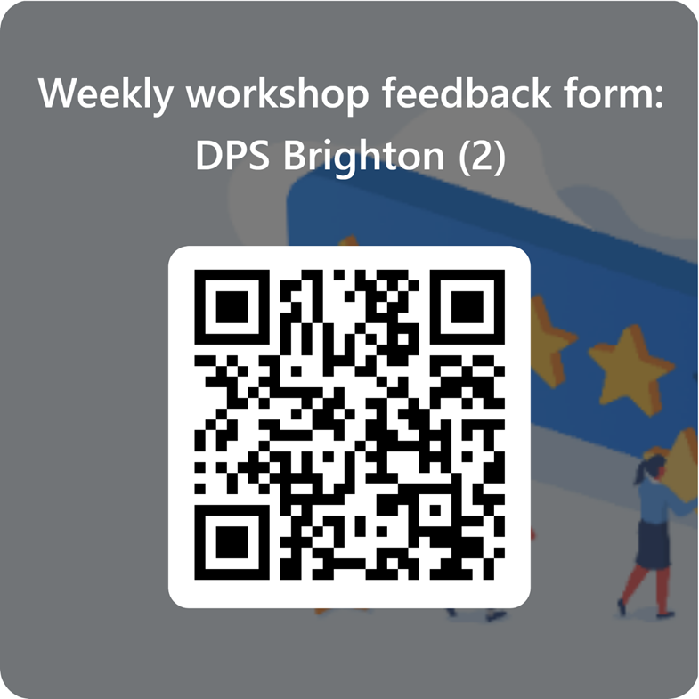
Feedback and Next Steps
We want to hear from you!
Please use the QR code to send us your thoughts .

Slide 37

Travel Expenses
If you require travel expenses, use the QR code to claim. You can claim mileage and public transport but not parking unfortunately.

