Slide 1


Health and Wellbeing
& Your Business

Slide 2
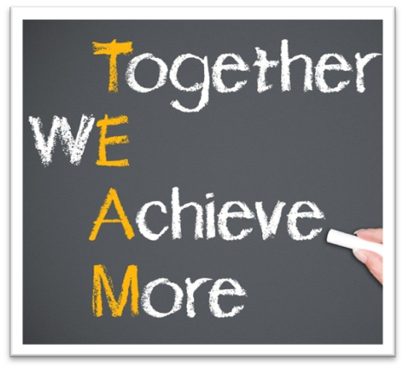
Ways Of Working
100% confidentiality
No multi-tasking, be fully present
Arrive on time and stay for the whole meeting
Commit to asking questions, listening & being non-judgmental
Sharing the air space
Implement agreed actions (Do what you say you will do)
Feedback at the following session
Complete all participant surveys at the end of each session
Philosophy…
“The knowledge is in the room, let’s learn from others and share”

Slide 3



Activity
What would be your own definition of:
“Excellent Health & Wellbeing in Business”
Write down a definition and place it on the board?
‘Look forward to working’
You have 5/10 minutes to write as many down as you can think of on an individual sticky note

Slide 4

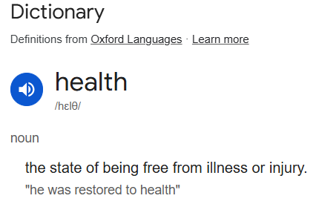
What do we define as
HEALTH?
There are many definitions of ‘Health’
“a person's mental or physical condition”
In truth, there can be many ways you can define health or define what it is to feel ‘healthy’
Today, we will look at
‘Business Health’

Slide 5

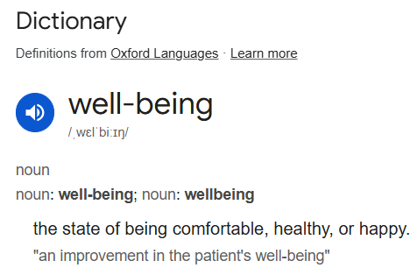
What do we define as
WELLBEING?
There are many definitions of ‘Wellbeing’
“the state of being comfortable, healthy, or happy”
In truth, there can be many ways you feel you have good ‘wellbeing’
Today, we will look at how
‘Health & Wellbeing’ impact you and your business

Slide 6

Where to get started when looking at Health & Wellbeing
for business

Slide 7
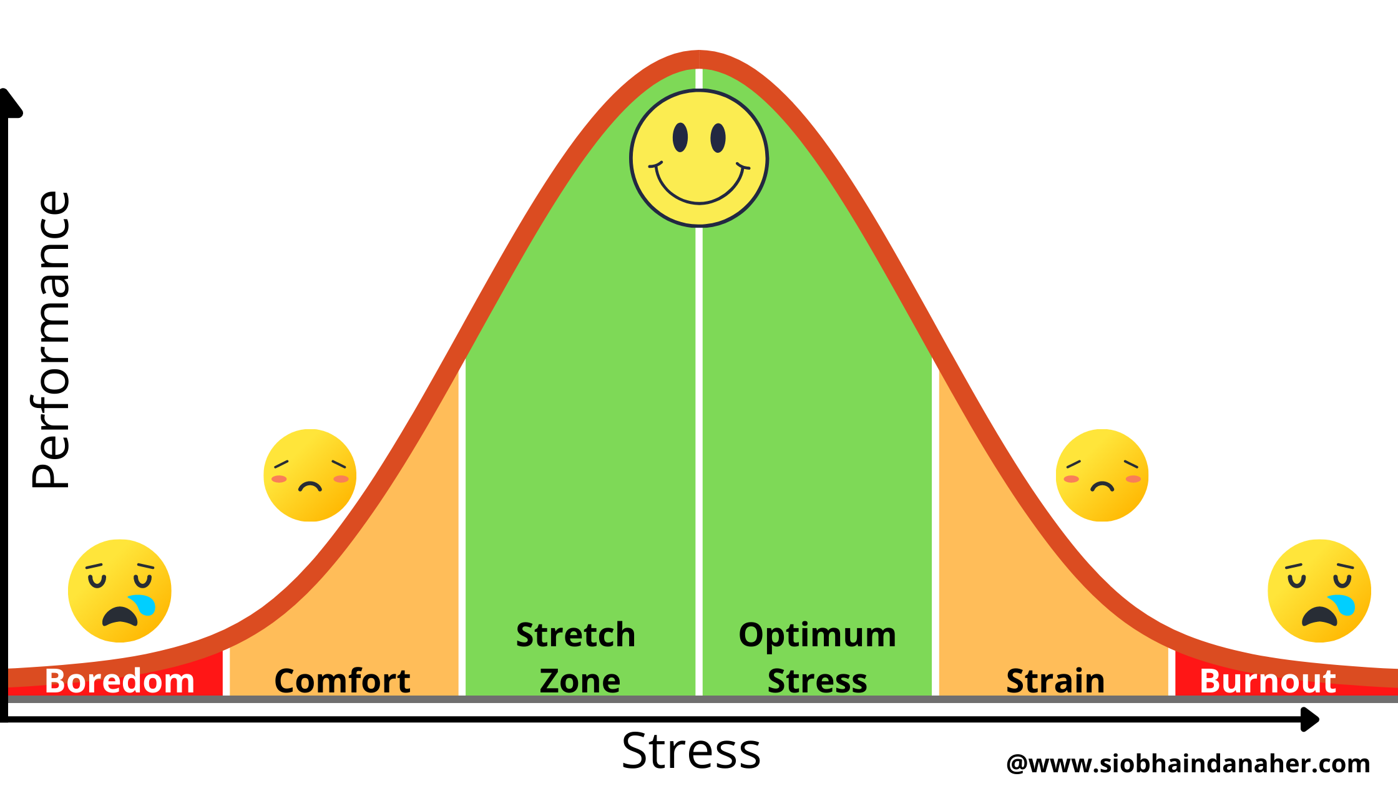
Business Health
The stress that we feel
Health & Wellbeing are of course, intrinsically linked
But can we? or more importantly…
Should we be expecting or searching for a business life without any stress or pressure?
Let’s take a look
Notes:
1. Boredom Zone
In the first zone there is very low stress and we are bored. Stay here too long and you will feel the effects of boreout which are just as dangerous as burnout. If you are in this zone in your life or work, your mental, emotional, physical & spiritual health is at risk. Performance in this zone is next to nothing.
2. Comfort Zone
As our stress levels increase we move into our comfort zone, this is manageable stress and is on the way to peak performance. It is comfortable here but there is no growth and if you stay here too long, you will slip back into the boredom zone. Performance in this zone is higher than in the boredom zone but not at it’s best.
3. Stretch Zone
As pressure & stress increases, we move into the stretch zone. This is where our minds & bodies are being stretched. You know that feeling when you’ve got a lot on your plate but you’re totally in control, you are busy but you are really enjoying it. This is the zone where your level of stress and your level of performance are at their optimal. Everyone wants to be here – not stressed, not overloaded, not under pressure but challenged, stretched & at absolute peak performance. This is where we do our best work.
4. Strain Zone
As pressure and stress levels increase we now move into the strain zone. We no longer feel in control and we start to feel under pressure, overloaded, too much on our plate and it’s hard to see the wood from the trees. In this zone we are no longer operating an optimum level – our performance, interest, happiness, health and energy levels decrease and everything starts to go downhill. Performance in this zone is diminished and reduces every day you stay here.
The other choice is to STOP.
Stop taking on work, stop taking on activities, stop taking on pressure & stress. Remove as much as we can from our workload. This is a very wise choice and as you start to remove items from your to-do list you will start to move backwards through the Stress Performance Curve.
5. Burnout Zone
When you are in the strain zone and you continue you to take on activities/work and continue to add to your to-do list you will eventually end up in the the burnout zone.
You may think you are getting loads done, that you are ploughing through stuff and you are on your A-game but you are not. You are now back to the level of performance that you were when you were in the boredom zone.
Performance in this zone is next to nothing.
You may be getting things done but there is no time for thinking, no time for creativity, no time for imagination, no time for innovation, no time for rest, relaxation and recuperation, no time for anything only the to-do list. Whilst you are getting to your to-do list, the pace and quality of work is immensely diminished.
In this zone it’s fight or flight and that’s about it.
Not only is this not sustainable but it is also dangerous to your mental, emotional, physical & spiritual health. There is no enjoyment in what you are doing and you wondering is the to-do list ever going to end! You probably become irritable, unfulfilled, unhappy, unproductive and apathetic.
This is a very real and dangerous place to find yourself in.
If you are here, do everything you can to get out of this zone, your health is more at risk than you would imagine.
The Stress Performance Curve is fascinating and the amount of time we spend in each of the zones and how long it takes us to go from one zone to another different for us all.
Knowing about and understanding the symptoms of each of the zones of the Stress Performance Curve goes a long way to ensuring you stay in the stretch zone or at least not too far away from it!
Human beings are not machines, we all have limits and going past those limits damages our most valuable asset, our health!

Slide 8
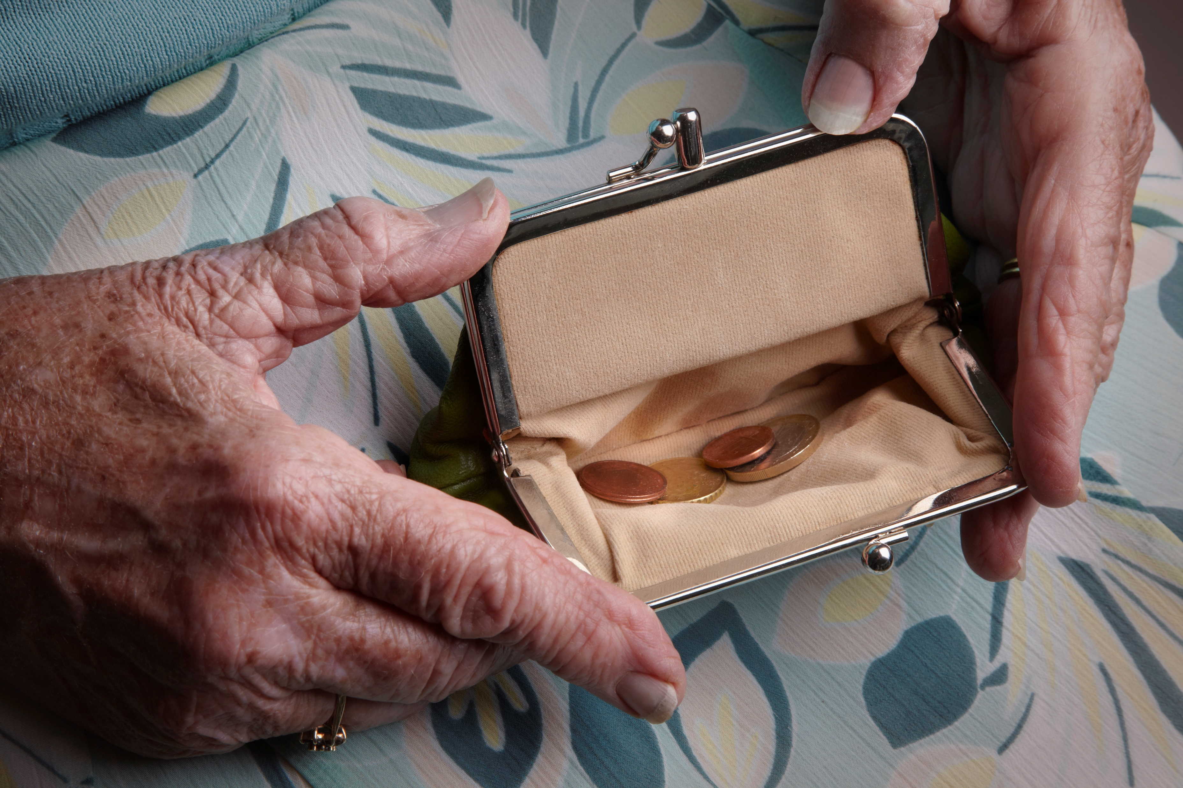

Business Stress
The symptoms we notice
Most common Business Stress?
Profit
Revenue
Cash flow
Essentially – Money coming into the business
“The symptoms are a messenger of a deeper problem. Let's get to the deeper problem”.
Johann Hari - British writer and journalist

Slide 9

Business Stress
The symptoms we notice
Symptoms, we see those
But what are the Root Causes? Let’s dig deeper and discuss what these could be?
Proactive or Reactive?
Planning ahead, or going with the flow?
Intervention or interaction?
What am I doing, to positively impact my ‘Business Health?’
If you had a cold… you’d take care of yourself. Don’t ignore your ‘Business Sniffles’

Slide 10

Business Health
The cause beneath the surface
Business Health - Cause & Effect
But what are the Root Causes? Let’s dig deeper and discuss what these could be?
Little or no marketing activity
Inconsistent or avoided networking
No clear diary plan or time/task management
Working ‘in’ the business, not ‘on’ the business
Fear of failure or even waiting for ‘perfect’
Thinking back to our previous session…
Is this Skill or Will ?
Is the aptitude or Attitude ?

Slide 11


Let’s take a moment to pause and consider your own key core pillars for good personal health
Think of 5 core principles:
Sleep
…
…
…
…
Let’s get into groups
8 hours sleep
These 5 principles should be the bedrock of your own personal health & wellbeing

Slide 12
Now, let’s take a moment to pause and consider your own key core pillars for “good business health”
Think of 5 core principles
Diary/Time Management
…
…
…
…
Let’s get into groups
Plan my weeks
These 5 principles should be the bedrock of your own business health & wellbeing

Slide 13
Finance
Time Management
Core
Business Health
&
Wellbeing
Marketing Plan
Business Boundaries
Review & React

Slide 14
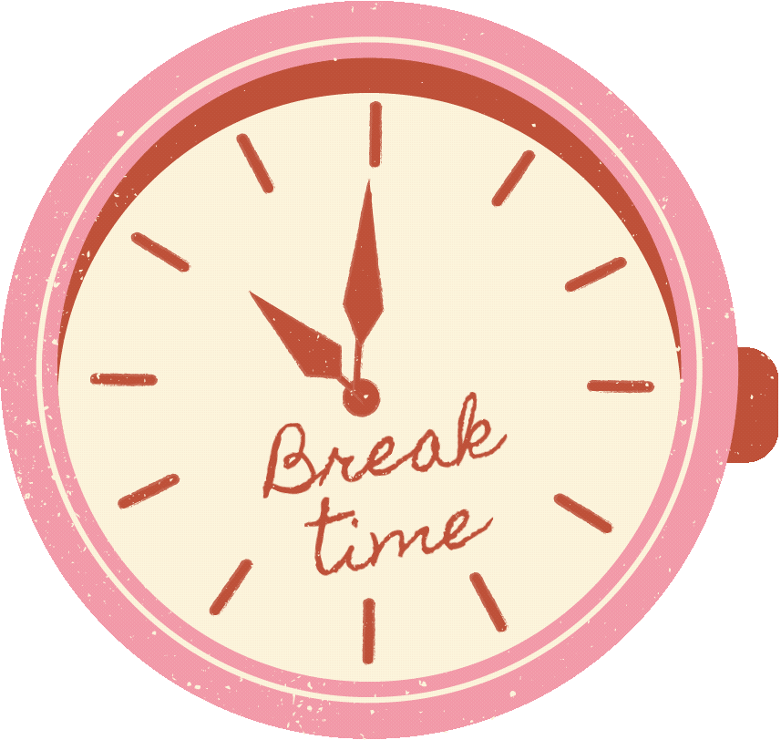

Slide 15
Finance
Time Management
Core
Business Health
&
Wellbeing
Marketing Plan
Business Boundaries
Review & React

Slide 16

Time Management
“Where am I going to MAKE the time?”
“If you don’t work with the clock, you will work against it”
As with many symptoms, it is often the simple things that can fix many roots causes?
Diary Management
How does my diary work… Do I even have/use one?
Am I running my diary, or is it running me?
Do I plan business time, or “squeeze it in” when I can
Do I prioritise what matters, or what shouts the loudest?

Slide 17

Time Management
Take time to make time…
Lowest attention = lowest output
There is very little that positive time management, cannot
make a strong impact upon:
Simple Practical Solutions:
Block non negotiable business time in your diary
Plan your week before it starts, not during it
Make time or wait for problems
Refer to the Business Skills Workshop for Time Management skills/techniques
‘Time is the coin of your life. It is the only coin you have, and only you can determine how it will be spent’ – Carl Sandburg

Slide 18

£86,400 every day…
How would you spend it everyday?
We all have 86,400 seconds,
gifted to us everyday…
As the saying goes…
“Time is money”
Are you ‘spending’ yours wisely?

Slide 19
£86,400 every day…
How would you spend it everyday?
Take a moment to reflect…
What will you do moving forward to have better time management, and work towards better business health?
Share with the group, either something you already do, or a commitment to yourself and your business moving forward…

Slide 20

“Which wolf will win?”
The old Cherokee simply replied, “The one you feed”
Notes:
1.7.2013
An old Cherokee is teaching his grandson about life. “A fight is going on inside me,” he said to the boy. “It is a terrible fight and it is between two wolves. One is evil – he is anger, envy, sorrow, regret, greed, arrogance, self-pity, guilt, resentment, inferiority, lies, false pride, superiority, and ego.”
He continued, “The other is good – he is joy, peace, love, hope, serenity, humility, kindness, benevolence, empathy, generosity, truth, compassion, and faith. The same fight is going on inside you – and inside every other person, too.”
The grandson thought about it for a minute and then asked his grandfather, “Which wolf will win?”
The old Cherokee simply replied, “The one you feed.”
‹#›

Slide 21

Finance
“We feel the stress… but the numbers tell the true story”
Finance underpins everything in business
Awareness or Avoidance?
Do I know what came in and what went out last month?
Do I avoid my finances when things feel tight?
Am I reacting to money problems, or planning ahead?
If revenue is low, do I know what action to take?
What am I doing, to positively impact my ‘Business Health’ financially?

Slide 22
Finance
“We feel the stress… but the numbers tell the true story”
Finance underpins everything in business
There is very little that positive financial planning, cannot make a strong impact upon:
Simple Practical Solutions:
Attack is the best form of defence - Don’t wait for problems, face your business finances head on
Review income/expenditure at an agreed regular interval – Not just annually!
What steps/actions can you take to try and increase your revenue?
Refer to the Finance workshops & workbooks for inspiration

Slide 23

There are many ways in which you can look to acquire
‘good business health’ through financial means
Control the controllables…
Influence the influenceables…
Reflect… what can you do, by this time next week to have positively impacted your business financial health?

Slide 24

Marketing Plan
If people don’t know you exist, they can’t buy from you
Low revenue is often cited as the problem, but inconsistent marketing can often be a root cause
Do I market consistently, or only when I feel inspired to?
Am I proactive, or do I rely on word of mouth?
Which are the most relevant and impactful marketing tools to help me increase revenue?
Do I have a plan, or follow a particular marketing strategy?
Inconsistent marketing = inconsistent income
You cannot ‘wing it’ long term, will only cause stress

Slide 25
Marketing Plan
If people don’t know you exist, they can’t buy from you
There is very little that positive business marketing, cannot make a strong impact upon:
Simple Practical Solutions:
Attack is the best form of defence - Don’t wait for ‘Word of Mouth’ and recommendations…
Create your own reputation and recommendations using marketing
Online vs Offline / Digital vs Non-Digital
New Customers vs Existing Customers
Networking vs Networking events
Set aside dedicated time for your marketing activities. Time to plan and then time to action!
Refer to the Marketing & Sales sessions for inspiration

Slide 26
There are many ways in which you can look to improve your
‘business health’ via a marketing plan of action(s)
Commit to consistency…
Look to provide value
Call to actions – Any easy wins?
What can you do, by this time next week to have positively impacted your business health through Marketing?

Slide 27

Business Boundaries
“You cannot pour from an empty cup”
Burnout rarely appears overnight.
It builds slowly when boundaries are missing or ignored.
Boundaries = Balance:
Do I say yes when I really want to say no?
Obligation rather than dedication?
Do I respond to clients outside working hours?
Underprice or overdeliver to avoid confrontations?
The hardest word can be NO
Who would like to share an example of when they said “No”, or refused something in their business?

Slide 28
Business Boundaries
“You cannot pour from an empty cup”
Boundary setting is about protection, not restriction
Boundaries = Balance:
Set and communicate business hours clearly
Build rest and recovery into your diary
“No” – justification not obliged
Boundaries also work in your favour
Avoid Positive Procrastination
Setting your yourself personal deadlines
Reflect upon objectives and their due dates
Like many things, boundaries can be framed in many ways. It’s for you to decide how you perceive them.

Slide 29
There are many ways in which you can look to improve your
‘business health’ by setting clear business boundaries
It may not be immediately.
But, next time your boundaries are challenged, what are you going to do?
How can you be proactive in your self-care.
Is this any action you could take today?

Slide 30

Review & Reflect
“What gets reviewed, gets improved”
Without regular review, businesses drift. Problems grow quietly and progress goes unnoticed.
Review:
What are my ‘measures of success’
Review what is working as well as not working
Am I reacting emotionally, or purposefully?
Do I give myself credit for progress?
Urgent gets attention? How long do I wait?

Slide 31
Review & Reflect
“What gets reviewed, gets improved”
Regular reviews, is not about carrot or stick. It is learning to be pragmatic and purposeful.
Review:
Schedule in a ‘Morning huddle’
Set a frequency and regularity
Have a ‘itinerary’ to follow
Reflect on the actions not just the outcomes.
What about the actions did/did not achieve?
Celebrate progress, not just pounds & pence
View this as your business ‘insights’ – It’s the information you need to take your next steps

Slide 32
There are many ways in which you can look to improve your ‘business health’ by setting time to reflect and review.
What do you want to know?
How often do you want/need this info?
Where will this make this biggest impact?
How can I positively impact my business and my health and wellbeing by taking time to regularly reflect & review?

Slide 33

To find good business health
You must also find good balance…

Slide 34

New year… new me
Complete a business ‘health check’

Slide 35

If we had to pick 7 key areas to conduct a “business health check”
What would those key areas be?
7 Key Areas:
Business Finances…
…
…
…
…
…
…
Let’s discuss
Taxes

Slide 36
New year… new me
Complete a business ‘health check’
Thinking of these 7 key areas:
What’s stopping you from putting into place, measures to support “good business health”?

Slide 38

Business Health
Business Wellbeing
Business Health - looks at the systems, structure, actions
Business Wellbeing - looks at the person driving them
Business Wellbeing:
How am I actually feeling day-to-day running my business?
How much energy do I have at the end of the week?
What joy/fulfilment do I get from being a business owner?
How do I measure my own wellbeing?
What do I do, or what have I done before, to positively impact my own wellbeing in business?

Slide 39
Business Health
Business (YOUR) Wellbeing
Business Health - looks at the systems, structure, actions
Business Wellbeing - looks at the person driving them
Business (YOUR) Wellbeing:
How am I actually feeling day-to-day running my business?
How much energy do I have at the end of the week?
What joy/fulfilment do I get from the life I lead?
How much does my business/self-employment impact the above?
What do I do, or what have I done before, to positively impact my own personal wellbeing?

Slide 40

What is most impactful,
when it comes to my wellbeing?
What really makes a difference?
Who would like to share an activity they like to do, they really helps them with their overall wellbeing?

Slide 41
Finance
Time Management
Core
Business Health
&
Wellbeing
Marketing Plan
Business Boundaries
Review & React

Slide 42

Traditional 9-5?
You’re self-employed, you decide!
What time are you most productive?
Not everyone works best within the confines of a traditional 9-5
When do you notice you feel least/most productive?
The Business & Your Wellness
Like business, wellness often runs well on routines
Plan to stick to a set routine(s)
Flexible within rigid lines – Use the sports court analogy
Give yourself time to adapt and embrace the time for given tasks.
“Ringfence” and protect this time for said task
How we transition to the next phase
This will be the case for most
Plan the time and commit to it.
Take time out if you need to, make it happen

Slide 43

Business Stress
Stress - the light on your business dashboard
Stress - Signal that something needs attention
Businesses stress usually shows up before problems become obvious. It is often the early warning sign that something in the business needs adjusting.
As a Business
What is my stress trying to tell me?
Have I planned in time to address the stressor?
Am I listening to the signal, or pushing through it?
Avoiding intervention, what needs to be done?
Can I do it alone, or do I need to delegate?
How do we address the stress?
Having plans of action like a Business plan, marketing plan
Taking affirmative action, stemmed from plans
Again, actually planning in time to address it
What am I doing or have planned in to positively impact my stressors.

Slide 44

Capacity, not motivation
You don’t need more motivation,
You do need more capacity!
What does this mean?
It is seldom a lack of motivation or willpower that creates stress, more often it is a question of time & capacity.
As a Business
Allocating capacity to focus on stressors
Time is one thing, energy is another
You have planned it in, but have you considered the ‘brain bandwidth’ needed.
Time is not your only commodity to consider here, you must also be functional
How we transition to the next phase
You will notice a theme here…
Time and task management into your diary
Reflect on your energy
Am I hoping for enough capacity, or planning for it?

Slide 45

Support System
Support is a bedrock of any good relationship
Why would your business be any different?
What does this mean?
Stress is often made worse by isolation. It is rarely a lack of ability or effort. More often, it is a lack of support, perspective, or shared load.
As a Business
Running a business alone means problems stay in your head for too long.
Problem shared… problem halved
In what other job would you do EVERYTHING!
You are not the only one who feels this way
Having a sense of Perspective
Collaborate and confer to gain insight
How we transition to the next phase
Proactive, not reactive wherever possible
Make time, don’t ‘find time’
Choose support system… ‘Accountability buddy?’
"No one becomes successful without lots of hard work, support from others, and a little luck." - Ron Conway

Slide 46

Time to grow
Water the seeds of your business health & wellbeing
As a business, your most valuable commodity is ’Your Time’
We’ve previously discussed this in the
‘business skills’ session. Take some time to re-review the presentation and workbook.
Let’s ensure you are ‘spending’ your business time wisely
This is why Time Management is so important.
It is often the simple things that can make the biggest difference

Slide 47
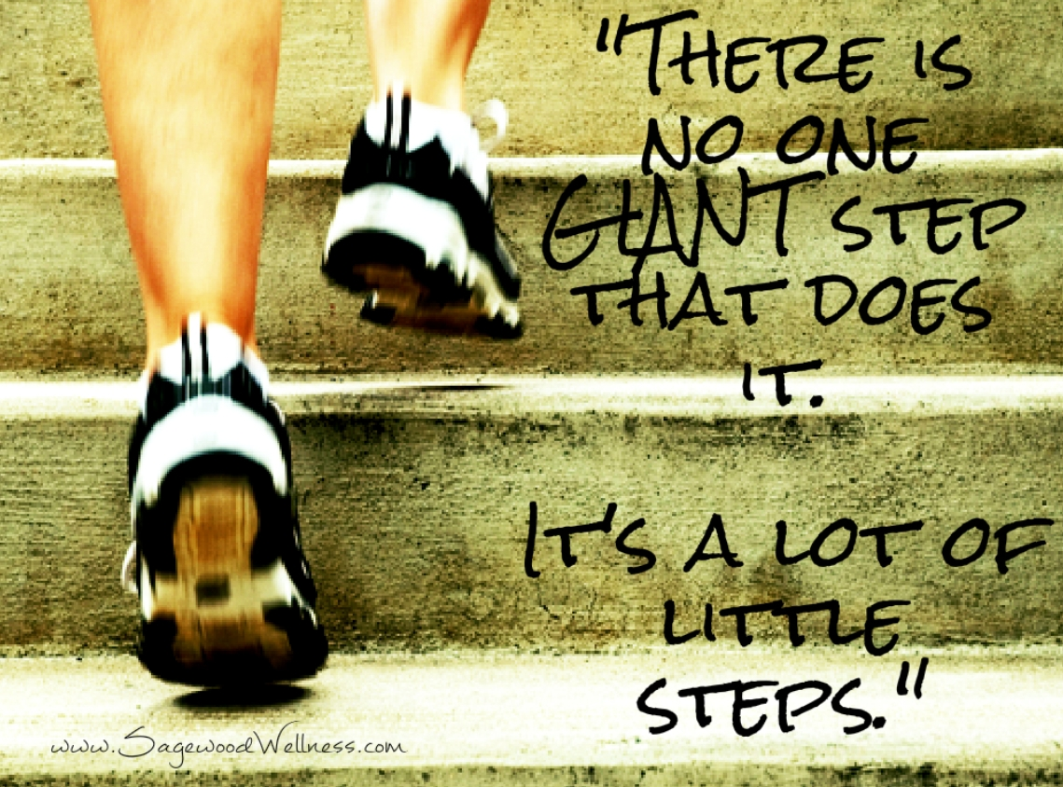

Slide 48

Anything to share?

Slide 49
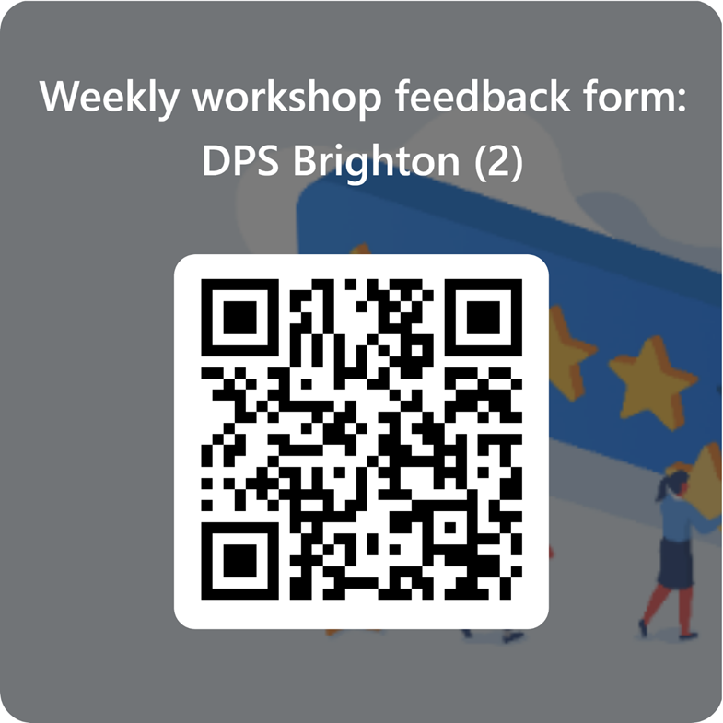
Feedback and Next Steps
We want to hear from you!
Please use the QR code to send us your thoughts .

Slide 50
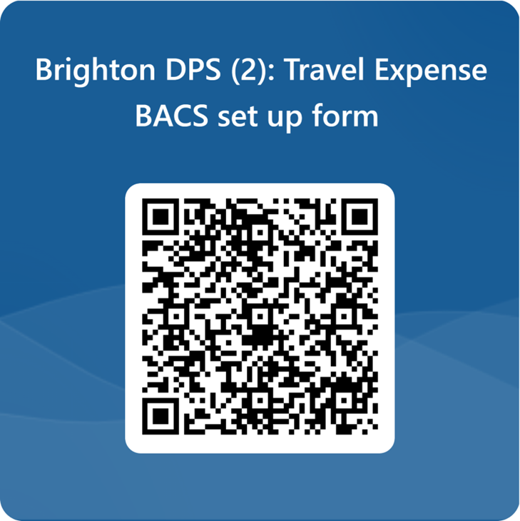
Travel Expenses
If you require travel expenses, use the QR code to claim. You can claim mileage and public transport but not parking unfortunately.

Slide 51

Thank you

