Slide 1


Business Skills
& Your Business

Slide 2
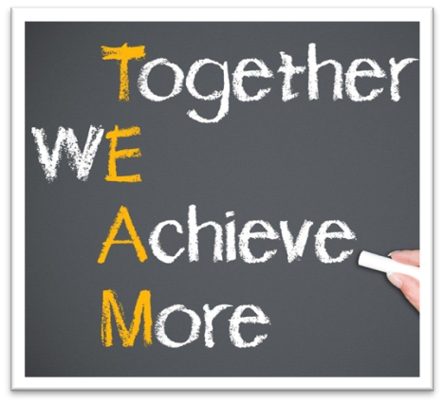
Ways Of Working
100% confidentiality
No multi-tasking – be fully present
Arrive on time and stay for the whole meeting
Commit to asking questions, listening & being non-judgmental
Sharing the air space
Implement agreed actions (Do what you say you will do)
Feedback at the following session
Complete all participant surveys at the end of each session
Philosophy –
“The knowledge is in the room, let’s learn from others and share”

Slide 3



Activity
What “Business Bottlenecks” do you have?
If you had one extra hour each week, what part of your business would you fix, improve, or finally get on top of?
Write them down
You have 5 minutes to make as many on an individual sticky note

Slide 4
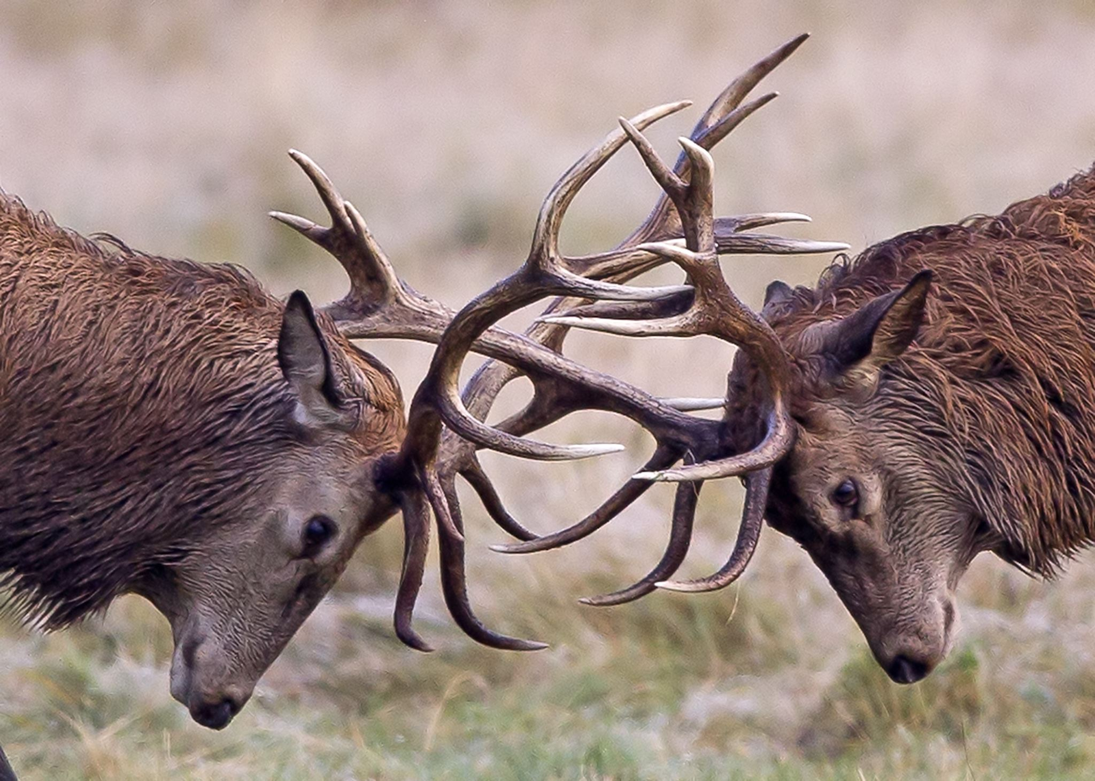
Butting heads with your business
It can often feel like you are
butting heads with your own business.
On these sticky notes, are YOUR
real-world challenges
The good news is…
they are all things we can influence

Slide 5

5ive
Core Business Skill Foundations
The Core

Slide 6
Leadership
Communication
Decision Making
Core
Business Skills
Negotiation
Adaptability

Slide 7

These 5ive core principles sit underneath almost all your key core business skills
Today. We are going to keep this real, simple and offer practical solutions

Slide 8

Leadership
“Who’s running this joint?”
When do we need leadership in business, even as a Solopreneur?
“Lead from the front”
Standards
Culture
Customer service standards
Planning, organization & time management
Notes:
Show example of www.coolors.co - hyperlinked

Slide 9
Leadership
“Who’s running this joint?”
What does good leadership in business look like?
If YOU, were an employee of your current business. What skills would you like your leader to have, that would help you in your day-to-day role?
Notes:
Show example of www.coolors.co - hyperlinked

Slide 10

Communication
“Can I speak to someone?”
When do you face communication moments in your business?
If we were to ring a recent customer of yours. How would they describe your communication style as a business?
Notes:
Show example of www.coolors.co - hyperlinked

Slide 11
Communication
“Can I speak to someone?”
What does good communication look like for a business?
Conversely, what does bad communication look like and why does it occur for small business?
Notes:
Show example of www.coolors.co - hyperlinked

Slide 12

Decision Making
“Are we going left or right?”
Why do you get stuck, when decision making in business?
When making decisions, what is your immediate go-to…?
Pros, cons, outcome, journey, how will it work?
Notes:
Show example of www.coolors.co - hyperlinked

Slide 13
Decision Making
“Are we going left or right?”
Why is a decisive person… decisive?
What allows them to have this freedom?
The desire and confidence to back themselves, their decision and the outcome
Follow a framework to allow them to refer to a plan or guideline of principles?
Notes:
Show example of www.coolors.co - hyperlinked

Slide 14
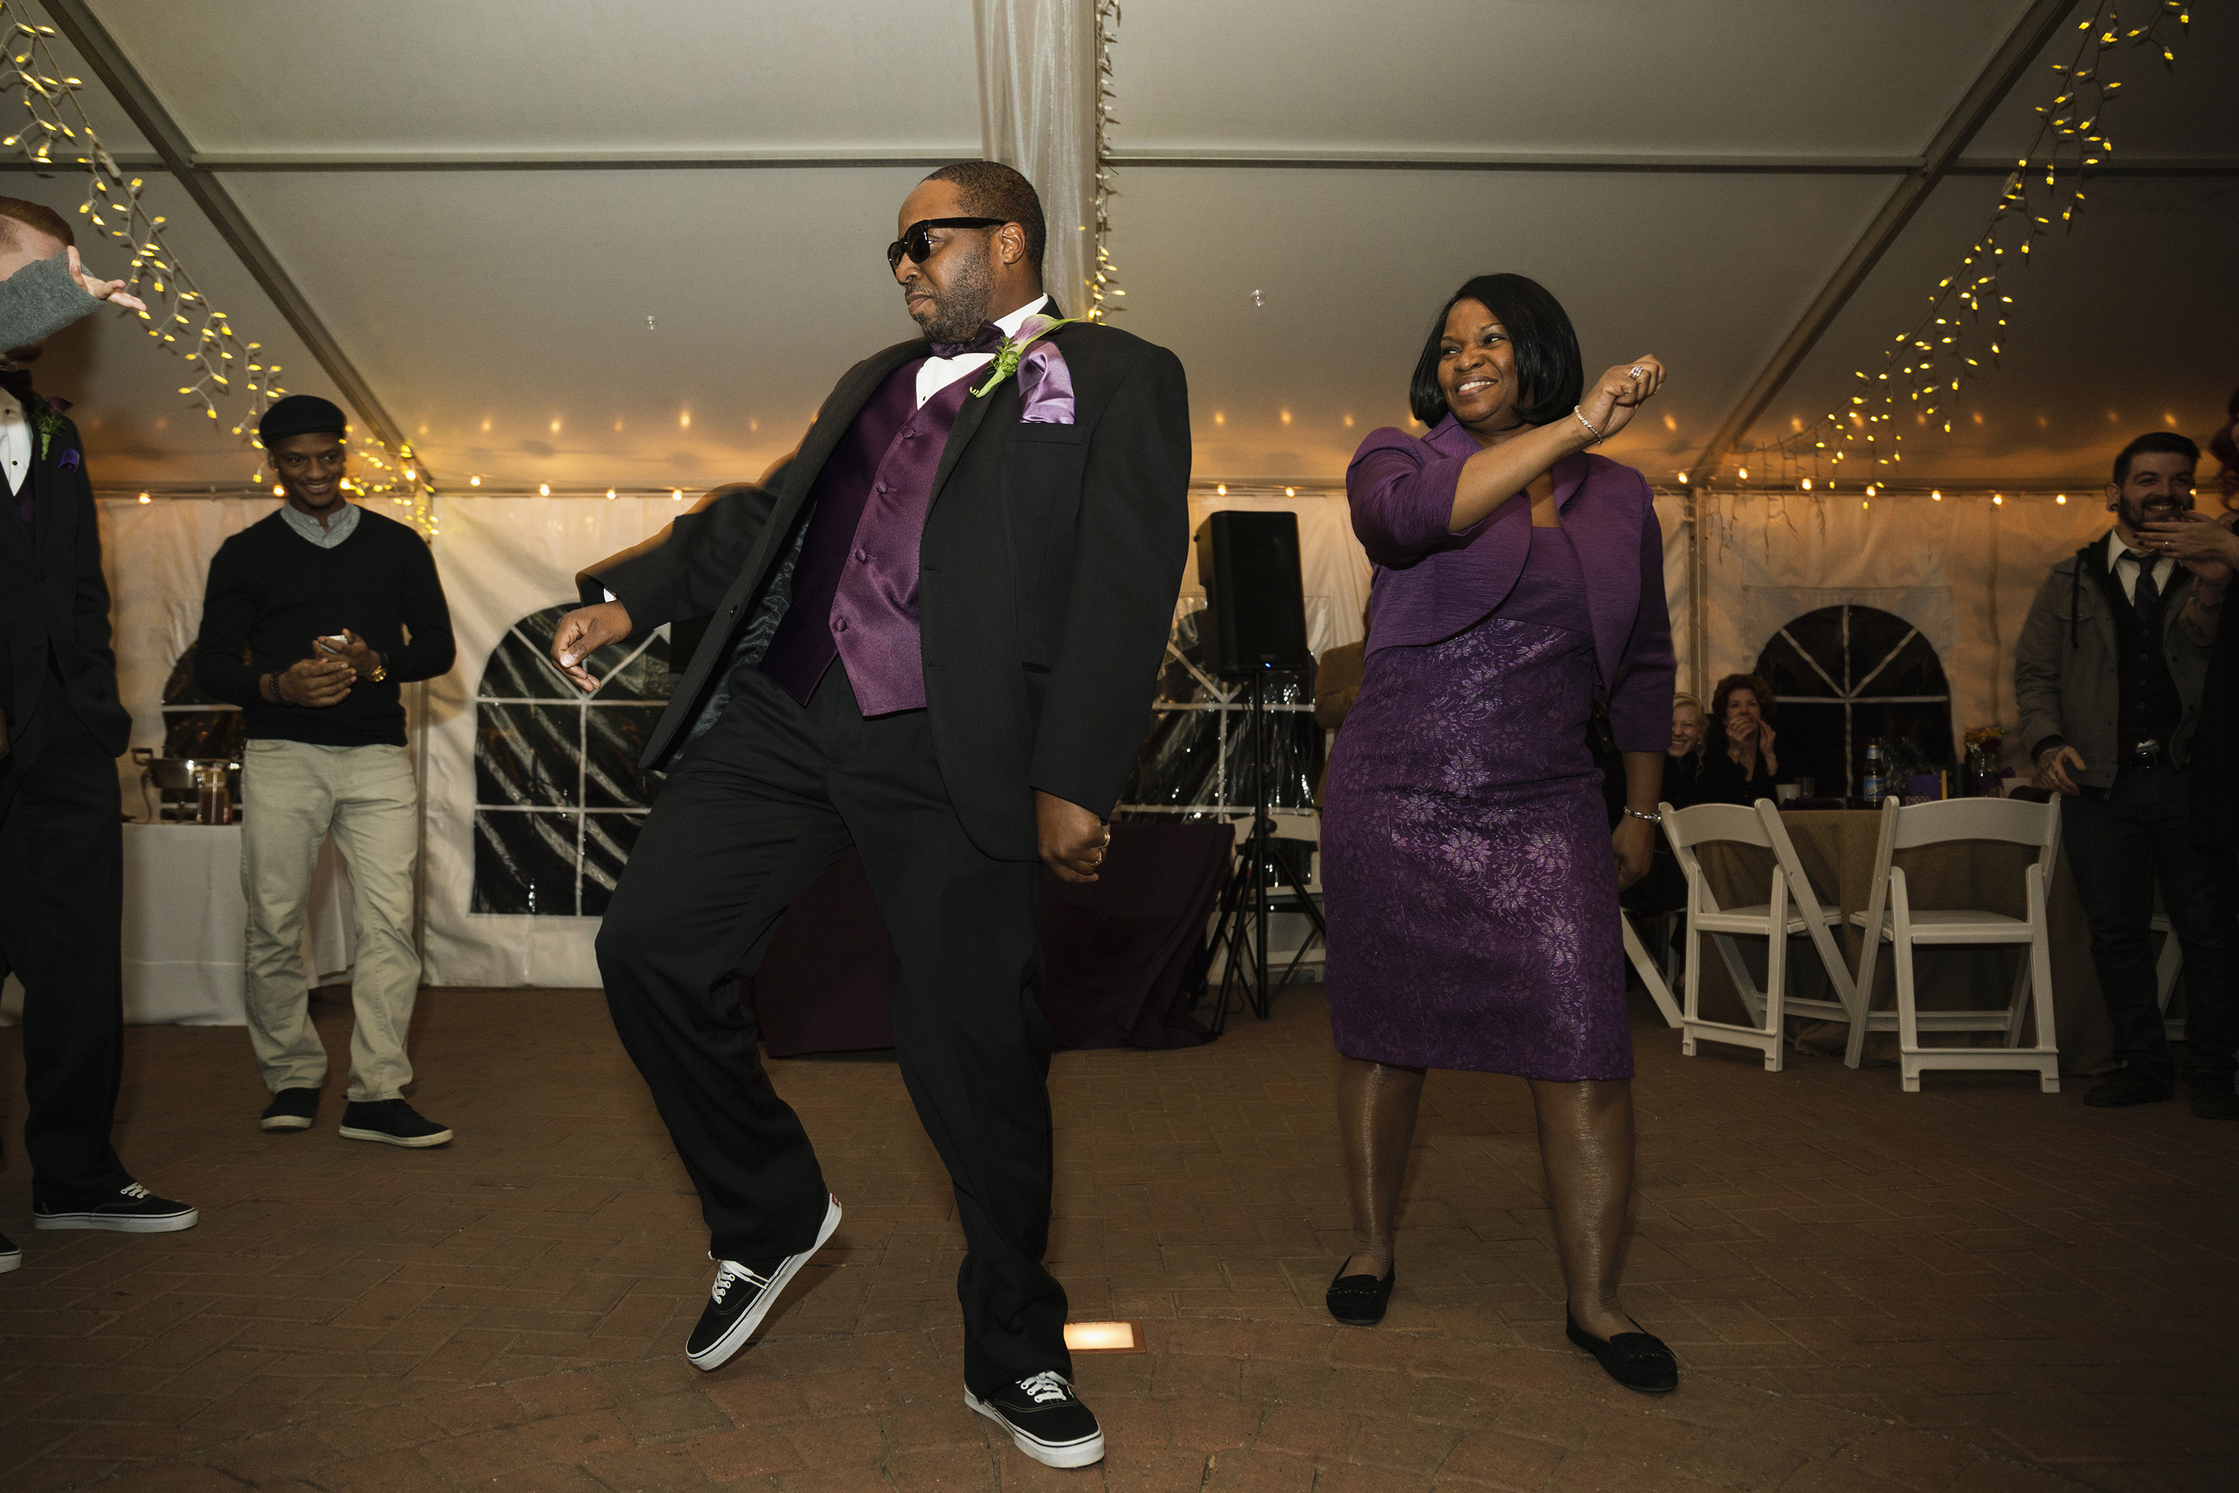
Adaptability
“Improvise, adapt & overcome”
When have you had to adapt in your business recently?
What has caused you to have to shift off the beaten path and adapt to a situation?
When do you feel you best handle ‘change’ in general?
Assess, process… proceed
Notes:
Show example of www.coolors.co - hyperlinked

Slide 15
Adaptability
“Improvise, adapt & overcome”
What traits does an individual or business have that allows them to be adaptable?
What is ‘good adaptability’?
Is it proactive or reactive?
Notes:
Show example of www.coolors.co - hyperlinked

Slide 16

Negotiation
“Meet me halfway on that?”
When do we face negotiation in business?
In reality we are often ‘negotiating’ in business.
How we ‘negotiate life’, not just business
Notes:
Show example of www.coolors.co - hyperlinked

Slide 17

Negotiation
“Meet me halfway on that?”
When do you recall the last time you felt you negotiated well?
How much of this was the “skill” of being a good negotiator?
How much of this was the “will” to barter and get the outcome you felt was acceptable?
Notes:
Show example of www.coolors.co - hyperlinked

Slide 18

5 Core
For my business, is it…
Skill
Will

Slide 19

Thinking about these
5 core principles
Leadership
Communication
Decision Making
Adaptability
Negotiation
Let’s get into groups
Where do we go?
Let’s look at our sticky notes.
Place them into 1 of the 5 sections.
Place into the most relevant (in your opinion)

Slide 20
5 Core
For my business, is it…
Aptitude
Attitude
Notes:
What about this ‘middle ground’
Where does aptitude meet attitude?

Slide 21






The ‘Bridge’
Leadership
Lead from the front… cross the bridge
Your ‘5 star’ Core Principles
Communication
Self-talk, inspire yourself to take a leap
Adaptability
It won’t always be linear, be flexible
Decision Making
Avoid positive procrastination
Negotiation
Compromise and move forward

Slide 22

where Knowledge meets Motivation
Confidence is created

Slide 23
The ‘Bridge’ between
Skill & Will
Where does skill become will, and vice versa?
re-write social media several times before posting
I have tried it before, it just doesn’t work
I am not photogenic, so I never post with me in it
I am not a morning person
I welcome new ideas from others
know my prices are too low, but I’m afraid to raise them
I am not very computer literate, CANVA won’t work for me
I can’t rely on anyone else to do it to my standards
Notes:
Show example of www.coolors.co - hyperlinked

Slide 24
Statement | Skill (Gap) | Will (Barrier) | Bridge (Action)
I’m not a morning person | No structure for personal energy | Limiting belief about mornings | Suggestion?
I welcome new ideas | Unsure how to test or prioritise | Open but easily overwhelmed | Suggestion?
Re-write social media posts | Lack of content structure | Fear of judgment | Suggestion?
Not photogenic | Doesn’t know photo basics | Fear of visibility | Suggestion?
Prices too low, afraid to raise | Lacks pricing method | Fear of rejection | Suggestion?
Tried it before, doesn’t work | Used wrong system | Discouraged mindset | Suggestion?
Can’t rely on others | No delegation system | Control or perfectionism | Suggestion?
The ‘Bridge’
Where does skill
become will,
and vice versa?
Notes:
Each example shows:
The Skill side (knowledge, process, system gap)
The Will side (mindset, emotional, belief barrier)
And the Bridge — the practical step that connects both.
💬 1. “I am not a morning person.”
Skill: No structured routine or method to plan energy levels.
Will: Belief that mornings = productivity failure, so resistance sets in.
Bridge: Identify your natural peak focus time and schedule your “Power Hour” there instead of forcing mornings. → Confidence grows when work matches energy, not the clock.
💬 2. “I welcome new ideas from others.”
Skill: Ability to filter, test, and integrate good ideas effectively.
Will: Openness and curiosity — willingness to learn.
Bridge: Apply one new idea each week, review it after seven days, and keep what works. → Turns enthusiasm into measurable learning momentum.
💬 3. “I rewrite my social media posts several times before posting.”
Skill: Uncertainty around content structure, tone, or platform best practice.
Will: Fear of judgment and perfectionism.
Bridge: Use a simple post template (hook, story, takeaway) and commit to posting once without editing. → Each published post builds confidence and skill together.
💬 4. “I am not photogenic, so I never post with me in it.”
Skill: Lack of knowledge on lighting, framing, or using phone camera tools.
Will: Low self-confidence or fear of visibility.
Bridge: Record one short video or take one selfie in comfortable lighting, even if you don’t post it — practice exposure. → Comfort grows with repetition; skill in presentation follows.
💬 5. “I know my prices are too low, but I’m afraid to raise them.”
Skill: Doesn’t know how to calculate value, cost, or communicate price increases.
Will: Fear of rejection or losing clients.
Bridge: Review competitors’ prices, build a one-line “value” statement, and raise rates slightly for new customers first. → Builds evidence that people still buy, strengthening confidence.
💬 6. “I have tried it before, it just doesn’t work.”
Skill: May not have used the right process, tool, or timing.
Will: Cynicism or fatigue from past failure; unwilling to try again.
Bridge: Revisit the method with one small tweak — shorter trial, clearer measure, or simpler goal — and observe outcomes. → Shifts focus from failure to learning.
💬 7. “I can’t rely on anyone else to do it to my standards.”
Skill: Lacks delegation systems, templates, or training guides.
Will: Control issues, perfectionism, fear of mistakes.
Bridge: Delegate one low-risk task with clear written instructions, then review results together. → Builds trust gradually, strengthens leadership skill.

Slide 25
Statement | Skill (Gap) | Will (Barrier) | Bridge (Action)
I’m not a morning person | No structure for personal energy | Limiting belief about mornings | Work to your best energy time; set consistent Power Hour
I welcome new ideas | Unsure how to test or prioritise | Open but easily overwhelmed | Trial one idea per week and reflect
Re-write social media posts | Lack of content structure | Fear of judgment | Use a template; post without over-editing
Not photogenic | Doesn’t know photo basics | Fear of visibility | Practise short, safe camera moments
Prices too low, afraid to raise | Lacks pricing method | Fear of rejection | Raise new client rate; collect success proof
Tried it before, doesn’t work | Used wrong system | Discouraged mindset | Try again with smaller experiment
Can’t rely on others | No delegation system | Control or perfectionism | Delegate one small job, review, repeat
The ‘Bridge’
Where does skill
become will,
and vice versa?
Notes:
Each example shows:
The Skill side (knowledge, process, system gap)
The Will side (mindset, emotional, belief barrier)
And the Bridge — the practical step that connects both.
💬 1. “I am not a morning person.”
Skill: No structured routine or method to plan energy levels.
Will: Belief that mornings = productivity failure, so resistance sets in.
Bridge: Identify your natural peak focus time and schedule your “Power Hour” there instead of forcing mornings. → Confidence grows when work matches energy, not the clock.
💬 2. “I welcome new ideas from others.”
Skill: Ability to filter, test, and integrate good ideas effectively.
Will: Openness and curiosity — willingness to learn.
Bridge: Apply one new idea each week, review it after seven days, and keep what works. → Turns enthusiasm into measurable learning momentum.
💬 3. “I rewrite my social media posts several times before posting.”
Skill: Uncertainty around content structure, tone, or platform best practice.
Will: Fear of judgment and perfectionism.
Bridge: Use a simple post template (hook, story, takeaway) and commit to posting once without editing. → Each published post builds confidence and skill together.
💬 4. “I am not photogenic, so I never post with me in it.”
Skill: Lack of knowledge on lighting, framing, or using phone camera tools.
Will: Low self-confidence or fear of visibility.
Bridge: Record one short video or take one selfie in comfortable lighting, even if you don’t post it — practice exposure. → Comfort grows with repetition; skill in presentation follows.
💬 5. “I know my prices are too low, but I’m afraid to raise them.”
Skill: Doesn’t know how to calculate value, cost, or communicate price increases.
Will: Fear of rejection or losing clients.
Bridge: Review competitors’ prices, build a one-line “value” statement, and raise rates slightly for new customers first. → Builds evidence that people still buy, strengthening confidence.
💬 6. “I have tried it before, it just doesn’t work.”
Skill: May not have used the right process, tool, or timing.
Will: Cynicism or fatigue from past failure; unwilling to try again.
Bridge: Revisit the method with one small tweak — shorter trial, clearer measure, or simpler goal — and observe outcomes. → Shifts focus from failure to learning.
💬 7. “I can’t rely on anyone else to do it to my standards.”
Skill: Lacks delegation systems, templates, or training guides.
Will: Control issues, perfectionism, fear of mistakes.
Bridge: Delegate one low-risk task with clear written instructions, then review results together. → Builds trust gradually, strengthens leadership skill.

Slide 26
Business Skills
For my business, is it a question of…
Skill
Will

Slide 27


Slide 28

Being organised
Why does it matter?
Increased productivity
No more ‘Positive Procrastination’
Improved focus
Increases ability to pay attention to detail
Reduce stress
Being organised = less stress
Have an actual plan
you know what you’re supposed to do

Slide 29

£86,400 every day…
How would you spend it everyday?
We all have 86,400 seconds,
gifted to us everyday…
As the saying goes…
“Time is money”
Are you ‘spending’ yours wisely?

Slide 30

Skills pay the bills
But not without a plan/structure
As a business, your most valuable commodity is ’Your Time’
Let’s take a look at some time management and task management techniques
Let’s ensure you are ‘spending’ your business time wisely
But first… does anyone know any or use any time management skills themselves?

Slide 31

The 80/20 Principle
“Pareto Principle”
The theory behind this method is:
80% of your results, come from
20% of your actions
For Example:
20% of your clients, bring in 80% of your income
20% of your marketing, produces 80% of your leads
20% of your daily tasks,
drive 80% of your progress
Practical takeaway:
Write a list of all weekly tasks
Circle the ones that truly move your business forward
Delegate, delay, or drop the rest where possible.
Ask daily: “Is this part of my 20%?”
Notes:
“In every business, a small handful of things bring in the most results. Your job is to find those things and do them first.”
Examples:
20% of your clients bring in 80% of your income.
20% of your marketing channels produce 80% of your leads.
20% of your daily tasks drive 80% of progress.
Practical takeaway:
Write a list of all weekly tasks. Circle the ones that truly move your business forward (client work, sales, follow-ups).
Delegate, delay, or drop the rest where possible.
Ask daily: “Is this part of my 20%?”

Slide 32
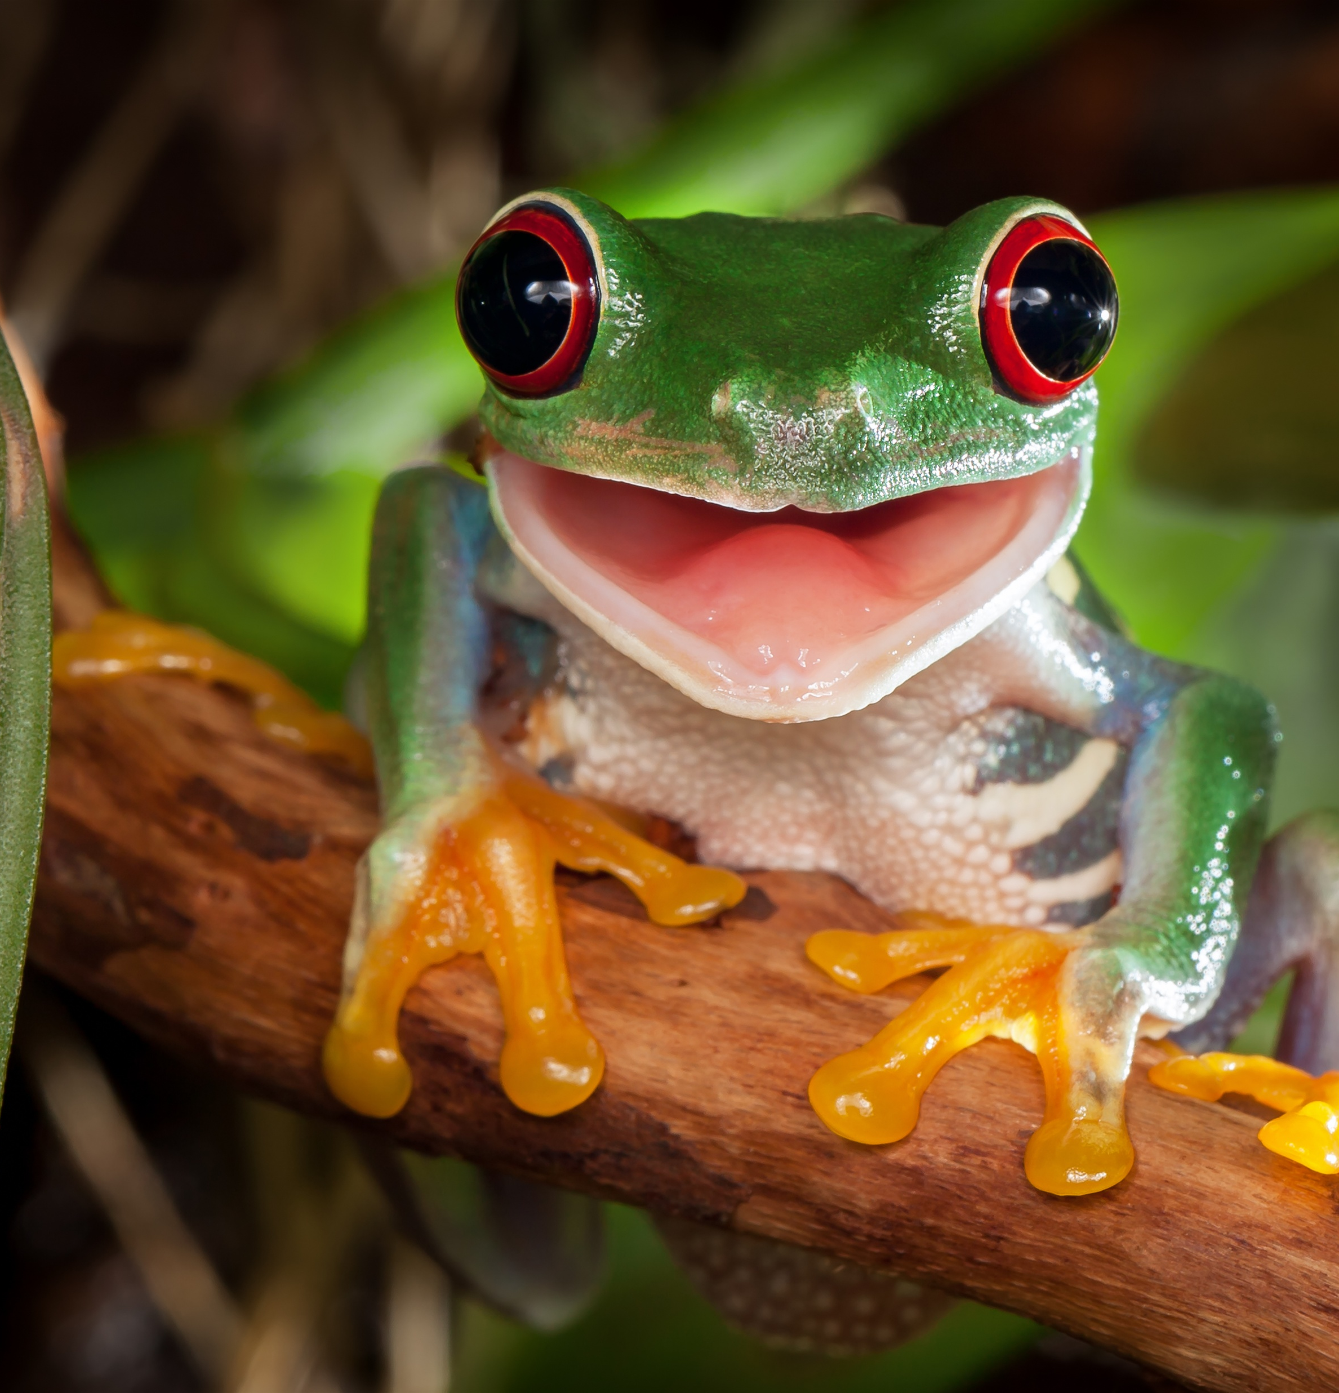
“Eat that Frog”
Author, Brian Tracy
The theory behind this method is: another way of saying that if you have two important tasks before you, start with the biggest, hardest, and most important task first
For Example:
“If you eat your biggest frog first thing in the morning, everything else feels easier”
Do the task you are most likely to avoid or put off, first!
Completion of these ‘frog tasks’ significantly reduce stress
Practical takeaway:
Each day, highlight one ‘frog’
Do it before checking email or social media
Reward yourself with an easy task afterward
Notes:
“In every business, a small handful of things bring in the most results. Your job is to find those things and do them first.”
Examples:
20% of your clients bring in 80% of your income.
20% of your marketing channels produce 80% of your leads.
20% of your daily tasks drive 80% of progress.
Practical takeaway:
Write a list of all weekly tasks. Circle the ones that truly move your business forward (client work, sales, follow-ups).
Delegate, delay, or drop the rest where possible.
Ask daily: “Is this part of my 20%?”

Slide 33

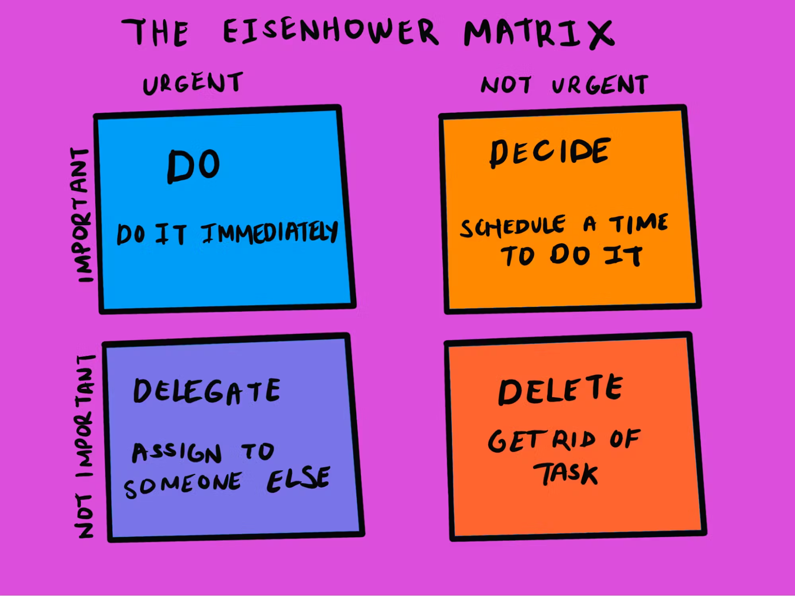
The Eisenhower Matrix
The Four D’s of Decisioning
The theory behind this method is:
Sort tasks by urgency and importance to prioritise clearly.
Notes:
The Eisenhower Matrix is a time-management strategy that helps you determine which tasks should be prioritized, which can be delegated, and which can be tackled at a later time - or not at all.
Activities in the urgent and important category should be done immediately, like preparing for a meeting that starts in an hour or handling a client crisis. Activities that are not urgent but important should be scheduled for a later date, but you must ensure to stick to that schedule and not put them off. This could include going to a routine health check-up or meeting up with a loved one. Activities in the urgent and not important section, like replying to emails or booking travel, should be delegated to someone else. Lastly, activities in the not urgent and not important category should be deleted altogether.² This might include scrolling social media, rearranging a perfectly tidy room, or online shopping for items you don’t need.
Quadrant 1: Do First (Urgent & Important)
Tasks that require immediate attention and are critical for success.
Quadrant 2: Schedule (Important but Not Urgent)
Tasks that contribute to long-term goals and success but don’t require immediate attention.
Quadrant 3: Delegate (Urgent but Not Important)
Tasks that demand immediate attention but do not require your expertise.
Quadrant 4: Don’t Do (Not Urgent & Not Important)
Tasks that do not contribute to productivity or long-term success.
According to proponents of the matrix, most of us spend too much time working in the wrong quadrants: that is, numbers 3 and 4.¹² Instead, we should be focusing our attention on quadrant two: important but not urgent.

Slide 34

Pomodoro Technique
Burst and break
The theory behind this method is:
Work in 25-minute bursts (“Pomodoro's”)
followed by a 5-minute break.
Once comfortable, take longer bursts
For Example:
If you are somebody who suffers with distraction and procrastination, agreeing with yourself short time bursts can really help ‘hotwire your brain’ to focus
Practical takeaway:
Use an alarm or prompt to stop/start
Use Pomofocus.io timer or Forest app
Keeps long tasks bite-sized and manageable

Slide 35
MustShouldCould
Must
These are tasks that you MUST do within a given timeframe (normally shorter timeframes)
These items are essentially put to the top of your to-do list and are the most pressing
“I MUST pay in £10 cash into my Business Bank account to avoid overdraft charges”
Should
These are tasks that you SHOULD be able to reasonably achieve within a given timeframe
These items are just behind your ‘MUST’ as they are necessary, but can wait vs your ‘Must’
“I SHOULD be able to post that Instagram draft, once I am back from the bank, but it’s not the end of the world if I post it tomorrow instead”
Could
These are tasks that you COULD do within a given timeframe.
These items are at the least important and can wait, but if you could achieve would be beneficial. Aas eventually
“If I could record some new footage of me at work so I can post it next week, that would be very helpful but it can wait if needed”

Slide 36

Time blocking
Blocks of time dedicated to task
The theory behind this method is:
Group similar tasks and protect them
with fixed blocks of time.
Your brain works best when it stays in one gear and singularly focused. Time blocking protects your focus.
For Example:
Dedicating days to certain batches of tasks
Ie Mondays are admin days
Practical takeaway:
Use an alarm or prompt to stop/start
Use Pomofocus.io timer or Forest app
Keeps long tasks bite-sized and manageable

Slide 37
Skills pay the bills
But not without a plan/structure
As a business, your most valuable commodity is ’Your Time’
There are many other skills & tools you can use.
EXERCISE:
Let’s create an “example week”
Please take the handout and see how we can use this to create a template to follow

Slide 38
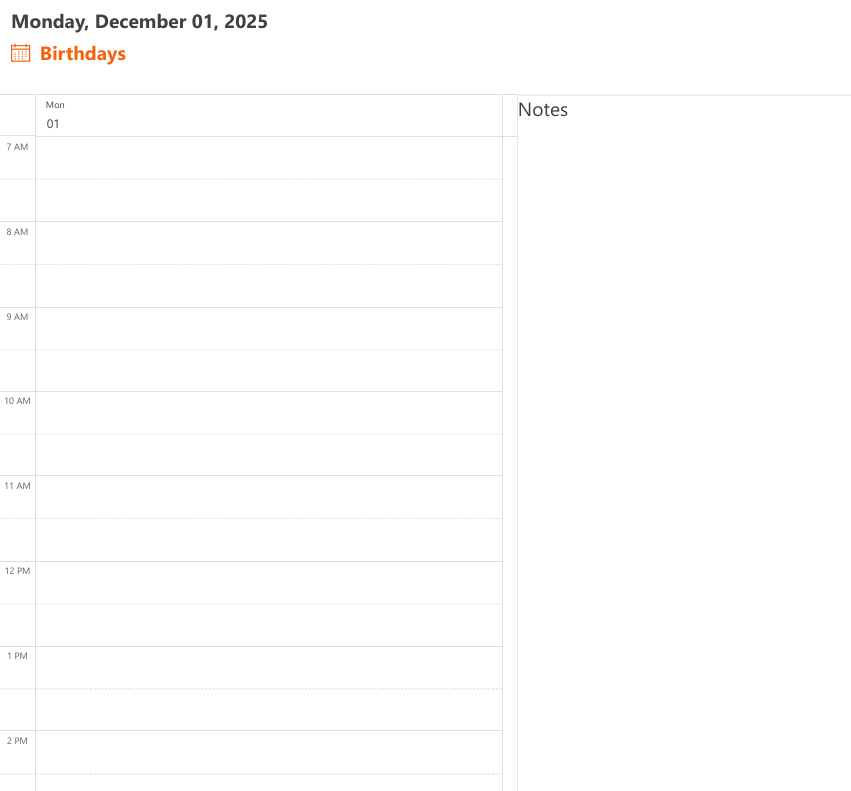
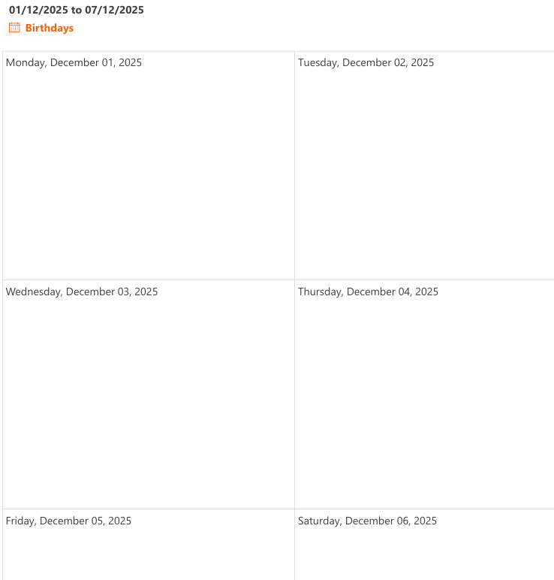
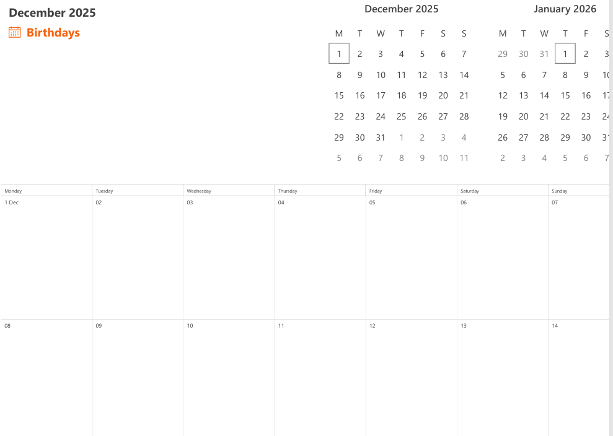
Skills pay the bills
Planning your day, week, month

Slide 39
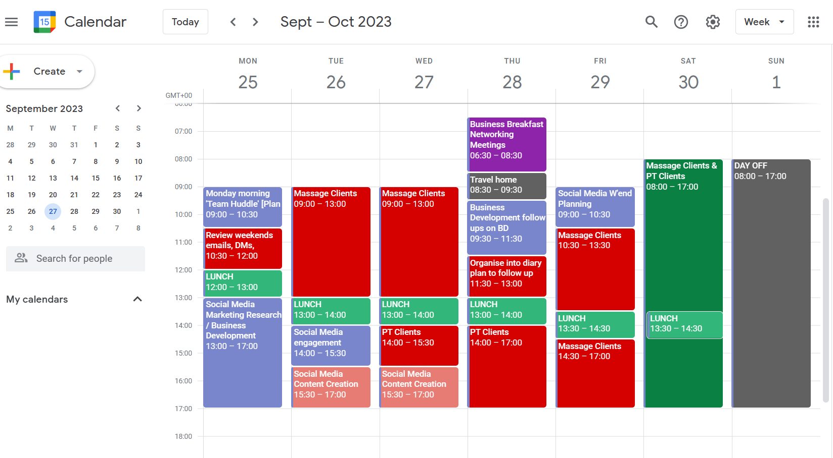
Your ‘Example Week’
Your template for success

Slide 40





Diary Layout
Calendar Conundrum
Microsoft vs Google vs Apple
Whichever is your ‘main one’ stick with that
Apple vs Android – Consider app compatibility
The ‘best’ diary is the one that works for you and the one you can stick to

Slide 41





From Diary management to Task Management
One thing is organizing your time, and this is always the start
The next is task management and to-do
How you spend your time, is just as important as ringfencing the time
What systems can we use to help us prioritise? Apps vs. Pen/Paper
Notes:
WAVE Web Accessibility Evaluation Tools

Slide 42
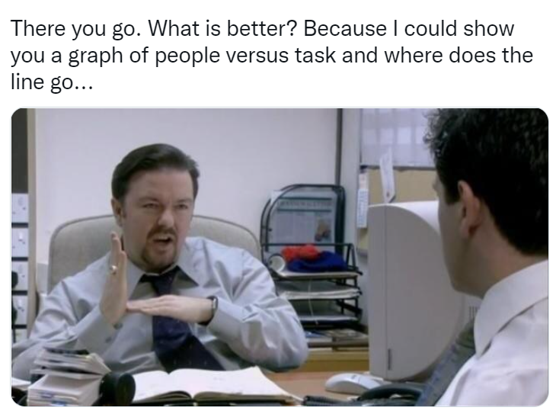
Time to task
“The Hybrid Theory”
“Must, Should & Could”
Paired with
Pomodoro Technique
So, how would this work?
“Eat that Frog”
Paired with
Time Blocking
So, how would this work?

Slide 43



What about apps?

Slide 44




What should I use?
“Try before you buy”
Many offer ‘free trials; so worth taking a look and getting a feel for a few
In fact, many have a ‘free’ version, which will more than suffice for most of us
The ‘Best’ one, is the one you can use and stick to!
Don’t dismiss traditional pen and paper diary. Can work just as well!

Slide 45
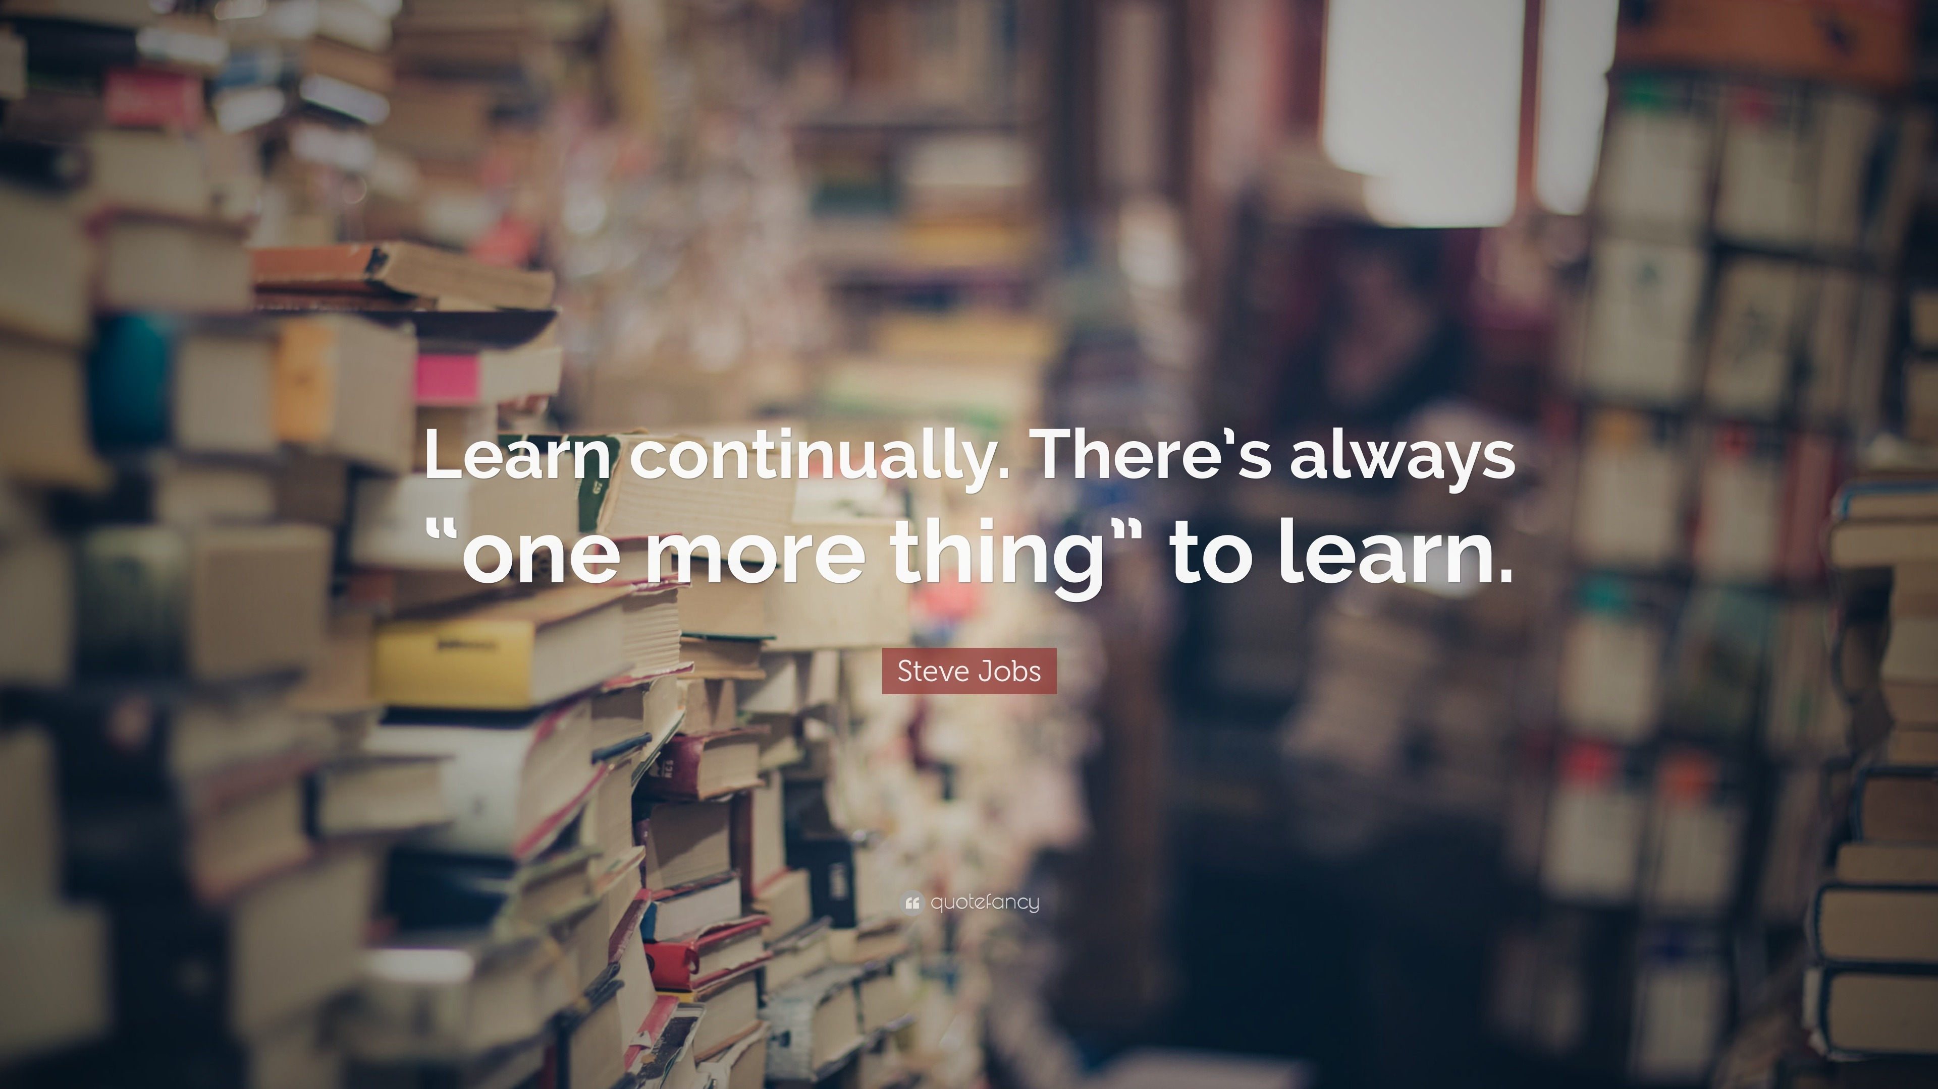

Slide 46
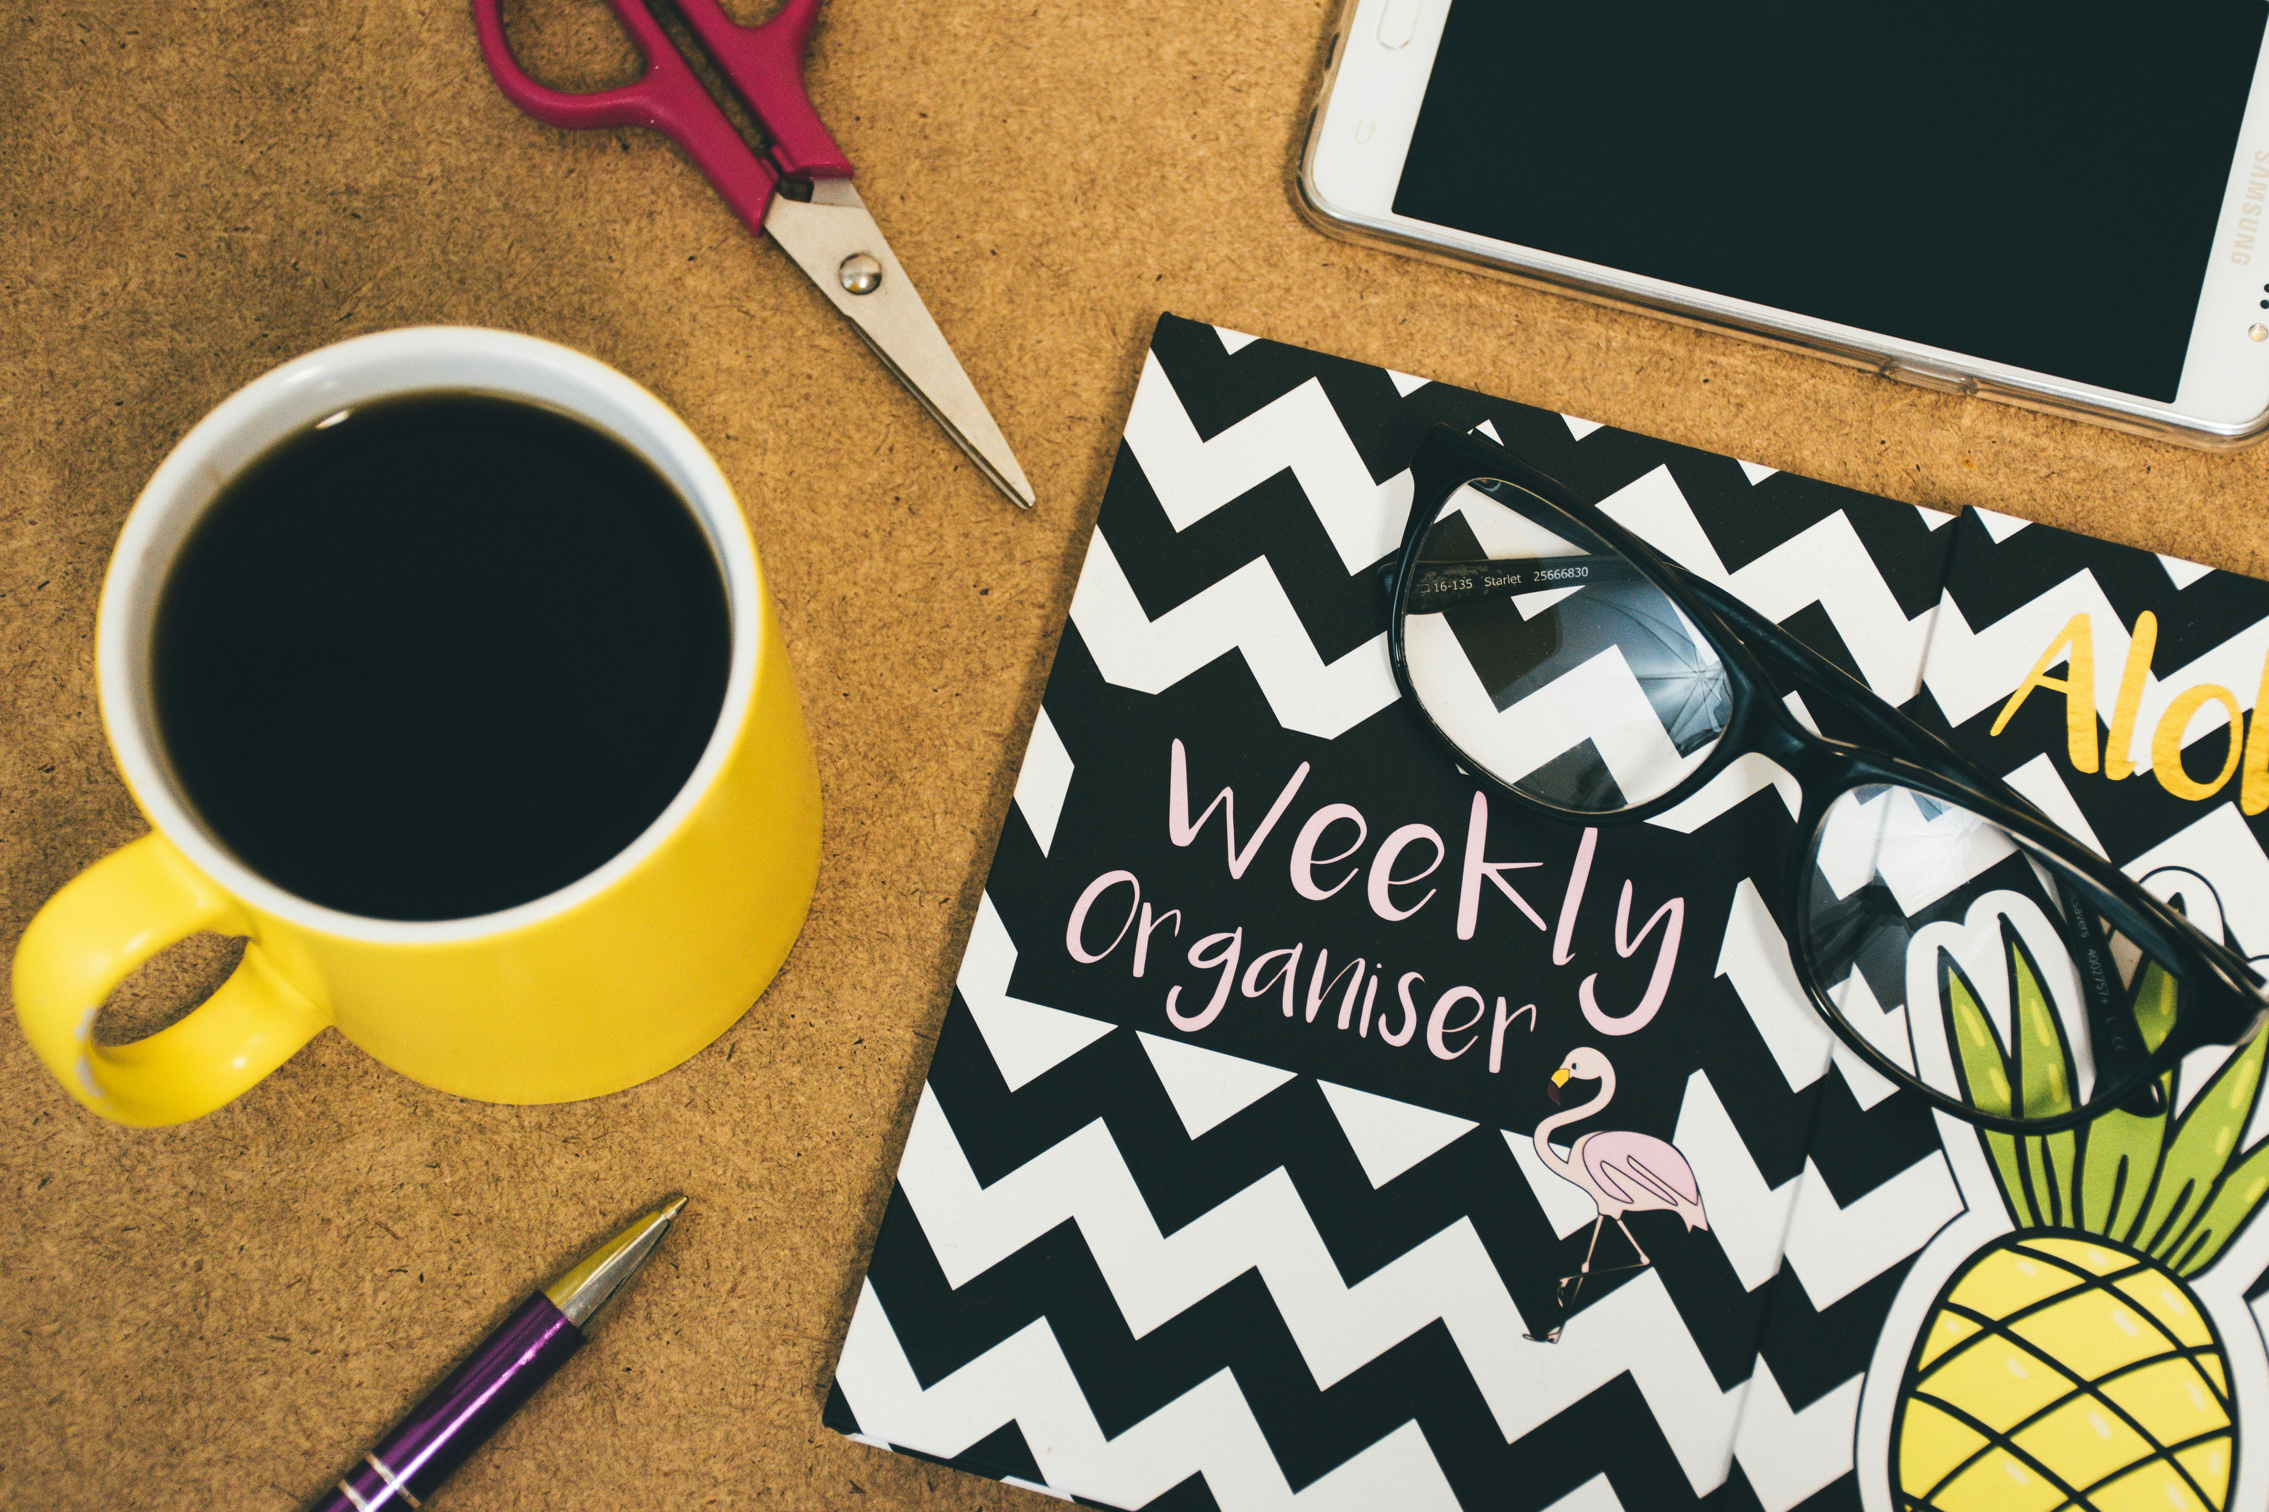
failing to prepare...
is
preparing to fail
Notes:
If you had asked me what is the number 1 reason why small businesses fail…
It’s poor time management, its poor resource allocation
If you are not organised, if you are not planning in the time you need to grow and operate, you can’t expect to succeed

Slide 47

Time is money
How are you going to ‘speculate to accumulate’ with your business?
Notes:
If you had asked me what is the number 1 reason why small businesses fail…
It’s poor time management, its poor resource allocation
If you are not organised, if you are not planning in the time you need to grow and operate, you can’t expect to succeed

Slide 48

Any
Questions?

Slide 49

Travel Expenses
If you require travel expenses, use the QR code to claim. You can claim mileage and public transport but not parking unfortunately.

Slide 50
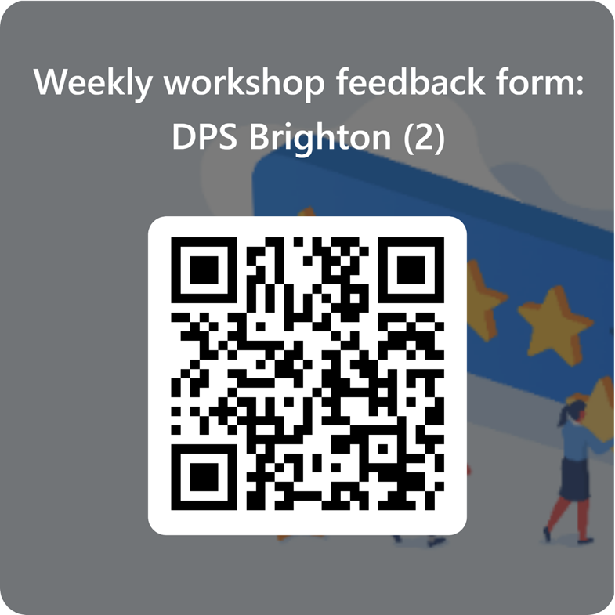
Feedback and Next Steps
We want to hear from you!
Please use the QR code to send us your thoughts .

Slide 51
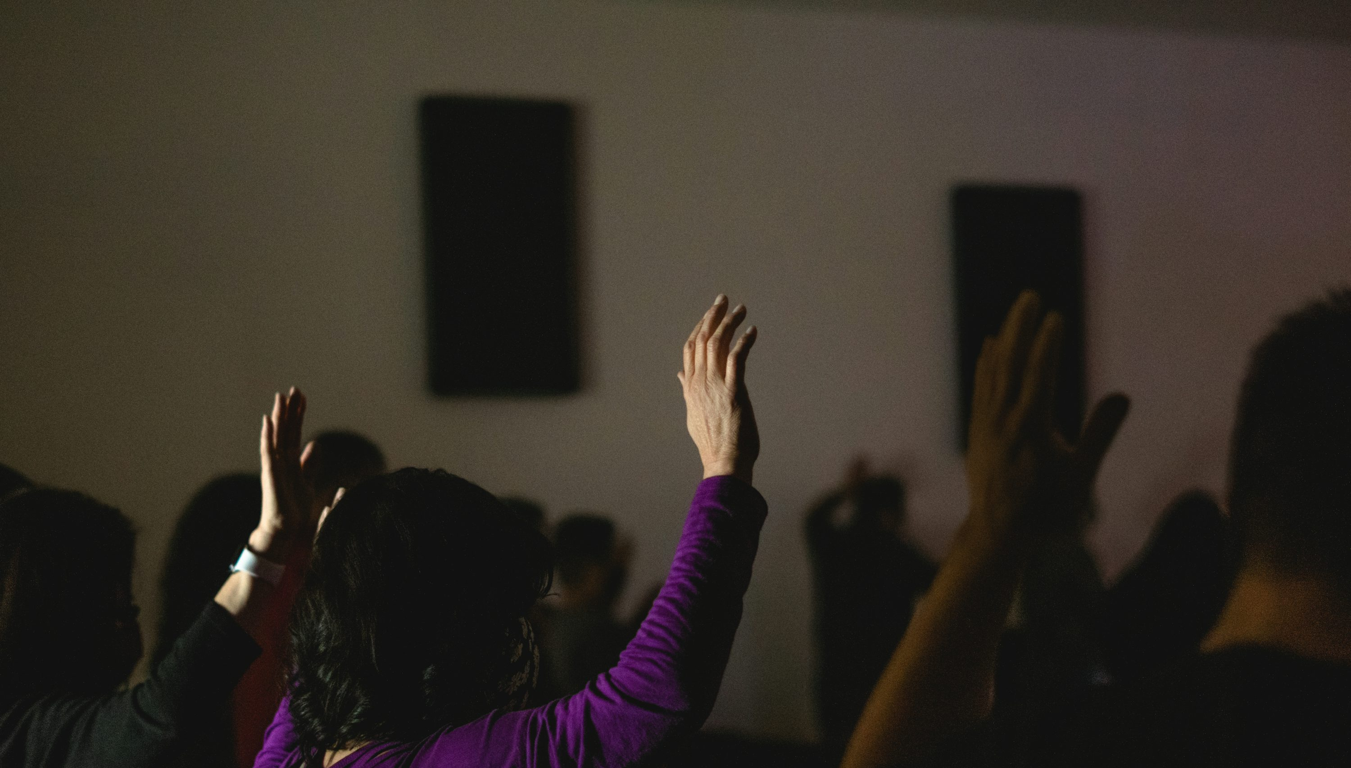
Thank you

