Slide 1


Website Design
& Your Business

Slide 2

Ways Of Working
100% confidentiality
No multi-tasking – be fully present
Arrive on time and stay for the whole meeting
Commit to asking questions, listening & being non-judgemental
Sharing the air space
Implement agreed actions (Do what you say you will do)
Feedback at the following session
Complete all participant surveys at the end of each session
Philosophy –
“The knowledge is in the room, let’s learn from others and share”

Slide 3

Disclaimer
The information provided in this presentation relates to website design and is based on our own knowledge and research from various online sources. While we have made every effort to ensure the content is accurate and up to date, we cannot guarantee that it is free from errors or that it will remain accurate over time. We cannot be held liable for any mistakes, omissions, or inaccuracies in the material presented. We encourage you to do your own research and verify any details before making design or business decisions based on this information.
We are business advisers, not website designers.
The content shared today is for educational and demonstration purposes only. It is drawn from personal experience, general business insights, and publicly available resources. The field of website design evolves rapidly—platforms, tools, and design standards can change frequently. Some examples we share may already be outdated, modified, or discontinued. Certain features we mention may only be available in paid versions of software or may later become restricted. Free tools and services can also change their terms, pricing, or availability without notice.
Nothing in this workshop should be taken as absolute fact, legal guidance, or technical web design instruction. Before making decisions for your business or website, always double-check details with trusted, up-to-date sources and, if needed, seek professional design or technical expertise. The aim of this workshop is to spark ideas, raise awareness, and encourage exploration—not to provide final answers. How you apply these insights rests with you as the business owner or decision-maker.

Slide 4
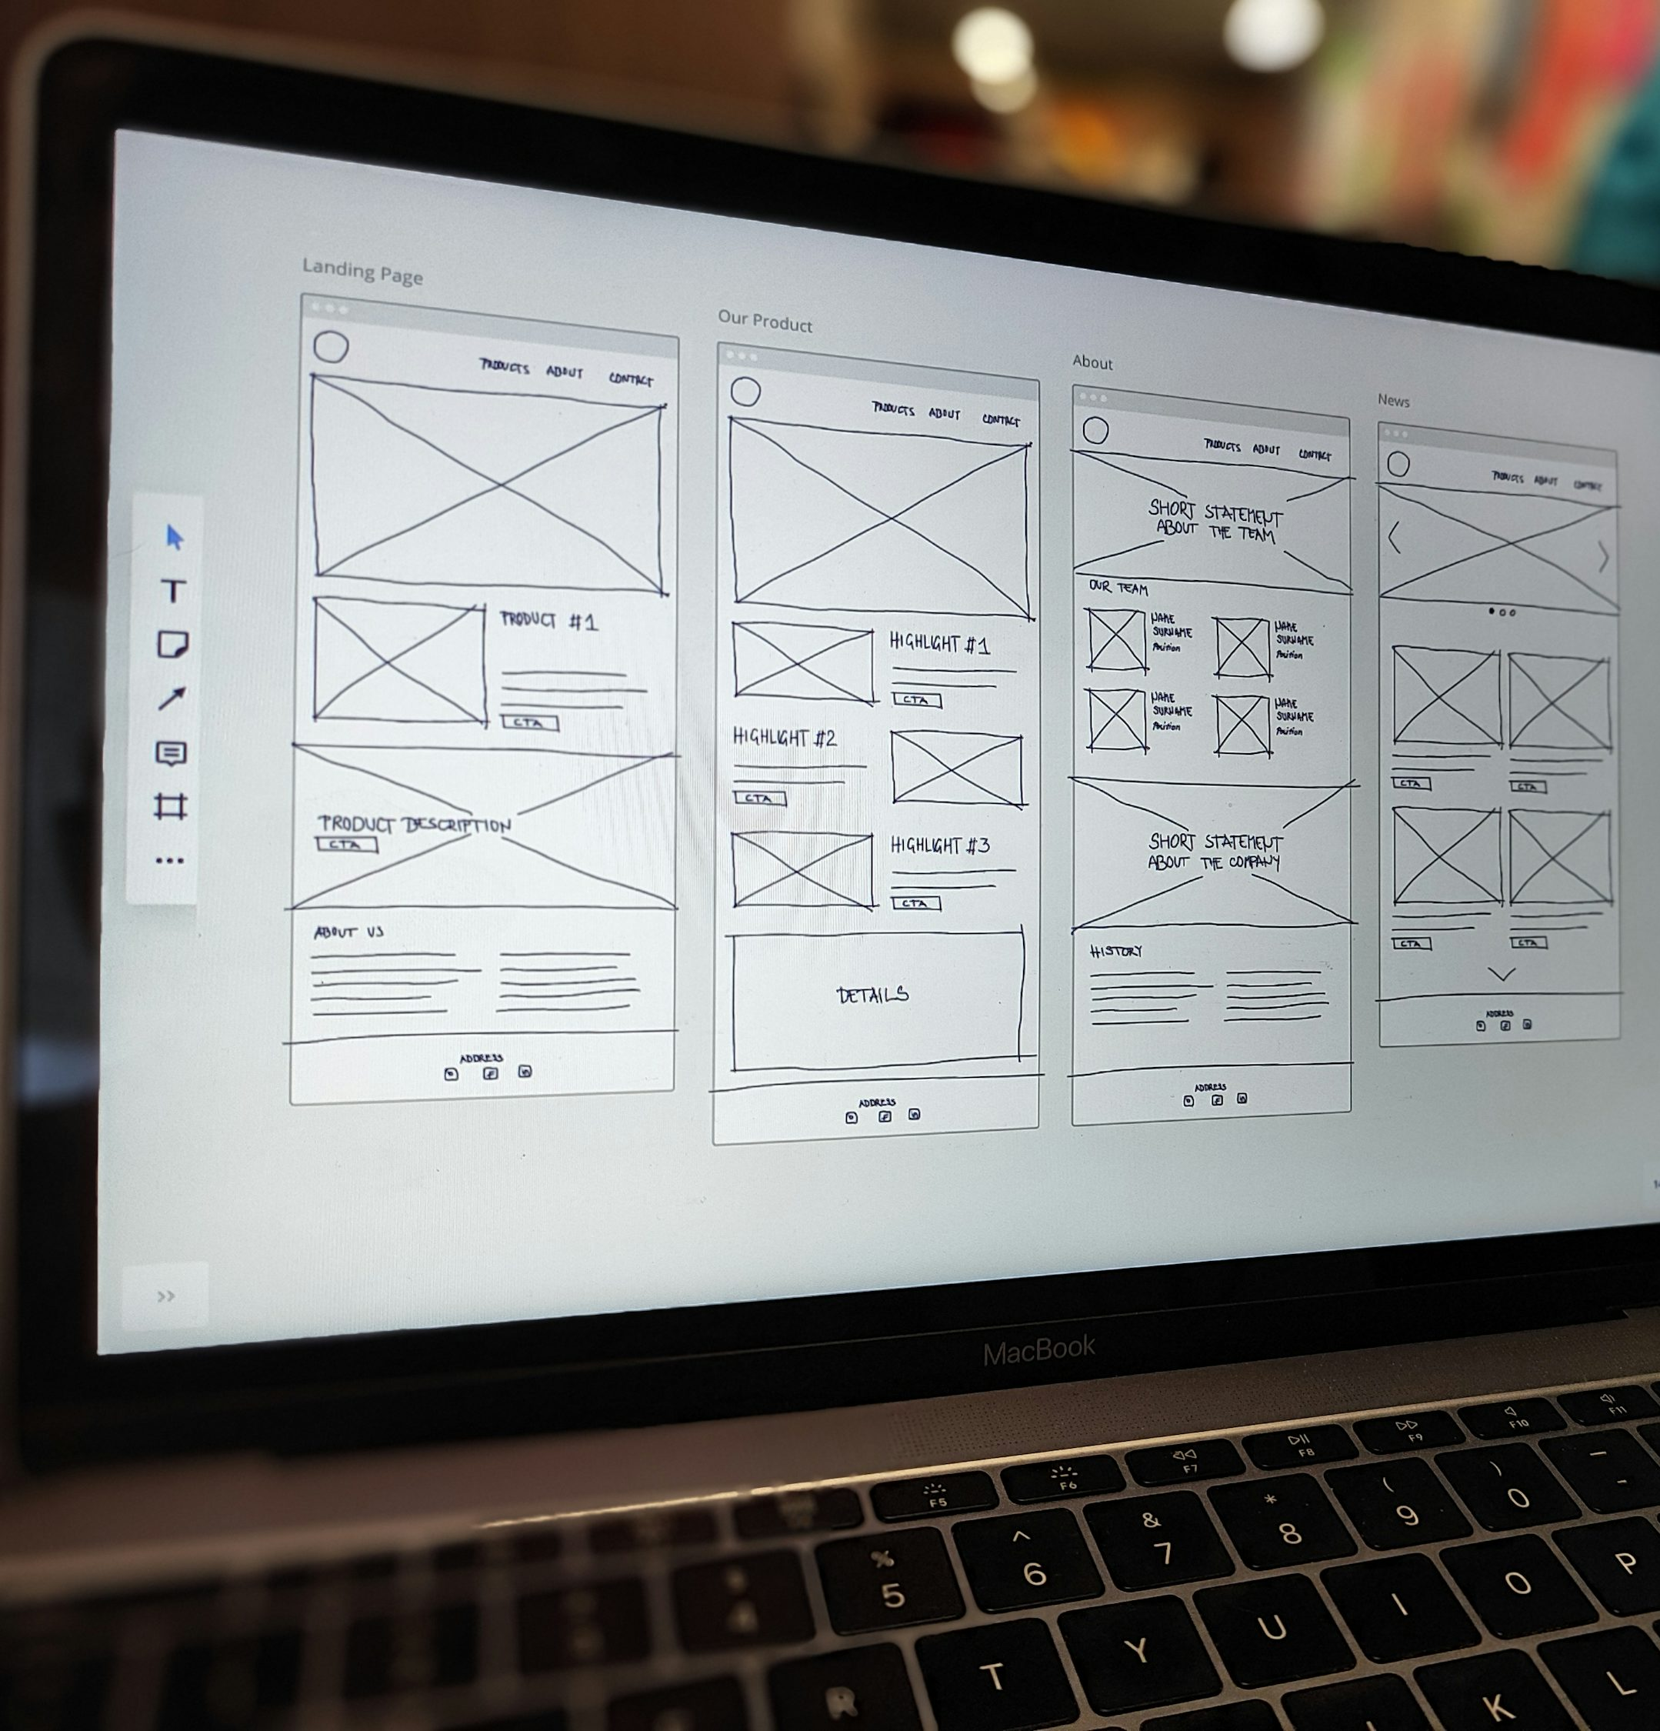
Why Design Matters
A professional website builds trust and credibility.
Good design makes your website easier to read, use and understand.
Visually clear design encourages visitors to stay longer and act.
Visitors form an opinion on your business within seconds.

Slide 5
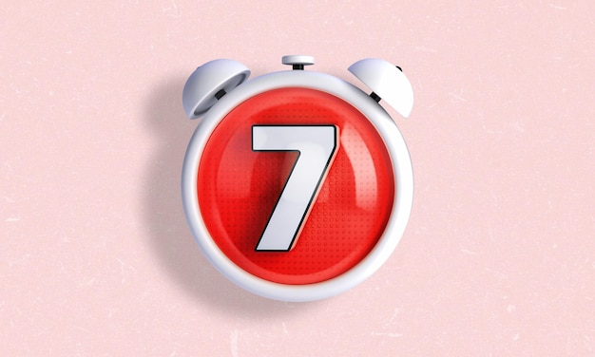
The 7 Second Rule
Your website has 7 seconds on average to answer: What do you offer?
How will it help me?
What should I do next?

Slide 6

Web Design
The basics

Slide 7
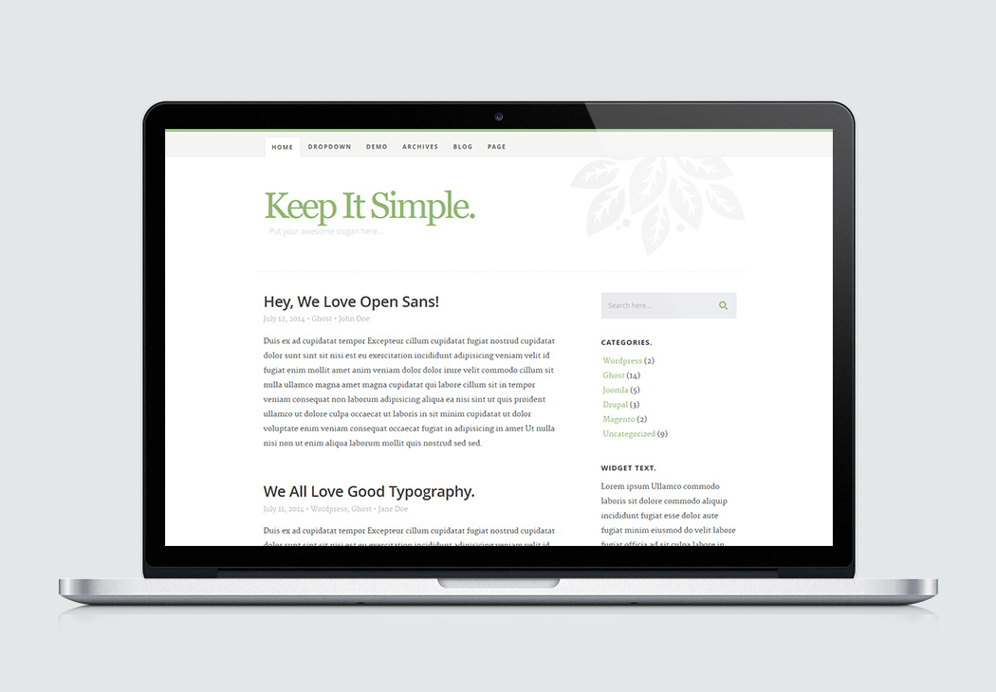
Keep It Simple
Quality over quantity
Avoid cluttered pages overloaded with content (Text, Images & videos)
White space is key, use it to make content easier to read
Put a focus on what visitors need to know
Make each page have one clear purpose
EXAMPLE
Notes:
Why it stands out:
Clean and simple layout: a bold headline, short supportive copy, and a single dominant CTA.
Minimal distractions — the design drills down to the key action the user should take.
Limited palette, strong typography, and effective whitespace help the site feel modern and focused.
What you can learn:
Even if you have many services, lead with one clear message and one clear action.
Keep navigation and options minimal so your user isn’t overwhelmed.
Use whitespace and typography to focus attention rather than fill space.

Slide 8

Colours
Choosing the right colours
Stick to 2 or 3 main colours across the website
Choose colours that reflect your brand itentity and tone
Use colour to guide attention to buttons or key areas
Use tools like coolors.co or canva.com to generate colour palettes
Notes:
Show example of www.coolors.co - hyperlinked

Slide 9
The 60, 30, 10 ‘Rule’
60% of your website should use your dominant colours
30% should use your brand colours
10 percent should use your ‘Accent’ colour
EXAMPLE
Notes:
Show example of www.coolors.co - hyperlinked

Slide 10
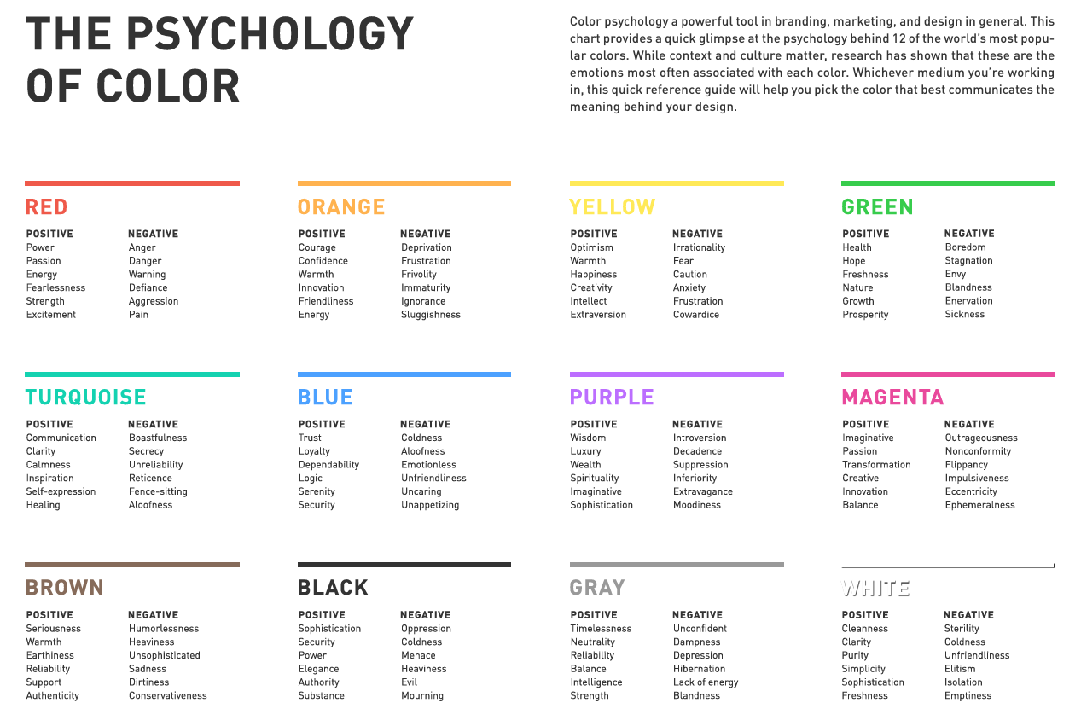
Notes:
What brands do you think of when you see these colours:?

Slide 11
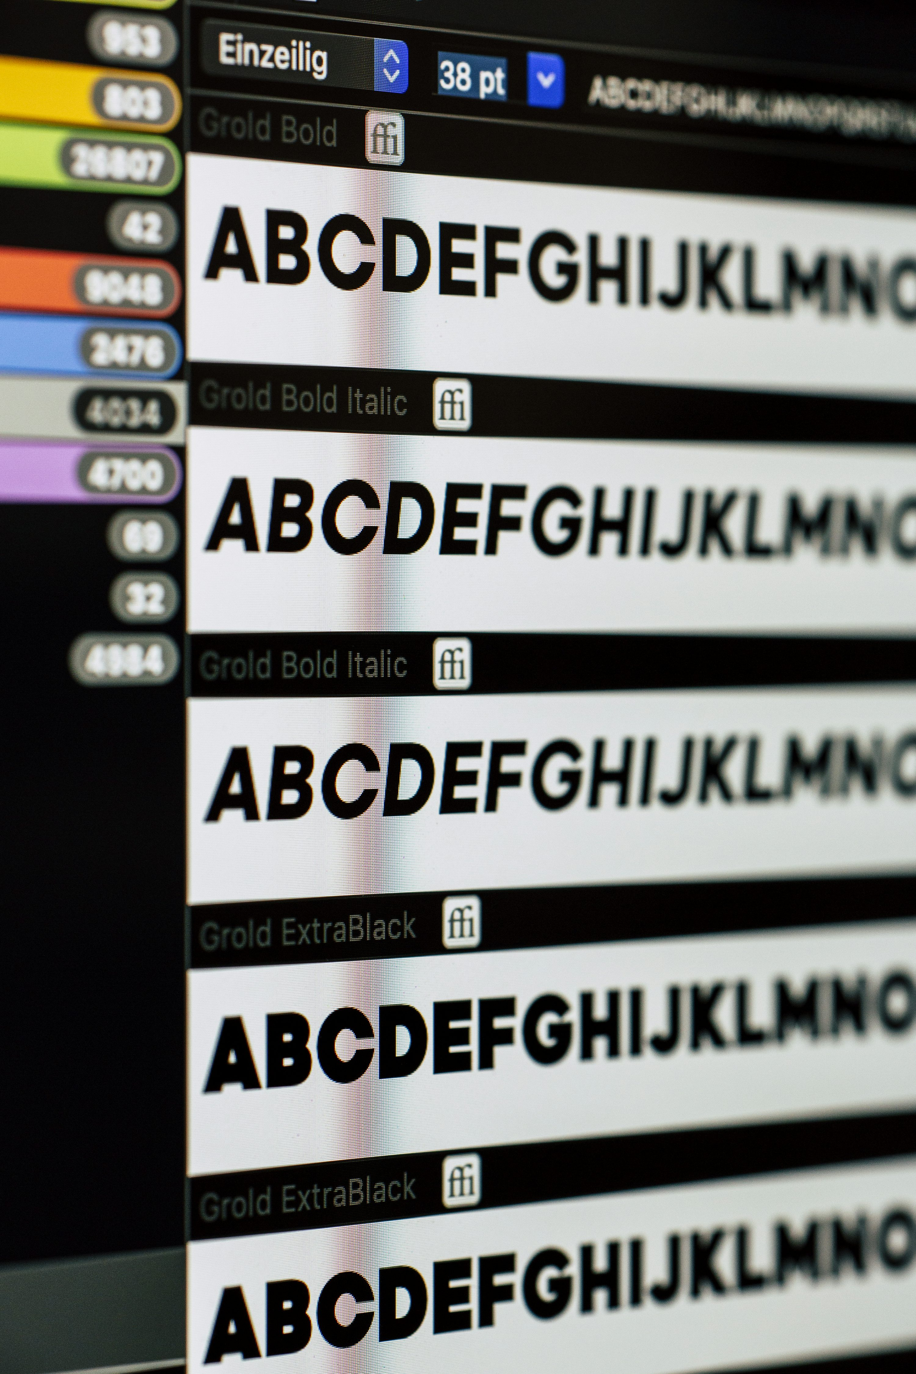




Fonts
Clear and readable fonts
Limit yourself to two fonts on your website for consistency
Choose fonts that are clear and easy to read
Use larger text for headings, and smaller for body content
Use consistent font sizes and styles, if your paragraph text is 18px on one page – it should be the same on the rest

Slide 12
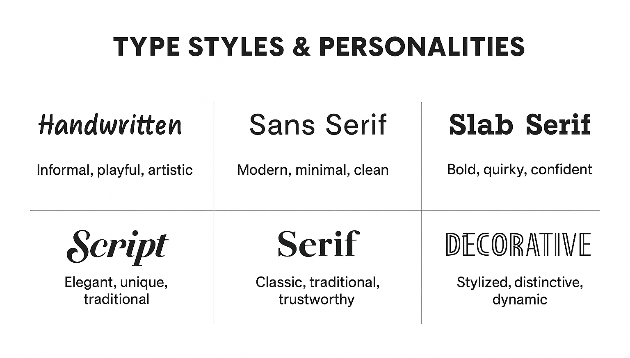

Slide 13
Structuring Text with H1, H2 & Paragraphs
H1 – Main Heading
The most important heading on a page (typically used once per page).
Clearly states the main topic or purpose.
Crucial for SEO and accessibility.
H2 – Subheadings
Used to organise content under the main heading.
Helps readers scan and understand sections easily.
Can be used multiple times for different sections.
Paragraphs (p)
Contain the main text content.
Should be concise, readable, and well-spaced.
Avoid long blocks of text, use line breaks and white space to improve readability.
Notes:
Show example of www.coolors.co - hyperlinked

Slide 14

VISUAL HIERARCHY

Slide 15
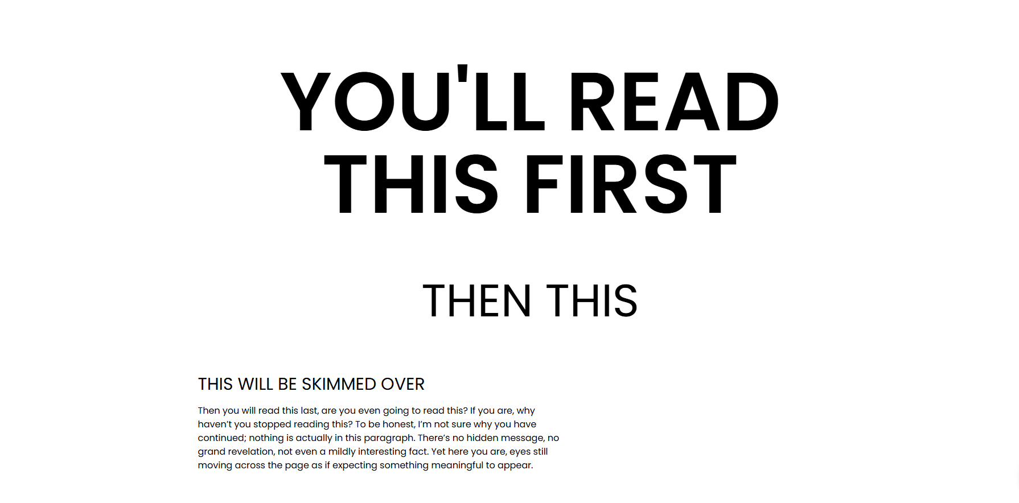

Slide 16
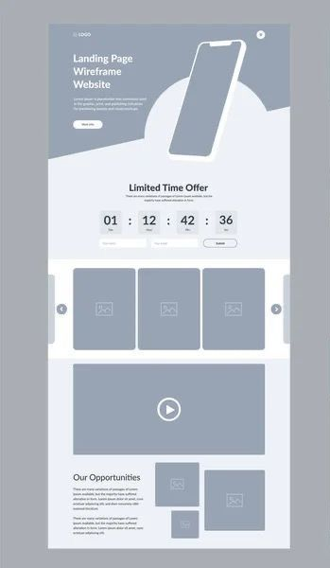


Layout
Easy to follow layout
Organise your site into clear sections
Avoid overcomplicated page designs
Guide visitors towards key actions
Place menus at the top or side where visitors would usually expect them

Slide 17
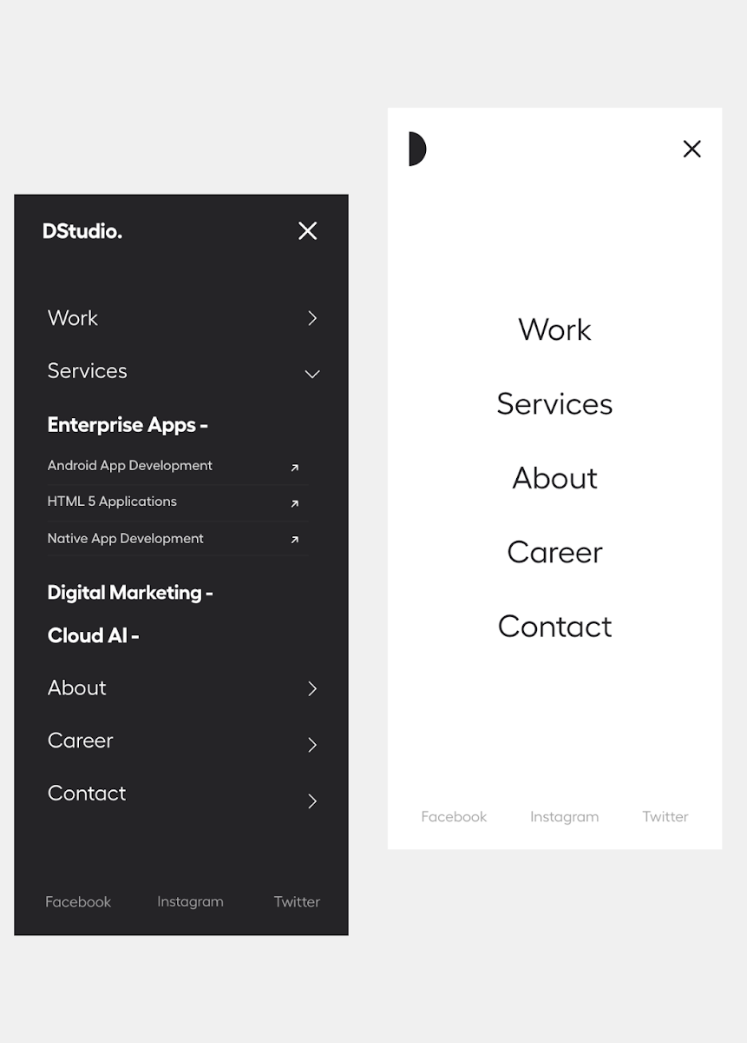


Navigation
Simple and Clear Navigation
Keep menus short and easy to understand
Use clear page titles and labels
Place the most important links at the top
Avoid too many drop down menu’s, content should be easy to find

Slide 18
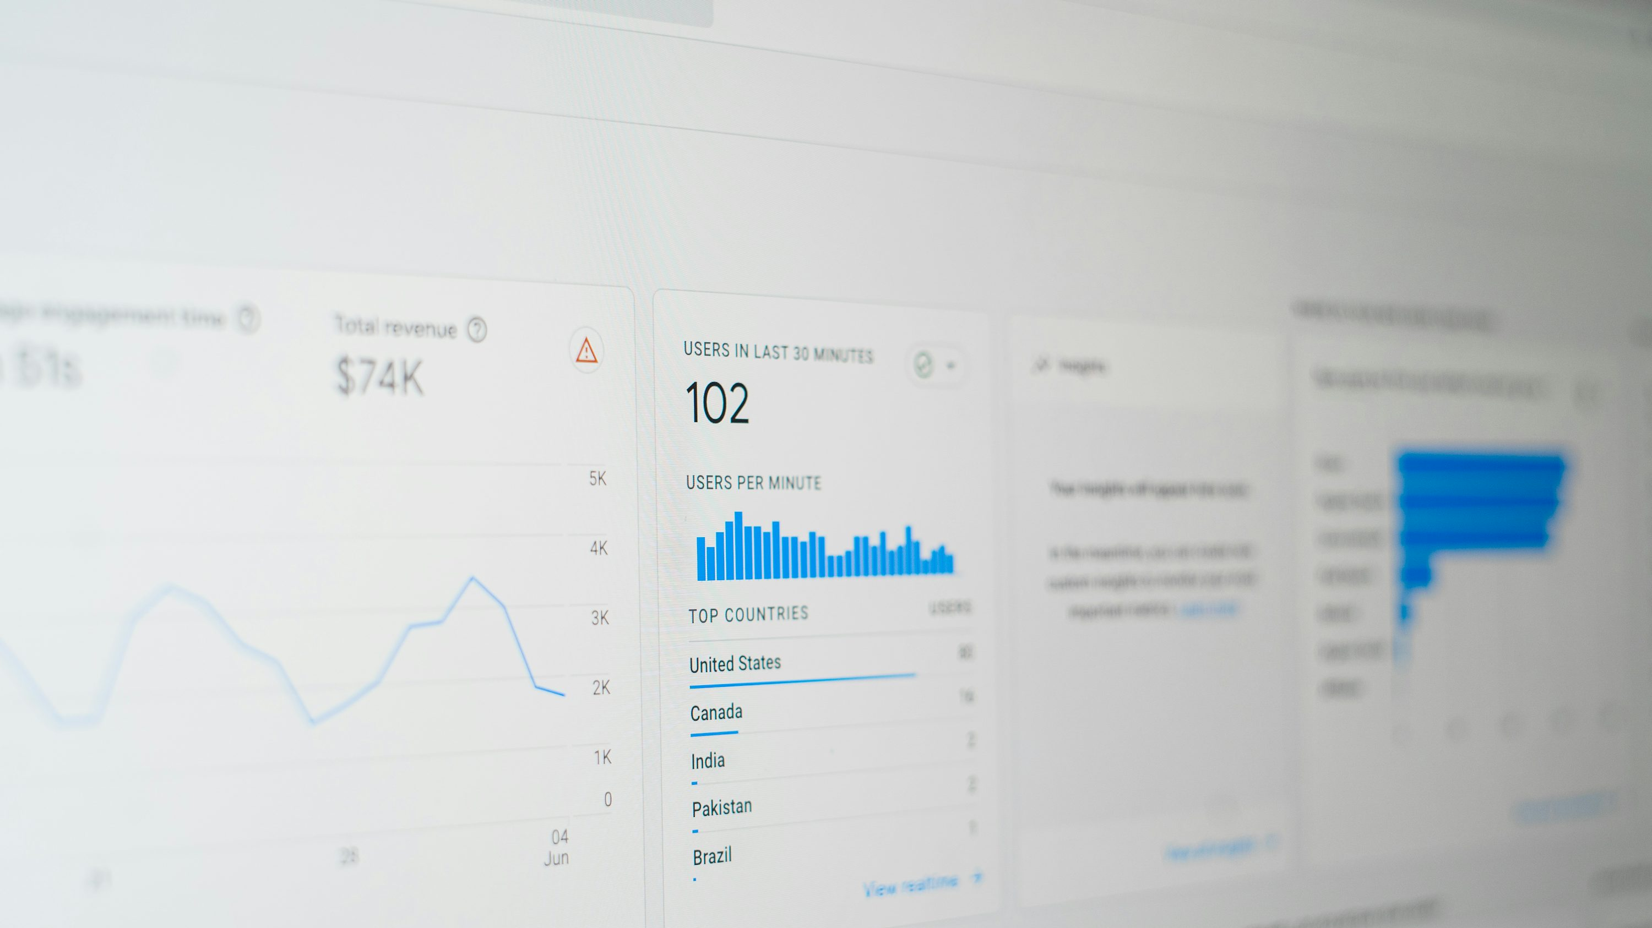
Real Websites - Good or Bad?
1
2
3
4
5
6
7

Slide 19
TESTING YOUR WEBSITE
In groups, open your current websites and grade each others from 1-5 on:
Can you tell what the website wants you to do within the first few seconds?
Is there a clear and visible button or action for visitors to take (e.g. “Buy Now,” “Contact Us,” “Book Today”)?
Is the page layout easy to follow, with information in a logical order?
Do the colours feel balanced and consistent, easy on the eyes and suitable for the business?
Does the website feel simple and focused, or cluttered and confusing?

Slide 20
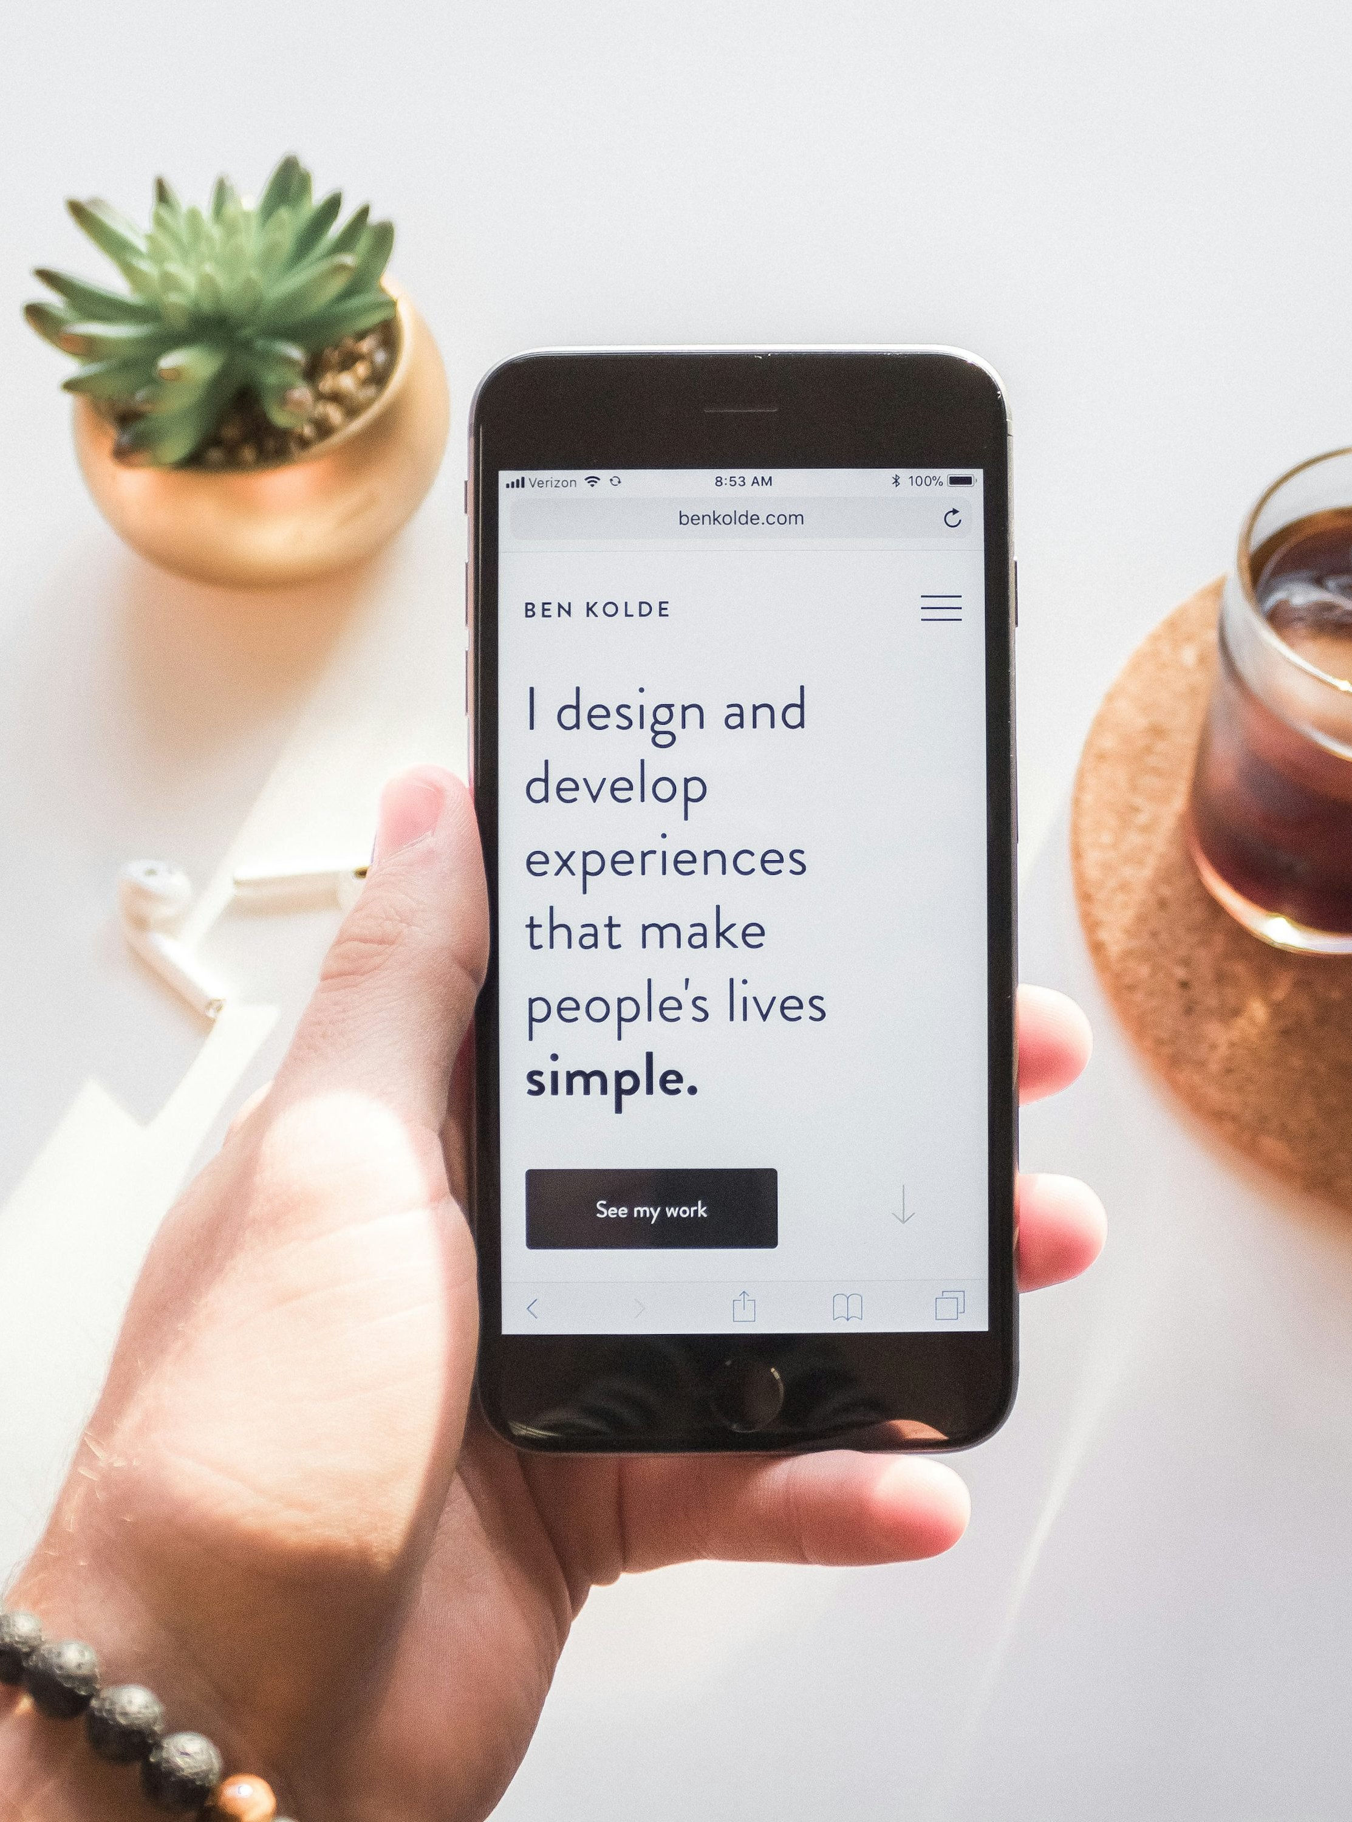
Mobile Friendly
Why Mobile Matters
Roughly 60% of all website traffic is from mobile devices
A mobile friendly website adapts to smaller screens and devices (tablet, laptop etc)
Google ranks mobile friendly sites higher on their search rankings
A bad mobile site can make your business seem outdated

Slide 21
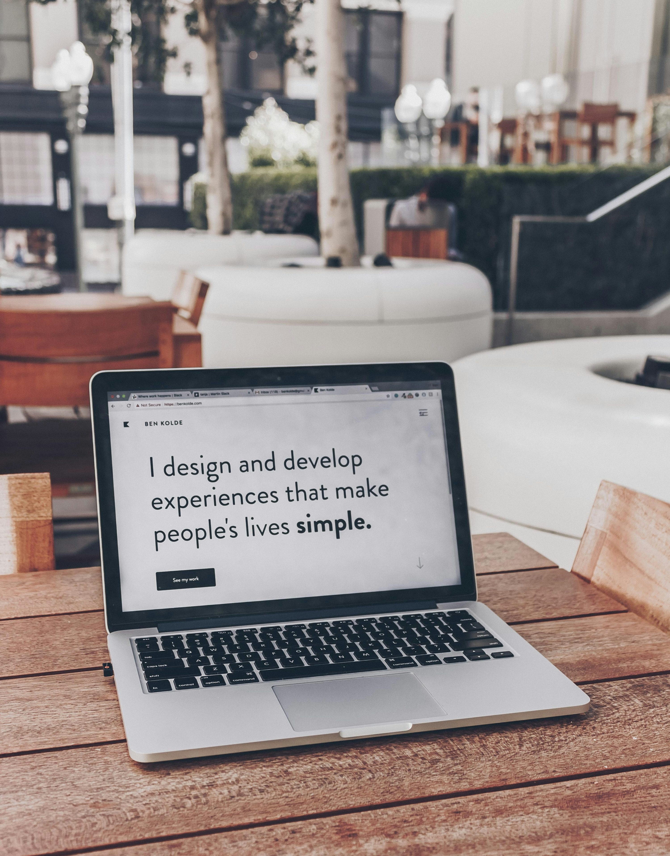
Images
Using Images Well
Choose high quality images that reflect your business well
Avoid using stock images that feel impersonal
Optimise images so pages load quickly – compress if needed
Add captions or text when useful
EXAMPLE

Slide 22
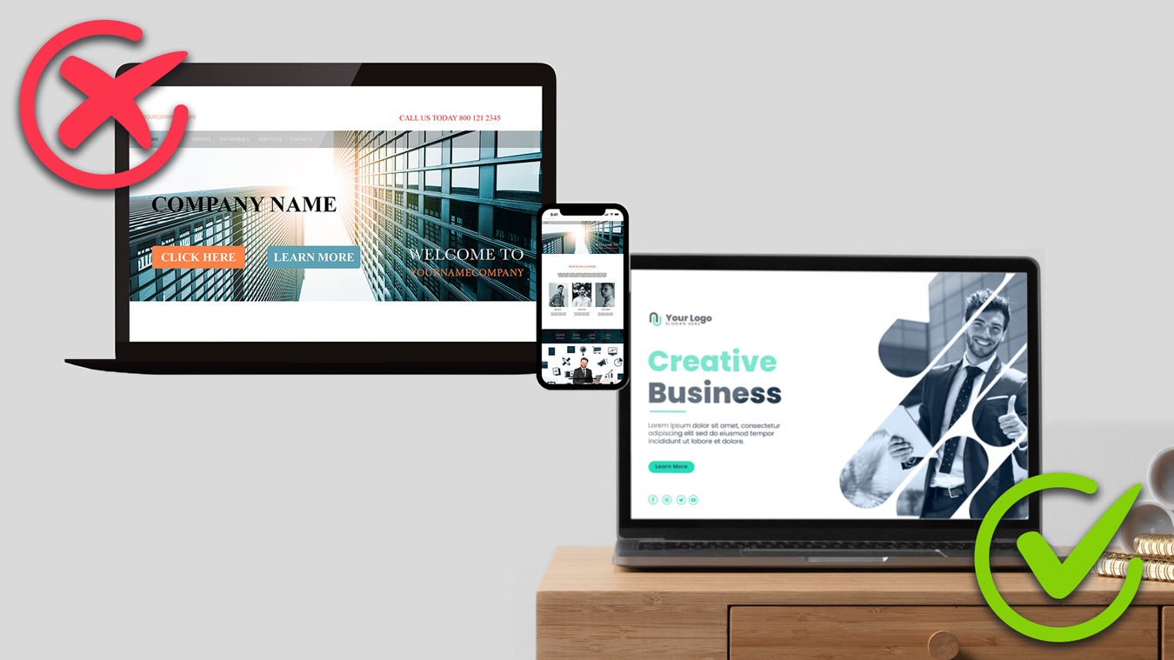
Examples

Slide 23
bit.ly/dpswebdesign
Website Mockup
Your Business: Bright Brew Coffee Co. “Local beans. Brighton vibes.”
Task: Use the whiteboard to draw a simple homepage layout, just boxes and labels. Keep it clean, clear, and focused on what matters most.
Your homepage should include:
Short intro: What makes them special
Main image: Coffee or café
Footer: Contact + social links
Review or testimonial
Header: Logo + slogan
Call to Action: “Order Beans Online”
Goal: Make it simple and easy to understand in 7 seconds. Where should the visitor’s eyes go first?

Slide 24


Slide 25





Making Your Site Accessible
Make sure there is a strong contrast between text and background
Add text descriptions for images – Alt Text
Use headings to organise content clearly
Make sure the site works with screen readers
Contrast Checker
https://wave.webaim.org/
Notes:
WAVE Web Accessibility Evaluation Tools

Slide 26
Why Some Websites Don’t Bring in Customers
Difficult Forms or Checkout
Long forms or unclear steps put people off.
Only ask for what’s needed and make it easy to finish.
Not Testing the Website
You don’t have to be a tech expert; just ask friends or family to try using your site.
Watch what confuses them and fix those parts.
Weak Call-to-Action Design
Buttons that blend into the background or aren’t visually clear get ignored.
Make CTAs stand out using colour, size, and positioning.

Slide 27
Why Some Websites Don’t Bring in Customers
No Clear Next Step:
Visitors don’t know what to click or do next.
Every page should gently guide people “Call now”, “Book a chat”, or “Buy now”.
Too Busy or Confusing Layout
If your site looks cluttered, people give up quickly.
Keep it simple, tidy, and focused on your main goal.
Missing Trust Builders
No reviews, photos, or personal touch makes it feel less reliable.
Add a friendly photo, a few real testimonials, or a local touch (like “Proudly based in Brighton”).

Slide 28
User Journey
Discovery
Engagement
Conversion
Retention
Advocacy
Notes:
Discovery
Visitor Arrives on the Website
User Explores Content
Data Collection
Engagement
User Interaction
Content Consumption
Conversion
Lead Generation
E-commerce: Purchase
Sign-ups or Subscriptions
Retention
Post-Conversion Engagement
Customer Support
Feedback Collection
Advocacy
Referral and Sharing
Reviews and Testimonials
Continuous Engagement

Slide 29

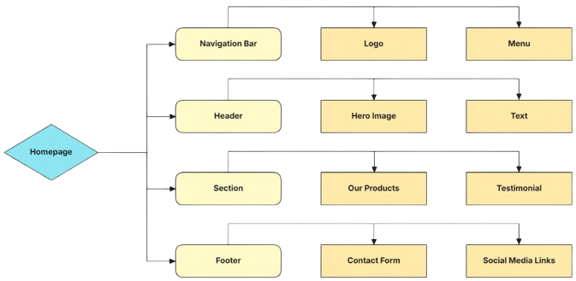
Typical Web Flow

Slide 30
Any Questions?

Slide 31
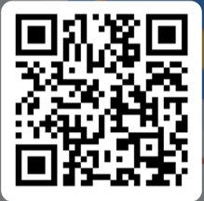
Feedback & Next Steps
Please complete the short feedback form on the QR code to the right.

