Slide 1

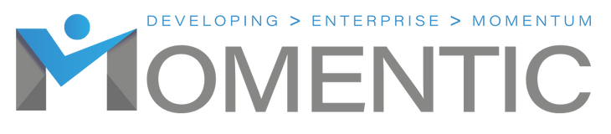
HMRC

Slide 2




Ways of Working
100% confidentiality
No multi-tasking – be fully present
Arrive on time and stay for the whole meeting
Commit to asking questions, listening & being non-judgmental
Sharing the air space
Implement agreed actions (Do what you say you will do)
Feedback at the following session
Complete all participant surveys at the end of each session
Philosophy –
“The knowledge is in the room, let’s learn from others and share”

Slide 3
What we will cover?
Your HMRC admin duties​
Your tax & money duties​
Bookkeeping that works​
VAT & Making Tax Digital​
LTD – what’s different​
​
Notes:
Presenter notes​
Workshop aim: To help sole traders (and small LTDs) understand what HMRC expects — both paperwork (admin) and money (tax).​
Key outcomes:​
Know when and how to register for Self Assessment.​
Understand deadlines: register by 5 October, file and pay by 31 January (online).​
Keep the right records for the right length of time (5+ years).​
Learn what expenses you can claim (including simplified options like mileage or flat rate for home).​
Be aware of VAT thresholds (£90,000 to register, £88,000 to deregister).​
Get a simple view of Making Tax Digital (MTD) for VAT and for Income Tax (from April 2026 onwards).​
Understand Income Tax and National Insurance as a sole trader.​
For LTDs: headline Corporation Tax rates (19% small profits, 25% main rate) and reporting cycle.​
Tone: Keep it simple. Most SMEs worry this area is scary, but today is about clarity and practical steps.​
Engagement: Quick poll — “Who here is already registered with HMRC as a sole trader? Who is still unsure?” This sets the room tone.

Slide 4

Register with HMRC- Sole Trader
“Risk is…”​
Do I need to register?​
When do I need to register by?​
How do I Register?​
​
If you are (going to be self-employed) and earn £1000+ for the tax year.​
Register by 5 October after the end of your first tax year of trading​
Create a ‘Government Gateway’ account and follow the instructions
Notes:
Presenter notes​
Workshop aim: To help sole traders (and small LTDs) understand what HMRC expects — both paperwork (admin) and money (tax).​
Key outcomes:​
Know when and how to register for Self Assessment.​
Understand deadlines: register by 5 October, file and pay by 31 January (online).​
Keep the right records for the right length of time (5+ years).​
Learn what expenses you can claim (including simplified options like mileage or flat rate for home).​
Be aware of VAT thresholds (£90,000 to register, £88,000 to deregister).​
Get a simple view of Making Tax Digital (MTD) for VAT and for Income Tax (from April 2026 onwards).​
Understand Income Tax and National Insurance as a sole trader.​
For LTDs: headline Corporation Tax rates (19% small profits, 25% main rate) and reporting cycle.​
Tone: Keep it simple. Most SMEs worry this area is scary, but today is about clarity and practical steps.​
Engagement: Quick poll — “Who here is already registered with HMRC as a sole trader? Who is still unsure?” This sets the room tone.

Slide 5
Register with HMRC- Self Assessment
Register online with HMRC and get your UTR​
• Use Government Gateway or the HMRC app​
• File returns online (HMRC portal or approved software)​
• Have your records ready: income, expenses, bank details, NI number​
• Support: GOV.UK guides, HMRC YouTube, helpline
Notes:
Overview / Snapshot​ Self Assessment isn’t just about deadlines — it’s about knowing the process and being prepared. The more organised you are, the smoother it goes. Let’s break down the key admin steps and tools you can use.​
Registering with HMRC​
Go to GOV.UK → “Register for Self Assessment and Class 2 National Insurance.”​
Provide your National Insurance number, start date, type of business, and personal details.​
HMRC will post your Unique Taxpayer Reference (UTR) within about 10 days.​
You also create or log into your Government Gateway account.​
HMRC app​
HMRC has a free app (iOS and Android).​
You can:​ • View your tax return deadlines.​ • Check what you owe.​ • Make payments directly.​ • See correspondence from HMRC.​
It’s a handy way to keep on top of things without always logging into the website.​
What you need before filing​
National Insurance number.​
UTR and Government Gateway login.​
Records of income (invoices, sales).​
Records of expenses (receipts, mileage, bills).​
Bank statements for cross-checking.​
Other income info (employment, dividends, rental).​
Reliefs or allowances you’re claiming (e.g. working from home).​
Filing your return​
You can use:​ • HMRC’s online Self Assessment service (sufficient for most sole traders).​ • Commercial software if you want more features (e.g. auto-upload of expenses).​
You can also upload and pay via the HMRC app, which makes the process quicker.​
Learning resources​
HMRC runs an official YouTube channel with short “How to” videos on completing returns, registering, and using the online system.​
GOV.UK has detailed step-by-step guides.​
There’s also the Self Assessment helpline for queries (best to call outside peak January times).

Slide 6
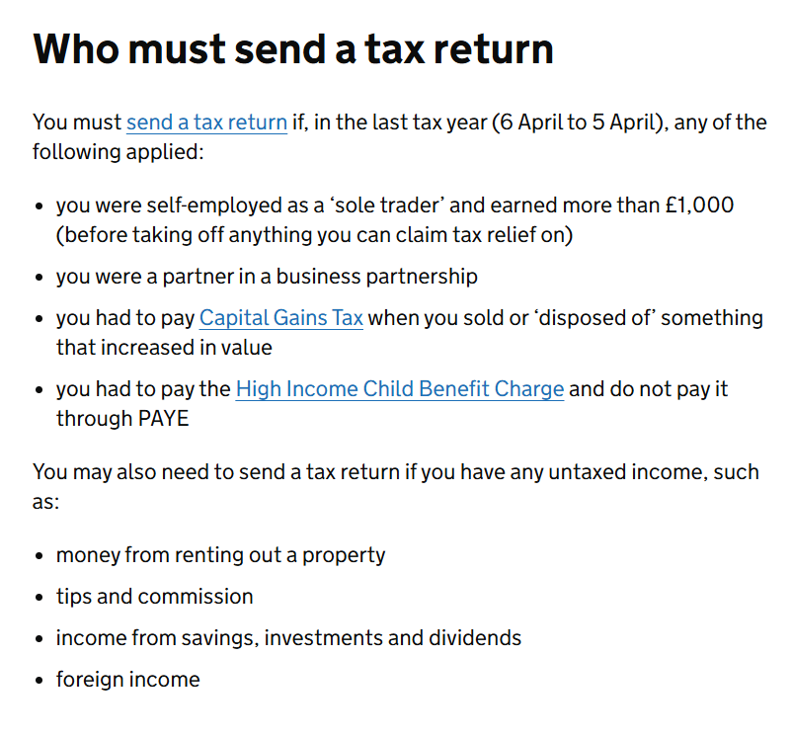
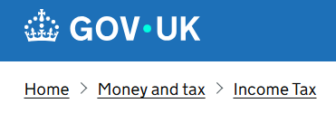
Register with HMRC- Self Assessment
Register online with HMRC and get your UTR​
• Use Government Gateway or the HMRC app​
• File returns online (HMRC portal or approved software)​
• Have your records ready: income, expenses, bank details, NI number​
• Support: GOV.UK guides, HMRC YouTube, helpline
Notes:
Overview / Snapshot​ Self Assessment isn’t just about deadlines — it’s about knowing the process and being prepared. The more organised you are, the smoother it goes. Let’s break down the key admin steps and tools you can use.​
Registering with HMRC​
Go to GOV.UK → “Register for Self Assessment and Class 2 National Insurance.”​
Provide your National Insurance number, start date, type of business, and personal details.​
HMRC will post your Unique Taxpayer Reference (UTR) within about 10 days.​
You also create or log into your Government Gateway account.​
HMRC app​
HMRC has a free app (iOS and Android).​
You can:​ • View your tax return deadlines.​ • Check what you owe.​ • Make payments directly.​ • See correspondence from HMRC.​
It’s a handy way to keep on top of things without always logging into the website.​
What you need before filing​
National Insurance number.​
UTR and Government Gateway login.​
Records of income (invoices, sales).​
Records of expenses (receipts, mileage, bills).​
Bank statements for cross-checking.​
Other income info (employment, dividends, rental).​
Reliefs or allowances you’re claiming (e.g. working from home).​
Filing your return​
You can use:​ • HMRC’s online Self Assessment service (sufficient for most sole traders).​ • Commercial software if you want more features (e.g. auto-upload of expenses).​
You can also upload and pay via the HMRC app, which makes the process quicker.​
Learning resources​
HMRC runs an official YouTube channel with short “How to” videos on completing returns, registering, and using the online system.​
GOV.UK has detailed step-by-step guides.​
There’s also the Self Assessment helpline for queries (best to call outside peak January times).

Slide 7
Register with HMRC- Limited Company
How do your administrative and financial obligations differ when it comes to the HMRC and a limited company (ltd)?

Slide 8

HMRC Obligations for a Limited Company- Admin
• Register with Companies House and HMRC (Corporation Tax)​
• File annual accounts with Companies House​
• Submit Company Tax Return (CT600) to HMRC​
• Maintain statutory records for 6 years​
• Operate PAYE if paying salaries (incl. directors)
Notes:
Running a Limited Company brings a heavier administrative burden than being a sole trader. HMRC and Companies House treat the company as a separate legal entity, which means double reporting and stricter rules. As a director, you are responsible for ensuring the company meets these obligations — even if you use an accountant.
Registering the company
When you set up, you must register the company with Companies House. This includes providing company name, registered office, directors, and shareholdings.
HMRC is automatically notified, but you must still register for Corporation Tax within 3 months of starting to trade.
Failing to register can mean penalties and interest later.
Annual accounts to Companies House
Each year, a company must file statutory accounts with Companies House.
For micro and small companies, these can be simplified versions, but they are still a legal requirement.
These accounts are publicly available, which means clients, competitors, and lenders can look them up.
Example: A local café runs as a Ltd company. Anyone can search Companies House and see their accounts, which shows turnover and profits.
Company Tax Return (CT600) to HMRC
Separately from Companies House, you must file a Company Tax Return with HMRC.
This includes full accounts, detailed profit calculations, and the Corporation Tax owed.
This return is usually due 12 months after the end of your accounting period.
Record keeping (6 years)
Companies must keep accounting records for 6 years: invoices, receipts, payroll, bank statements, contracts, and statutory records (register of directors, shareholders, board minutes).
HMRC or Companies House can request these for inspection.
Pitfall: many small companies forget to keep dividend vouchers or board minutes, but these are legally required.
PAYE if paying salaries
If the company pays staff or directors a salary, it must register as an employer with HMRC.
You then run payroll under the PAYE system, deducting Income Tax and NI, and reporting via Real Time Information (RTI) every pay cycle.
Even if you’re the only person in the company, PAYE applies if you pay yourself a salary.
Pitfalls and penalties
Missing deadlines = automatic penalties (late filing at Companies House, or late returns with HMRC).
Not registering as an employer when paying salaries leads to fines.
Forgetting statutory records (e.g. directors’ decisions) can cause compliance issues if HMRC investigates.
Summary Administrative duties for Limited Companies include dual registration, filing accounts and tax returns, keeping records for 6 years, and complying with PAYE. Unlike a sole trader, you cannot separate yourself from the company’s paperwork. The company has obligations of its own, and as a director, you’re legally responsible for meeting them.

Slide 9
HMRC Obligations for a Limited Company- Finance
Pay Corporation Tax on profits​
• 19% if profits ≤ £50,000​
• 25% if profits ≥ £250,000​
• Marginal relief for profits between £50,001–£250,000​
• Directors/shareholders pay Income Tax & Dividend Tax separately
Notes:
Marginal Relief provides a gradual increase in Corporation Tax rate between the small profits rate and the main rate — this allows you to reduce your rate from the 25% main rate.
Overview / Snapshot Unlike sole traders, who pay Income Tax and NI directly on their profits, Limited Companies pay Corporation Tax first, then directors/shareholders are taxed again when they take money out. This “double layer” is the key difference between a sole trader and a Ltd company.
Corporation Tax
Corporation Tax applies to company profits after allowable business expenses.
Rates from April 2023 (still current for 2024/25): • 19% if profits are £50,000 or less (small profits rate). • 25% if profits are £250,000 or more (main rate). • Between these, marginal relief gives a tapered effective rate.
Example: A company makes £40,000 profit. Corporation Tax at 19% = £7,600.
Payment deadlines
Corporation Tax is due 9 months and 1 day after the end of the accounting period.
Example: If your year ends 31 March, payment is due by 1 January.
Late payment leads to interest charges and potential penalties.
Separating company money and personal money
One of the most common mistakes is thinking “company money is my money.”
In reality, company funds belong to the company.
Money can only leave as: • Salary – through PAYE (subject to Income Tax and NI). • Dividends – declared from post-tax profits (subject to dividend tax). • Director’s loan – repayable and subject to special tax rules if not repaid.

Slide 10
HMRC Obligations for a Limited Company- Directors
• Must file Self Assessment if paid via dividends or benefits​
• Salary taxed through PAYE like any employee​
• Dividends taxed separately at 8.75% / 33.75% / 39.35%​
• Keep records of dividends and directors’ loans​
• Responsible for ensuring the company meets obligations
Notes:
Overview / Snapshot Directors wear two hats: they manage the company’s obligations, but they also have personal HMRC obligations. It’s easy to forget that money you take home has its own tax rules, separate from Corporation Tax.
Self Assessment
Directors must file a Self Assessment tax return if they receive dividends, expense benefits, or any untaxed income.
Even if salary is processed under PAYE, Self Assessment is usually required to declare dividends.
Example: Director pays themselves £9,000 salary (PAYE, no tax due), plus £15,000 in dividends. The dividends must be reported in Self Assessment and dividend tax is due.
Salary via PAYE
Directors are office holders and if paid a salary, this is processed under PAYE.
The company deducts Income Tax and NIC each pay cycle and reports via RTI.
At year end, the director receives a P60 like any employee.
Dividends
Dividends are taxed separately from salary. For 2024/25: • First £500 is covered by the Dividend Allowance (tax-free). • Anything above this is taxed at 8.75% (basic rate), 33.75% (higher rate), or 39.35% (additional rate).
Dividends must be paid only from post-tax profits and must be supported by paperwork (board minutes + dividend vouchers).
Example: £20,000 in dividends. First £500 is tax-free, remaining £19,500 taxed at dividend rates.
Director’s loans
If you take money out of the company that isn’t salary or dividends, it’s a Director’s loan.
If the loan is not repaid within 9 months after year end, the company pays tax at 33.75% under section 455.
When repaid, this tax can be reclaimed, but it creates cash flow issues.
Personal responsibility
Directors are personally responsible for ensuring the company complies with tax laws, even if they use an accountant.
Failing to file or pay Corporation Tax can lead to penalties, and directors can face disqualification in serious cases.
Pitfalls
Forgetting to file Self Assessment for dividends.
Treating dividends as salary (they are different and have different tax treatments).
Taking money as a “loan” without recording or repaying it.
Assuming “my accountant will deal with it” — HMRC holds directors accountable.
Summary Directors must manage their own tax affairs alongside the company’s. Salary goes through PAYE, dividends are declared via Self Assessment, and loans must be tracked. Paperwork matters — minutes, vouchers, and accurate records protect you. Ultimately, directors are personally responsible for ensuring the company pays the right taxes.
Personal taxation for directors/shareholders
Dividends are taxed at: • 8.75% (basic rate) • 33.75% (higher rate) • 39.35% (additional rate)
There is a Dividend Allowance (£500 for 2024/25), after which tax applies.
Example: A director takes £9,000 salary and £20,000 dividends. Salary is below the personal allowance, so no Income Tax or NIC. But dividends above the allowance are taxed via Self Assessment.
Pitfalls
Paying dividends illegally (without post-tax profits available).
Forgetting to save for Corporation Tax — treating it like personal money.
Ignoring director’s loans (if left unpaid 9 months after year-end, s.455 tax applies at 33.75%).
Summary Finance obligations for Ltd companies include paying Corporation Tax on profits at 19–25%, then managing personal tax when extracting funds. This creates more flexibility than a sole trader but adds complexity. Understanding the separation between company and personal money is critical.

Slide 11


Slide 12
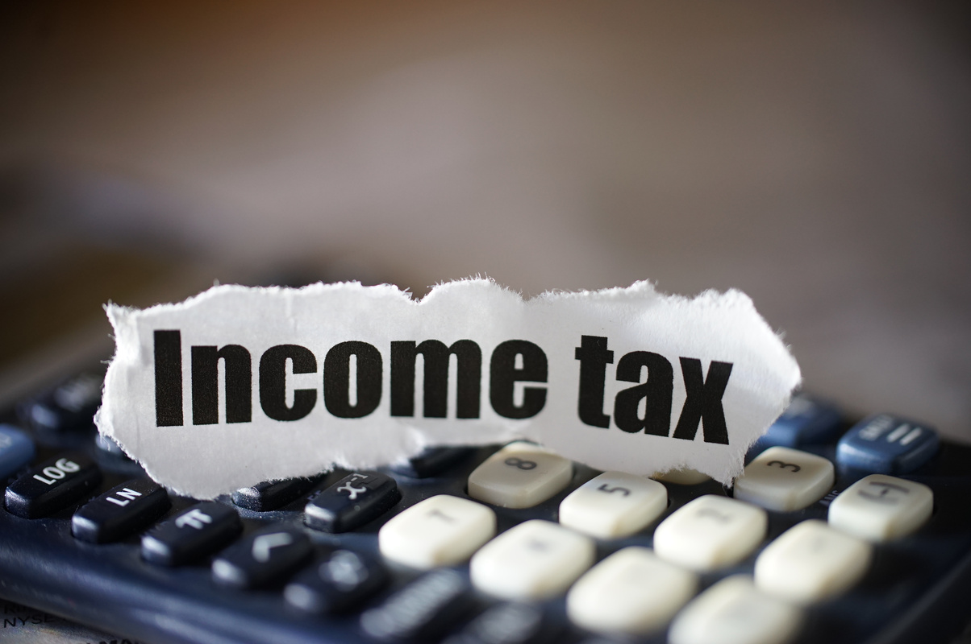
Paying Income Tax and National Insurance
Sole Trader:​
✅ Payments on account (Jan & July)​
✅ Deadline for payment: 31 January​
⚠ You = Even if you didn’t have to financially, always worth considering voluntarily paying your NIC (National Insurance Contributions)​

Slide 13
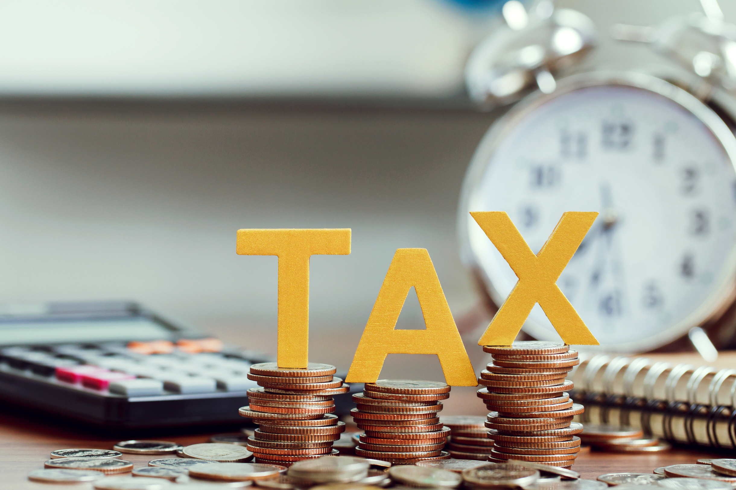
Income Tax - What Are My Administrative and Financial Obligations?

Slide 14
Income Tax -The Red Tape
Register with HMRC by 5 October if you need to file​
File a Self Assessment tax return each year​
Deadlines 31 Oct paper, 31 Jan online​
Keep business records for 5 years after filing deadline​
You can file early and still pay by 31 January
Notes:
Overview / Snapshot
Your admin duties are simple but time critical.
Register by 5 October after your first trading year.
File annually: 31 October (paper), 31 January (online).
Keep records for 5 years after the filing deadline.
You can file early from April and still pay in January.
Do I need to register and when?
Problem: Many leave it too late → no UTR → cannot file.
Solution: Register by 5 October after your first tax year of trading.
Example: Started July 2024 (tax year 2024/25) → register by 5 Oct 2025.
What are the filing and payment dates?
Problem: People confuse the dates.
Solution:
Paper = 31 Oct
Online = 31 Jan
Payment also due 31 Jan (plus 31 July if payments on account apply).
Example: 2024/25 return filed online by 31 Jan 2026.
Can I pay through PAYE code?
Problem: Some employees don’t know this option.
Solution: If bill is <£3,000 and you’re on PAYE, HMRC can collect via code if you file by 30 Dec online (or 31 Oct paper).
How long must I keep records?
Problem: People throw away receipts too soon.
Solution: Keep records 5 years after 31 Jan filing deadline.
Example: File 2024/25 return by 31 Jan 2026 → keep until Jan 2031.
Why file early?
Problem: Leaving it to Jan = stress + no time to fix errors.
Solution: File early from April → you know your bill and can budget. Payment still due by 31 Jan.
Pitfalls
Waiting until January to register or file.
Sending paper returns after 31 Oct.
Not keeping records long enough.
Summary of Slide 5a Admin for Income Tax means register, file, and keep records on time. Anchor dates: 5 Oct, 31 Oct, 31 Jan. Filing early gives peace of mind.
Overview / Snapshot Income Tax is the main element of a sole trader’s tax bill. It is based on your business profits after expenses, not on turnover. Every individual gets a Personal Allowance (£12,570 in 2024/25) before tax starts. Beyond that, tax is charged in bands: 20% (basic), 40% (higher), and 45% (additional). Filing and paying on time is key, and for many, payments on account mean there is also a second instalment due in July.
“Do I pay tax on all my sales?”
Problem: Some confuse turnover (total sales) with profit.
Solution: You only pay Income Tax on profits — income minus allowable expenses.
Example: A tutor earns £20,000 in fees but spends £5,000 on travel and materials. Tax is due on £15,000 profit, not the full £20,000.
“How does the Personal Allowance work?”
Problem: Some don’t realise the first part of their profit is tax-free.
Solution: Everyone gets a Personal Allowance (£12,570 in 2024/25). Tax starts above this threshold.
Example: Profit £14,000 → only £1,430 is taxed at 20%.
“What are the tax bands for 2024/25?”
Problem: Many think they’ll suddenly lose all their profit if they step into the next band.
Solution: Tax is progressive — only the slice above each threshold is taxed at the higher rate. • 20% on £12,571–£50,270 • 40% on £50,271–£125,140 • 45% on anything above £125,140
Example: Profit £55,000 → pay 20% up to £50,270, then 40% only on £4,730.
“What are payments on account?”
Problem: Many think their July bill is a penalty, not an advance.
Solution: If your bill is over £1,000 and less than 80% was collected at source, you must pay advance instalments for the next year. These are due 31 January and 31 July.
Example: 2024/25 tax bill = £3,000. Pay £3,000 in Jan 2026 plus £1,500 on account. Another £1,500 due July 2026. The balance is settled in Jan 2027.
“What happens if I miss the deadline?”
Problem: Some wait and hope HMRC won’t notice.
Solution: Filing late triggers penalties. Paying late adds interest. File early to know your bill, even if you plan to pay in January.
Example: Filing two months late = £100 penalty + daily fines if past 3 months.
Engagement activity Pose the question: “If you made £18,000 profit, how much would be taxed at 20% after your allowance?” Ask the group to work it out (Answer: £5,430 × 20% = £1,086).
Summary of Slide 5a Income Tax for sole traders is based on profit, not turnover. The first £12,570 is tax-free, with tax charged in slices above that. Many will also face payments on account in January and July. By understanding the bands, using your allowance, and filing early, you can avoid surprises and manage cash flow effectively.

Slide 15
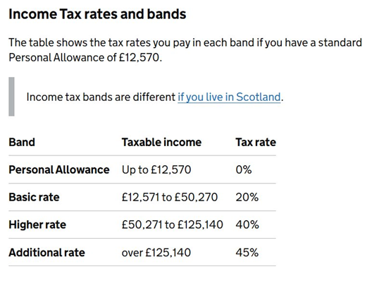
Income Tax -The Numbers
Tax is on profit, not sales​
First £12,570 profit is tax free in 2024 to 2025​
Tax bands 20%, 40%, 45% percent apply above thresholds​
Payments on account may apply if tax over £1,000​
Use reliefs and allowances to reduce tax liabilities
Notes:
Overview / Snapshot
Income Tax is on profit, not turnover.
Everyone gets a Personal Allowance of £12,570 (2024/25).
Tax is progressive → 20%, 40%, 45%.
Payments on account spread tax into Jan & July.
Reliefs and allowances can lower your bill.
Do I pay on sales or profit?
Problem: People fear tax on all income.
Solution: Tax only on profit (income – expenses).
Example: £20,000 sales – £5,000 expenses = £15,000 taxable.
What are the tax-free allowances?
Solution: £12,570 Personal Allowance. Above this = taxed.
Example: £14,000 profit → £1,430 taxed at 20%.
Note: £1,000 trading allowance for very small income streams.
How do the tax bands work?
Problem: People think one pound over means all taxed higher.
Solution: Progressive system — only the slice above threshold is higher.
Example: £55,000 profit → 20% up to £50,270, then 40% on £4,730.
What are payments on account?
Problem: July bills look like penalties.
Solution: Advance instalments if tax > £1,000 and <80% deducted at source.
Example: £3,000 bill → £3,000 in Jan 2026 + £1,500 Jan + £1,500 July (on account for 25/26). Balance in Jan 2027.
Which reliefs and allowances reduce the bill?
Trading allowance (£1,000 small income).
Marriage allowance (transfer spare allowance).
Loss relief (offset losses).
Simplified expenses (mileage, home working).
Pension contributions & Gift Aid donations (reduce taxable income).
Worked examples for clarity
Profit £15,000 → tax = £486.
Profit £40,000 → tax = £5,486.
Profit £60,000 → mix of 20% and 40%. Use HMRC calculator to show.
Pitfalls
Confusing turnover and profit.
Ignoring payments on account → cash squeeze in July.
Missing reliefs → overpaying tax.
Summary of Slide 5b Income Tax is profit-based, progressive, and predictable if you plan. Allowances, reliefs, and payments on account can shape your bill. Budget monthly and you avoid surprises.

Slide 16

National Insurance
What Are My Administrative and Financial Obligations?

Slide 17
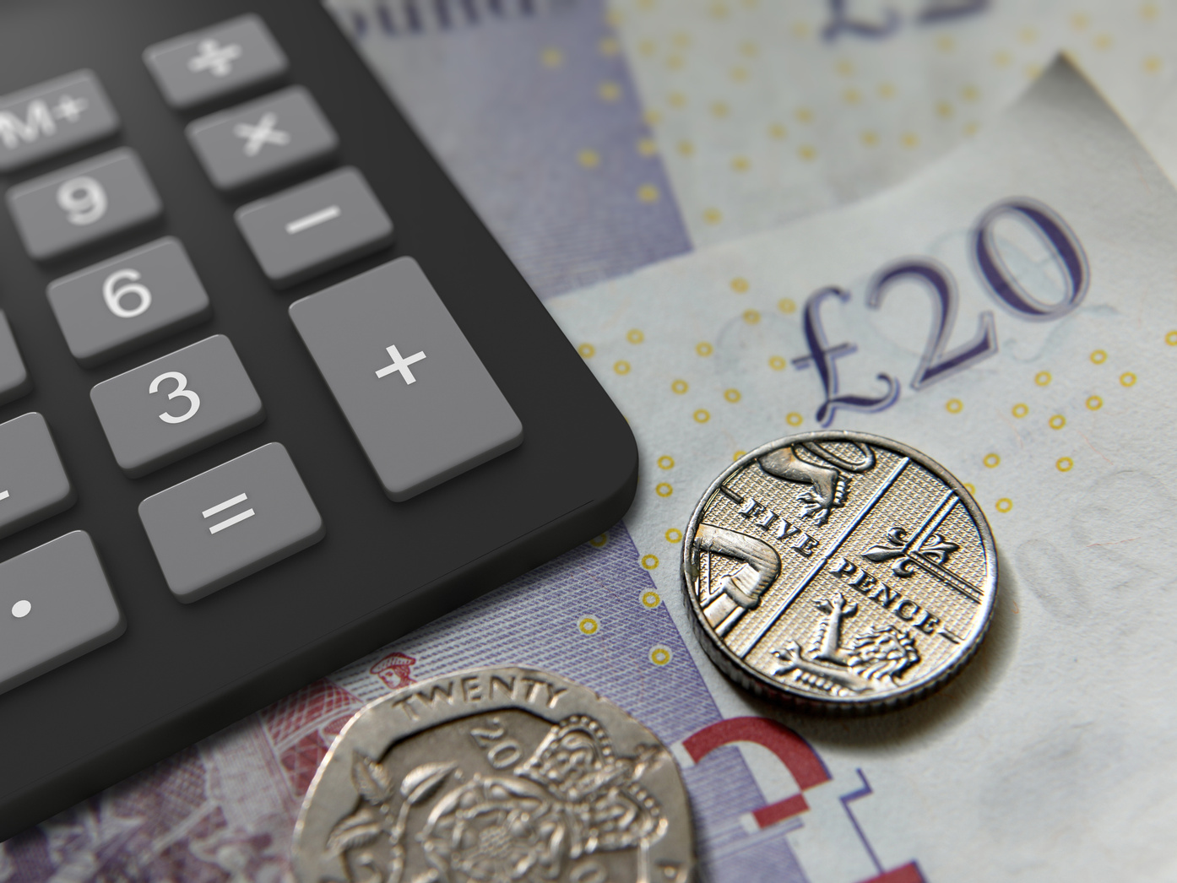
National Insurance Contributions > The Red Tape
Sole traders pay Class 2 and Class 4 NI​
Class 2 abolished from April 2024 (credits still apply)​
Class 4 paid through Self Assessment with tax​
Voluntary Class 2 keeps State Pension record if profits are low​
Records must show profits to calculate NI correctly
Notes:
Overview / Snapshot
Sole traders have separate National Insurance (NI) duties from employees.
From April 2024, Class 2 NI is abolished for most, but NI credits still protect your State Pension.
Class 4 NI remains and is collected via Self Assessment alongside tax.
Voluntary Class 2 contributions are still available if profits are too low to qualify.
Which NI classes apply to sole traders?
Problem: Many assume NI is only for employees.
Solution: Sole traders pay Class 2 (now credits) and Class 4 (main self-employed NI).
How is Class 2 changing from April 2024?
Problem: Confusion about whether it still exists.
Solution: From April 2024, you no longer pay Class 2 if your profits are above £6,725 — but you still receive credits towards State Pension.
Example: Profit £9,000 → no Class 2 payment, but still credited for State Pension.
What if my profits are below £6,725?
Problem: Low-profit traders risk losing pension entitlement.
Solution: You can pay voluntary Class 2 NI to keep your NI record complete.
Example: Profit £5,000 → pay voluntary Class 2 (around £3.45/week) to protect pension years.
How is Class 4 paid?
Problem: Some expect separate bills.
Solution: Class 4 NI is calculated and collected with Income Tax through Self Assessment.
Pitfalls
Assuming Class 2 is gone and no credits are needed → missing out on State Pension years.
Forgetting that Class 4 still applies and adds to your bill.
Summary of Slide 5c Admin for NI means knowing Class 2 has been removed as a charge but still gives credits, while Class 4 is part of your tax return. Voluntary Class 2 may be crucial for protecting your pension if profits are very low.

Slide 18
National Insurance Contributions -The Numbers
Self-employed National Insurance rates
The class you pay depends on your profits.
You work out your profits by deducting your expenses from your self-employed income.
If your profits are £6,845 or more a year
Class 2 contributions are treated as having been paid to protect your National Insurance record. This means you do not have to pay Class 2 contributions.
If your profits are more than £12,570 a year, you must pay Class 4 contributions.
If your profits are less than £6,845 a year
You do not have to pay anything but you can choose to pay voluntary Class 2 contributions.
The Class 2 rate for tax year 2025 to 2026 is £3.50 a week.
How to pay?
Most people pay Class 2 and Class 4 National Insurance through Self Assessment.
Special rules for specific jobs
Some self-employed people do not pay National Insurance through Self Assessment, but may want to pay voluntary contributions. These are:
examiners, moderators, invigilators and people who set exam questions
ministers of religion who do not receive a salary or stipend
people who make investments for themselves or others - but not as a business and without getting a fee or commission
Source: https://www.gov.uk/self-employed-national-insurance-rates

Slide 19
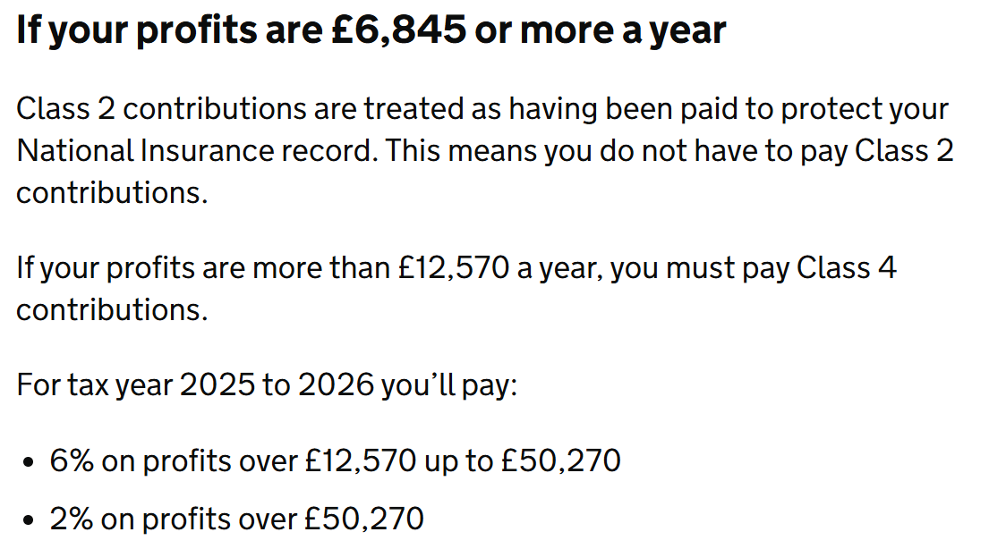
Income Tax & NIC - The Numbers
Notes:
Overview / Snapshot
Income Tax is on profit, not turnover.
Everyone gets a Personal Allowance of £12,570 (2024/25).
Tax is progressive → 20%, 40%, 45%.
Payments on account spread tax into Jan & July.
Reliefs and allowances can lower your bill.
Do I pay on sales or profit?
Problem: People fear tax on all income.
Solution: Tax only on profit (income – expenses).
Example: £20,000 sales – £5,000 expenses = £15,000 taxable.
What are the tax-free allowances?
Solution: £12,570 Personal Allowance. Above this = taxed.
Example: £14,000 profit → £1,430 taxed at 20%.
Note: £1,000 trading allowance for very small income streams.
How do the tax bands work?
Problem: People think one pound over means all taxed higher.
Solution: Progressive system — only the slice above threshold is higher.
Example: £55,000 profit → 20% up to £50,270, then 40% on £4,730.
What are payments on account?
Problem: July bills look like penalties.
Solution: Advance instalments if tax > £1,000 and <80% deducted at source.
Example: £3,000 bill → £3,000 in Jan 2026 + £1,500 Jan + £1,500 July (on account for 25/26). Balance in Jan 2027.
Which reliefs and allowances reduce the bill?
Trading allowance (£1,000 small income).
Marriage allowance (transfer spare allowance).
Loss relief (offset losses).
Simplified expenses (mileage, home working).
Pension contributions & Gift Aid donations (reduce taxable income).
Worked examples for clarity
Profit £15,000 → tax = £486.
Profit £40,000 → tax = £5,486.
Profit £60,000 → mix of 20% and 40%. Use HMRC calculator to show.
Pitfalls
Confusing turnover and profit.
Ignoring payments on account → cash squeeze in July.
Missing reliefs → overpaying tax.
Summary of Slide 5b Income Tax is profit-based, progressive, and predictable if you plan. Allowances, reliefs, and payments on account can shape your bill. Budget monthly and you avoid surprises.

Slide 20

Income Tax and NIC
Case 1:
Profit = £20,000​
Income Tax = £12,570
(tax-free Personal Allowance​)
Remaining £7,430 falls entirely in the basic rate band (20%)​
£7,430 × 20% = £1,486​
Class 4 National Insurance
NI threshold starts at £12,570​
Profits between £12,570 and £20,000 = £7,430​
£7,430 × 6% = £446​
Total​
Income Tax £1,486 + NI £446 = £1,932​
Effective rate ≈ 10% of profit
It’s easy to talk about tax and National Insurance separately, but in reality, they hit your pocket at the same time.
Let’s bring them together to see what a sole trader’s real bill might look like at different profit levels in 2024/25.
These examples assume no other income, standard Personal Allowance of £12,570, and only basic reliefs.​

Slide 21
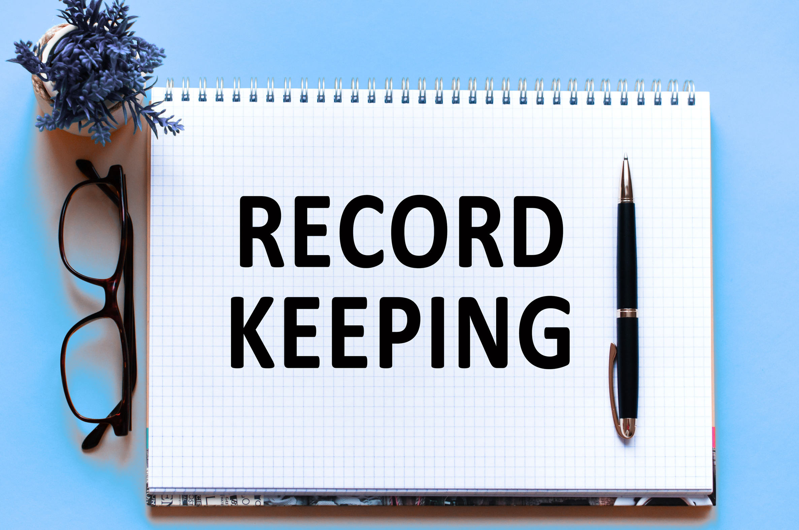

Slide 22
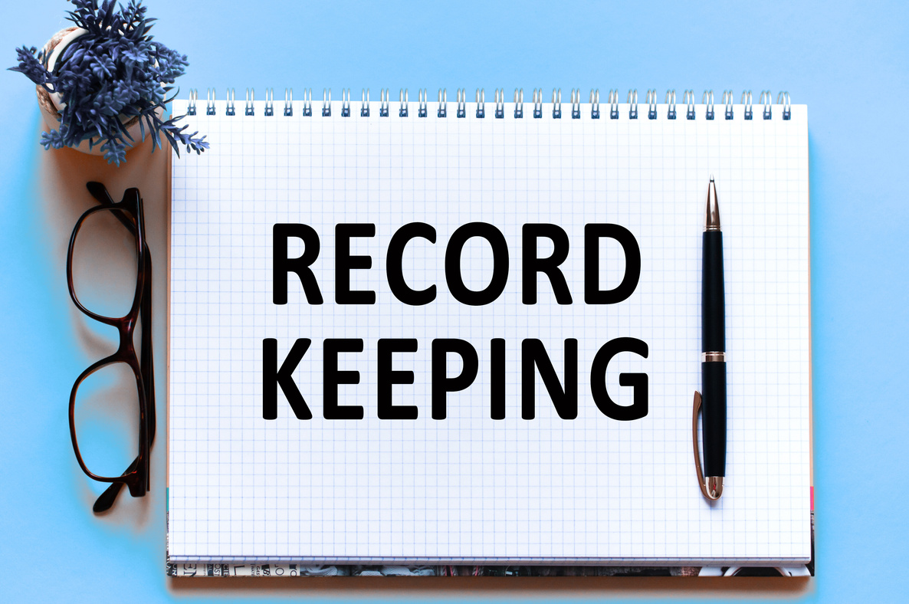
Must keep accurate records of income and expenses​
Self Assessment: 5 years after 31 Jan filing deadline​
VAT: at least 6 years if registered​
Records may be paper or digital (cloud or local storage)​
Protect customer data – follow GDPR and ICO guidance
Notes:
Overview / Snapshot
HMRC requires every sole trader to keep reliable records of financial activity—both for Self Assessment and VAT compliance.
With digital record-keeping becoming standard, you may use cloud storage—but you must also manage data protection responsibilities under GDPR and register with the ICO if you process personal data.
Being aware of UK-based cloud providers and data residency is essential for compliance and peace of mind.
Digital storage: is cloud OK?
Solution: Yes—HMRC accepts scanned or photographed receipts, bank statements, and invoices, provided they’re readable.
Providers with UK-based servers:
Civo’s UK Sovereign Cloud: 100% UK-based infrastructure (hosts compute, Kubernetes, AI workloads) Civo.com
OVHcloud: European provider ensuring full data ownership and UK law compliance OVHcloud
iomart: UK-grown company delivering cloud and managed IT services from UK data centres Wikipedia
Pulsant: Operates multiple secure data centres across the UK, ISO-certified Wikipedia
Brightbox, CWCS, Hyve, Webhosting UK: UK-based hosting providers with local data centres and support Skynet Technologies USA LLC
Why UK-based storage matters
Enhanced data sovereignty and legal clarity under UK GDPR.
Physical servers located in UK receive added protection as critical national infrastructure, giving stronger resilience against cyber threats Reuters.
GDPR and ICO compliance
Issue: Invoices and records contain client personal data—names, addresses, payment details—protected under GDPR.
You must:
Secure data with adequate measures (password protection, encryption, limited access)
Retain only what's necessary—and only for as long as legally required (e.g. 5 years for HMRC)
Delete or anonymise data when no longer needed
Register with the ICO, paying a small annual fee, unless you’re exempt (e.g. only minimal, non-personal data processing) Wikipedia.
Secure practices for cloud use
Use strong, unique passwords and enable two-factor authentication.
Choose reputable UK-based cloud services with transparent privacy policies.
Always back up locally and to secure cloud systems.
Avoid storing client invoices on unprotected devices or email—this risks GDPR breaches.
Engagement Trigger
Ask: “How many of you use cloud storage for your invoices or receipts? Who knows if your provider stores data in the UK or overseas?” Discuss risks and benefits of both—particularly for businesses handling client data or sensitive records.
Summary of Slide 6 Digitising records is legal and efficient, but must be done securely and compliantly. UK-based cloud providers reduce risk from cross-border legal complexity. You’re responsible for GDPR compliance and must register with the ICO if handling personal data. Good habits today protect both your business and your customers.

Slide 23
Practical Record Keeping- Everyday Methods
Paper logbooks or diaries – simple and low cos
​
Spreadsheets – flexible and familiar​
Accounting apps – automate and link to bank​
Pick the method that works for you and use it regularly
Notes:
Overview / Snapshot
Record keeping isn’t one-size-fits-all.
Some sole traders prefer pen and paper, others like spreadsheets, and some move to apps.
The “best” method is the one you will actually use consistently.
Paper methods
Option: Use a diary, cash book, or duplicate invoice book.
How it works: Write down daily income and expenses, keep receipts in labelled envelopes.
Example: A gardener notes “£50 lawn cut – cash received” in diary, keeps receipt for petrol in monthly envelope.
Pros: Low cost, tangible, easy to understand.
Cons: Easy to lose, harder to calculate totals at year end, not suitable for MTD VAT.
Spreadsheets
Option: Excel or Google Sheets template.
How it works: Two tabs – one for income, one for expenses. Columns for date, description, category, amount.
Example: A dog walker logs “12 April – 3 walks – £45 – income”. Expenses tab shows “12 April – fuel – £15 – travel cost”.
Pros: Cheap, flexible, easy to share with an accountant.
Cons: Manual entry, prone to mistakes if formulas aren’t set up.
Accounting apps
Options: FreeAgent (free with NatWest/RBS), QuickBooks, Xero, Zoho Books, Tide/Monzo business banking apps.
How it works: Link bank account, take photos of receipts, send invoices from the app.
Example: A photographer uploads receipt for camera lens by photo, app categorises as equipment. Bank feed pulls in payments from clients automatically.
Pros: Saves time, integrates with Making Tax Digital, some banks include apps free.
Cons: Subscription costs (unless free with bank), learning curve.
Top practical tips
Choose one system and stick to it — don’t mix methods.
Set aside time every week (e.g. Friday afternoon) to update records.
Keep business and personal bank accounts separate for clarity.
Always capture receipts at point of purchase (photo, scan, or file).
Review monthly so you’re not surprised at year end.
Summary of Slide 6b There are three main approaches: paper, spreadsheets, and apps. Each has pros and cons, but the best method is the one you use consistently. Update records regularly, keep receipts safe, and review monthly to stay in control.

Slide 24
Practical Record Keeping- Paper
(Shoe Box Method
Use diary, ledger, or cash book for daily notes​
Store receipts in envelopes or folders by month
​
“Shoebox method” is common but risky if disorganised​
Works for very small traders, but totals must be accurate
Notes:
Overview / Snapshot
Many sole traders still keep paper records. It’s simple, cheap, and requires no tech.
HMRC will accept well-kept paper records, but they must be clear and complete.
The so-called “shoebox method” — stuffing receipts into a box until January — is very common, but dangerous if not organised.
How to do it properly
Use a diary or ledger: write down every sale and every expense daily or weekly.
Store receipts in envelopes or folders labelled by month.
If using the “shoebox method”, sort and label receipts at least monthly so they are not just a jumble.
Example
A gardener notes in a diary:
2 May – Client Smith – £50 cash received
2 May – Petrol – £12.50 Tesco
At the end of May, totals up income and expenses, stores all May receipts in an envelope.
The “Shoebox method” explained
Problem: Sole traders often stuff receipts into a box all year. By January, receipts are faded, missing, or unlabelled → makes filing stressful and error-prone.
Solution: If you prefer physical storage, use a box or folder but: • Sort receipts by month • Add handwritten notes on what each was for • Keep an index or running diary of totals
Positive outcome: Same low-cost system, but much less chaos at year-end.
Pros
Low cost, tangible, simple to start.
Works well if transaction volume is very low.
Cons
Totals must be added manually.
Easy to lose receipts or forget context (“what was this £45 for?”).
Not suitable for VAT/Making Tax Digital compliance.
Summary of Slide 6b Paper methods, including the “shoebox”, can work if organised, but they rely heavily on discipline. Best for small traders with a handful of transactions. For anything more, spreadsheets or apps give better control.

Slide 25
Practical Record Keeping- Apps
Use free or budget-friendly apps (e.g. Zoho, QuickFile, Wave, GnuCash)​
Automate bank feeds and receipt capture​
Efficient and MTD-ready = minimal manual work​
Some limitations on free plans, and setup learning required​
Best if you prefer speed, automation, and cloud backup
Notes:
Overview / Snapshot Apps for record keeping bring automation, accuracy, and integration with Making Tax Digital. Many are free or offer a generous free tier — ideal if you’re self-employed and want smart, low-maintenance bookkeeping.
Examples of free or free-tier apps (no endorsement of specific brands)
Zoho Books (Free tier) – Including MTD VAT filing, invoice creation, and expense tracking but capped at 1,000 invoices/year. Startups.co.uk
QuickFile – UK cloud-based accounting that supports VAT returns and smart bank feeds; free for smaller accounts. IFAs & Financial Advisers FinderQuickFile
Wave – Fully free, unlimited accounting, invoicing, and receipts (US-based, but used internationally); basic VAT support. IFAs & Financial Advisers FinderWikipedia
GnuCash – Free, open-source, desktop software with double-entry bookkeeping; no cloud or mobile app. IFAs & Financial Advisers FinderWikipedia
Other notable mentions:
FreeAgent (free with certain UK business bank accounts) IFAs & Financial Advisers Finder
Crunch Free and Sage Individual Free for simple UK-based platforms. Simply Business UK
General pros of using most accounting apps
Automate bank transaction feeds and reconciliation
Snap photo receipts with mobile capture
Generate invoices, quotes, and client statements
Prepare VAT returns and comply with Making Tax Digital
Cloud-based access and secure backups
General cons and considerations
Free tiers may limit the number of invoices or features
Subscription costs if you need advanced functionality
Initial setup and learning curve required
You must still maintain proper categories and review accuracy
Requires reliable internet access and secure credentials

Slide 26
App | Pros (3) | Cons (3) | Best For
Xero | • Fully MTD-compliant for VAT & Income Tax • Excellent automation (bank feeds, receipt capture) • Scales easily as your business grows | • Paid subscription after free trial • Starter plan limits invoices/bills • Interface can overwhelm beginners | Sole traders planning to grow and needing full-featured software
QuickBooks Self-Employed | • Very easy to use, beginner-friendly • Mobile app with tax estimate tools • Widely recognised, MTD-ready | • Subscription from ~£10/month • VAT and payroll often cost extra • Customer support can be patchy | Freelancers/sole traders wanting simple, HMRC-ready bookkeeping
Coconut | • Built specifically for UK sole traders • Clear tax dashboard with real-time estimates • Links smoothly to UK bank accounts | • No free plan (from ~£9/month) • Limited advanced features vs bigger apps • App-only, less desktop use | Mobile-first freelancers who want tax-focused simplicity
Zoho Books (Free plan) | • Free tier available for small users • MTD-compliant (Income Tax & VAT) • Includes automation and bank feeds | • Free plan capped at 1,000 invoices/year • Advanced features require upgrade • Slight learning curve initially | Tech-savvy traders needing a free/low-cost MTD option
Wave | • 100% free for invoicing and expenses • Double-entry accounting built-in • Simple, clean interface | • Weak UK VAT/MTD support • Bank feeds may need paid add-ons • US-focused, limited UK support | Sole traders on tight budgets who only need basic accounts
FreeAgent | • Free with NatWest, RBS or Mettle bank accounts • Designed for UK freelancers/contractors • Strong VAT & Self Assessment support | • Paid if not with partner bank • Pricier than other starter options • Interface can feel dated | Contractors/freelancers with linked UK accounts who want built-in tax tools
Notes:
Overview / Snapshot Apps for record keeping bring automation, accuracy, and integration with Making Tax Digital. Many are free or offer a generous free tier — ideal if you’re self-employed and want smart, low-maintenance bookkeeping.
Examples of free or free-tier apps (no endorsement of specific brands)
Zoho Books (Free tier) – Including MTD VAT filing, invoice creation, and expense tracking but capped at 1,000 invoices/year. Startups.co.uk
QuickFile – UK cloud-based accounting that supports VAT returns and smart bank feeds; free for smaller accounts. IFAs & Financial Advisers FinderQuickFile
Wave – Fully free, unlimited accounting, invoicing, and receipts (US-based, but used internationally); basic VAT support. IFAs & Financial Advisers FinderWikipedia
GnuCash – Free, open-source, desktop software with double-entry bookkeeping; no cloud or mobile app. IFAs & Financial Advisers FinderWikipedia
Other notable mentions:
FreeAgent (free with certain UK business bank accounts) IFAs & Financial Advisers Finder
Crunch Free and Sage Individual Free for simple UK-based platforms. Simply Business UK
General pros of using most accounting apps
Automate bank transaction feeds and reconciliation
Snap photo receipts with mobile capture
Generate invoices, quotes, and client statements
Prepare VAT returns and comply with Making Tax Digital
Cloud-based access and secure backups
General cons and considerations
Free tiers may limit the number of invoices or features
Subscription costs if you need advanced functionality
Initial setup and learning curve required
You must still maintain proper categories and review accuracy
Requires reliable internet access and secure credentials

Slide 27
Practical Record Keeping- Comparing Apps
Xero – Best if you plan to grow and need advanced features​
QuickBooks Self-Employed – Best if you are new and want something simple​
Coconut – Best if you are mobile-first and want quick tax estimates​
Zoho Books (Free) – Best if you want a free, MTD-compliant option​
Wave – Best if you want completely free basics and don’t need VAT/MTD​
Notes:
Examples
A growing graphic design business → Xero (scalable, professional, can handle payroll later).
A first-time dog walker → QuickBooks Self-Employed (simple app, easy to understand tax estimates).
A freelancer working on the go → Coconut (mobile dashboard, UK tax-focused).
Someone very cost-conscious but still wanting MTD compliance → Zoho Books free plan.
A hobby crafter with a handful of sales → Wave (free, easy, no frills).
A contractor who already banks with NatWest → FreeAgent (free with account, tailored for sole traders).

Slide 28
Practical Record Keeping- Spreadsheets
Use Excel, Google Sheets, or Numbers​
Income and expenses on separate tabs​
Columns for date, description, category, amount​
Totals update automatically with formulas​
Free, flexible, but manual entry needed
Notes:
Overview / Snapshot
Spreadsheets are a very popular middle-ground between paper and apps.
They’re free (Google Sheets) or already included on most computers (Excel, Numbers).
You can build a simple structure to log income and expenses with totals calculated automatically.
How to set it up
Create one tab for income and one for expenses.
Use columns such as: Date | Description | Category | Amount | Paid/Unpaid.
At the bottom, add a SUM formula to total each column.
Optional: add filters to view by category or by month.
Example
A dog walker uses Google Sheets:
Income tab:
5 June | Client Jones | Dog walks | £30 | Paid
Expenses tab:
5 June | Fuel | Travel | £15
At month end: totals show £30 income, £15 expenses → £15 profit.
Pros
Free or very low cost.
Customisable for any type of business.
Easy to share with an accountant or mentor.
Totals and summaries update instantly with formulas.
Cons
Manual data entry required — prone to human error.
Must design your own categories and formulas (unless you use a template).
Not compliant with Making Tax Digital VAT submissions unless linked to bridging software.
Practical tips
Create drop-down lists for categories (e.g. Travel, Materials, Marketing).
Save your sheet in the cloud (Google Drive, OneDrive) for backup.
Protect the file with a password if it contains client data.
Set a weekly routine to update rather than leaving until year end.
Summary of Slide 6c Spreadsheets are flexible and familiar, making them a great step up from paper. They’re free, customisable, and effective for small businesses — but they rely on discipline and accuracy

Slide 29
Excel vs Google Sheets – ​Which to use?
FEATURE | MICROSOFT EXCEL | GOOGLE SHEETS
Cost | Free on web browser via email account [limited features] Full access through paid version of Microsoft 365 | Free with a Google/Gmail account
Access | Desktop software, some online features | 100% cloud-based, works in browser/app
Collaboration | Limited unless using OneDrive/SharePoint | Real-time multi-user collaboration
Power & Features | Very powerful, advanced formulas & tools | Simpler, fewer advanced features
Integration | Works with Microsoft ecosystem | Works with Google ecosystem
Offline use | Full offline desktop | Limited offline unless pre-set
Notes:
Overview / Snapshot
Both Excel and Google Sheets are widely used by small businesses for bookkeeping.
Which you choose depends on cost, how you work, and whether you need collaboration or advanced features.
Microsoft Excel
Pros: Extremely powerful with advanced formulas, pivot tables, and analysis tools. Great for complex bookkeeping or larger datasets. Works offline reliably.
Cons: Requires a subscription (Office 365), collaboration features less seamless without OneDrive.
Google Sheets
Pros: Free, accessible anywhere with internet, and brilliant for collaboration (accountant can check live). Saves automatically in the cloud.
Cons: Fewer advanced tools, can slow down with very large datasets, offline use limited unless set up in advance.
Practical tips
If you’re a solo trader with simple needs, Google Sheets is often enough.
If you want to do detailed financial modelling, Excel is the stronger choice.
Many businesses actually use both — Sheets for sharing day-to-day and Excel for deep dives.
Summary of Slide 6c.1 Excel is best for power and complexity; Google Sheets is best for free, simple, collaborative use. The right choice depends on your budget and working style.

Slide 30
Comparing record keeping methods​
METHOD | PROS | CONS
Paper (Shoebox/Diary) | • Cheap & simple • No tech needed • Tangible & familiar | • Disorganised if receipts pile up • Easy to lose/damage • Manual totals & not MTD-ready
Spreadsheets | • Free/low cost • Flexible with formulas • Easy to share with accountant | • Manual entry needed • Errors if formulas wrong • Not MTD-ready without bridging
Apps | • Automates bank feeds & receipts • Cloud backup & secure storage • MTD-compliant, saves time | • Subscription costs (unless free with bank) • Learning curve to set up • Needs internet & strong security
Notes:
Overview / Snapshot
Here’s a side-by-side view of the three main methods. Each has strengths and weaknesses — no method is “perfect.”
The best method is the one you can commit to regularly updating.
Paper (Shoebox/Diary)
Pros: • Cheap and simple. • No need for internet or software. • Tangible and familiar for many.
Cons: • A “shoebox” of unsorted receipts causes chaos at year-end. • Easy to lose, damage, or fade. • Totals must be done by hand, not MTD-compliant.
Spreadsheets
Pros: • Free (Google Sheets) or low cost (Excel often already installed). • Flexible — you design categories and formulas to suit your business. • Easy to send to an accountant by email.
Cons: • Manual entry needed every week/month. • Mistakes creep in if formulas are wrong. • Not MTD-compliant unless linked with bridging software.
Apps
Pros: • Automates bank feeds and reconciles transactions. • Snap receipts with your phone → instantly stored in cloud. • MTD-compliant for VAT and saves time at year-end.
Cons: • Subscription costs (unless free via your bank). • Learning curve to use effectively. • Needs internet, passwords, and secure login to stay GDPR-compliant.
Summary of Slide 6e
Paper = simple but risky.
Spreadsheets = flexible middle ground.
Apps = efficient and compliant.
Consistency matters more than the tool — whichever method you choose, commit to updating it regularly.

Slide 31
Practical Record Keeping- Weekly Routine
Set aside 30–60 minutes each week
Record all income and expenses
​
Store or scan receipts straight away
​
Reconcile with bank account
​
Review totals monthly to stay on track
Notes:
Overview / Snapshot
Record keeping works best when it becomes a habit.
A short, regular routine (30–60 minutes per week) saves hours at year-end and avoids mistakes.
The process is the same whether you use paper, spreadsheets, or apps.
Step 1 – Capture income
Write in diary, enter in spreadsheet, or log in app.
Include date, customer, description, amount, and whether it’s been paid.
Example: Hairdresser – 5 July – Client Smith – Cut & Colour – £60 – Paid.
Step 2 – Capture expenses
Collect receipts for everything business-related (fuel, supplies, subscriptions).
Paper: file in monthly envelope.
Spreadsheet: type entry into “Expenses” tab.
App: snap photo of receipt and categorise.
Step 3 – Reconcile with bank account
Compare your records to your bank statement.
Tick off what matches.
Investigate missing entries (e.g. cash payments not recorded).
Step 4 – Review monthly
At the end of each month, check income vs expenses.
Update your “tax pot” savings (e.g. move 20–25% of profit into a separate account).
This prevents January and July tax bill shocks.
Tips for success
Pick a fixed slot each week (e.g. Friday afternoon or Monday morning).
Don’t mix personal and business spending — use a separate business account.
Always store receipts at point of purchase (photo or envelope).
File early — don’t leave it all until January.
Summary of Slide 6f A weekly 30–60 minute routine keeps your books accurate, your tax savings on track, and your stress levels low. Little-and-often is the key to record keeping success, no matter which method you use.

Slide 32
GDPR and Cloud Record Keeping
Invoices and records often contain personal data​
You are legally responsible under UK GDPR​
Most sole traders must register with the ICO​
Use secure cloud or local storage with access controls​
Delete or anonymize data when retention period ends
Notes:
Overview / Snapshot
Sole traders often underestimate GDPR. Even something simple like an invoice can hold personal data — names, addresses, payment details.
Under UK GDPR, you are a data controller. This means you decide what data is collected, why, and how it’s stored.
The ICO is the regulator. Most businesses that process personal data (beyond purely household use) must register with the ICO and pay the small annual fee.
“What counts as personal data?”
Solution: Anything that identifies an individual, e.g.: • Names and addresses on invoices • Customer contact details in order records • Bank or card details, if stored
Example: A dog walker keeps client addresses for pick-ups. These are personal data and must be stored securely.
“Do I need to register with the ICO?”
Solution: Yes, most sole traders do. The fee is usually £40–£60 per year.
Only very small businesses with no customer data and no electronic storage might be exempt.
Example: A cleaner who invoices clients by email is processing personal data and must register.
“How do I store data securely?”
Use reputable UK-based cloud storage where possible (e.g. Pulsant, iomart, OVHcloud UK).
Protect access with: • Strong, unique passwords • Two-factor authentication • Encryption where possible
Back up data regularly and avoid storing sensitive invoices only on a personal phone or USB stick.
“How long should I keep records?”
Solution: Keep records for HMRC’s legal minimum (5 years after 31 Jan for Self Assessment, 6 years for VAT).
After that, delete or anonymise them — keeping them longer without a lawful reason can breach GDPR.
“What are the risks of getting it wrong?”
Fines or enforcement action from the ICO.
Loss of customer trust if data is exposed.
Example: A lost unencrypted laptop with invoices = reportable data breach.
Key Takeaway for SMEs
Think of GDPR as protecting your business as much as your customers.
Being careless with invoices or cloud storage can damage reputation and lead to penalties.
Good data hygiene is as important as financial hygiene.
Summary of Slide 6a Invoices and records are personal data. You must protect them under UK GDPR, register with the ICO, and store them securely. Use UK-based or trusted cloud storage, control access, and delete data once the legal retention period ends. Compliance builds trust and avoids penalties.

Slide 33
Sole Trader Tax Return Key Dates
👤 Sole Trader:​
✅ Paper deadline: 31 October​
✅ Online deadline: 31 January​
⚠ You = Must file even if little or no profit​
⚠ Once you have registered, you must declare every tax year. Even if a zero, until which point you inform them you are no longer Self-employed.
Notes:
Presenter notes
Overview / Snapshot Sole traders must not only file but also pay their tax and National Insurance (NI). A bill may include Income Tax, Class 4 NI, and sometimes advance instalments called payments on account. From April 2024, Class 2 NI is abolished for most, but voluntary contributions can protect future State Pension entitlement.
How do I know what I need to pay?
Problem: Many are unsure what their bill actually covers.
Solution: Your bill includes • Income Tax on profits above £12,570 (personal allowance for 2024/25) • Class 4 NI at 6% between £12,570 and £50,270, and 2% above £50,270 • Class 2 NI no longer payable from April 2024, but credits still apply if profits exceed £6,725. Below this, you may pay Class 2 voluntarily to protect State Pension.
Example: Profit £20,000 → Income Tax on £7,430 (20% of £20,000–£12,570) + Class 4 NI on the same slice.
What are payments on account, and why do I owe money in July?
Problem: Many are surprised by a second tax bill mid-year.
Solution: Payments on account are advance instalments for the next year if your bill is over £1,000 and less than 80% is deducted at source. Half is due in January, half in July, with a balancing payment the following January.
Example: Bill of £3,000 for 2024/25 → pay £3,000 in Jan 2026 plus £1,500 on account. Then £1,500 again in July 2026. If the 2025/26 bill ends up higher, the extra is settled in Jan 2027.
Positive outcome: Save monthly into a tax account so both January and July bills are covered.
What if I cannot pay?
Problem: Some ignore the debt until penalties escalate.
Solution: Always file the return on time. Then use HMRC’s Time to Pay if you cannot pay in full. Eligible online if debt is £30,000 or less, within 60 days, and no other plan exists. Interest applies, but you avoid penalties and legal action.
Pitfall: Not contacting HMRC. Delay only makes matters worse.
How do I avoid tax bill shocks?
Problem: Many sole traders budget too late and run out of cash.
Solution: Set aside 20–25% of profits monthly in a separate account.
Example: Profit £2,000/month → save £400–£500 monthly. By January and July, funds are ready.
Positive outcome: Predictable bills, less stress, smoother cash flow.
Summary of Slide 5 Paying tax and NI is not just a one-off January bill. It includes Income Tax, National Insurance, and often a July instalment. The best way to stay on top is to budget monthly, file early, and use Time to Pay if needed. This avoids penalties and makes tax predictable instead of stressful.

Slide 34
How Long Do I Need To Keep My Tax Records
✅ Must keep accurate business records​
✅ Ensure they are regularly updated​
⚠ Self Assessment: 5 years after 31 Jan deadline​
⚠ VAT: 6 years minimum​
​
Having a physical record is great, but I would highly recommend a digital backup stored securely on a ‘Cloud Drive’ of some description
Notes:
Presenter notes
Overview / Snapshot Good record keeping is the foundation of running a business. HMRC require sole traders to keep evidence of income and expenses for years after the tax year ends. Records can be digital or paper, but they must be complete, accurate, and accessible. For Self Assessment, keep them for 5 years after the filing deadline. For VAT, 6 years is the minimum. Strong records help you claim expenses confidently, survive an HMRC check, and make business decisions with real data.
Why do I need to keep records for so long?
Problem: Many SMEs throw out receipts or rely on memory when it comes time to file.
Solution: HMRC can ask to see your records years later. Without them, you may face fines, lose expense claims, or pay more tax than you should.
Example: Profit for 2024/25 filed by Jan 2026 → records must be kept until at least Jan 2031. If VAT registered, you must hold records for 6 years.
What should I keep?
Problem: People aren’t sure what counts as a “record.”
Solution: Keep all invoices, receipts, bank statements, mileage logs, and any evidence of expenses or sales. For VAT, you must also keep VAT invoices and digital records of sales and purchases.
Example: A café keeps till receipts, invoices for stock, and supplier VAT invoices. A freelancer keeps copies of invoices issued, receipts for software, and mileage logs.
Paper or digital?
Problem: Some think receipts must be physical. Others risk losing everything if they only keep paper copies.
Solution: Digital records are acceptable. You can scan or photograph receipts, but they must be clear and readable. Use apps or cloud storage for safety.
Pitfall: Saving to a personal phone without backup — if it’s lost, the records are gone.
How often should I update my records?
Problem: Leaving it until January creates errors, missed claims, and stress.
Solution: Set a routine — weekly or monthly updates. Reconcile your bank account, check invoices are paid, and log expenses. A consistent rhythm reduces mistakes and saves time at year-end.
Example: Monday mornings → send invoices; Wednesday → upload expenses; Friday → reconcile bank statement.
Engagement activity Ask: “Who here updates their records weekly? Monthly? Once a year?” Then discuss the risks of leaving it too late. Encourage them to commit to one small weekly habit.
Summary of Slide 6 Keeping records is not optional — it’s a legal duty. By keeping clear, complete, and organised records for at least 5 years (6 for VAT), you stay compliant, avoid penalties, and make better business decisions. Strong records mean smoother tax returns, less stress, and confidence if HMRC ever check.

Slide 35
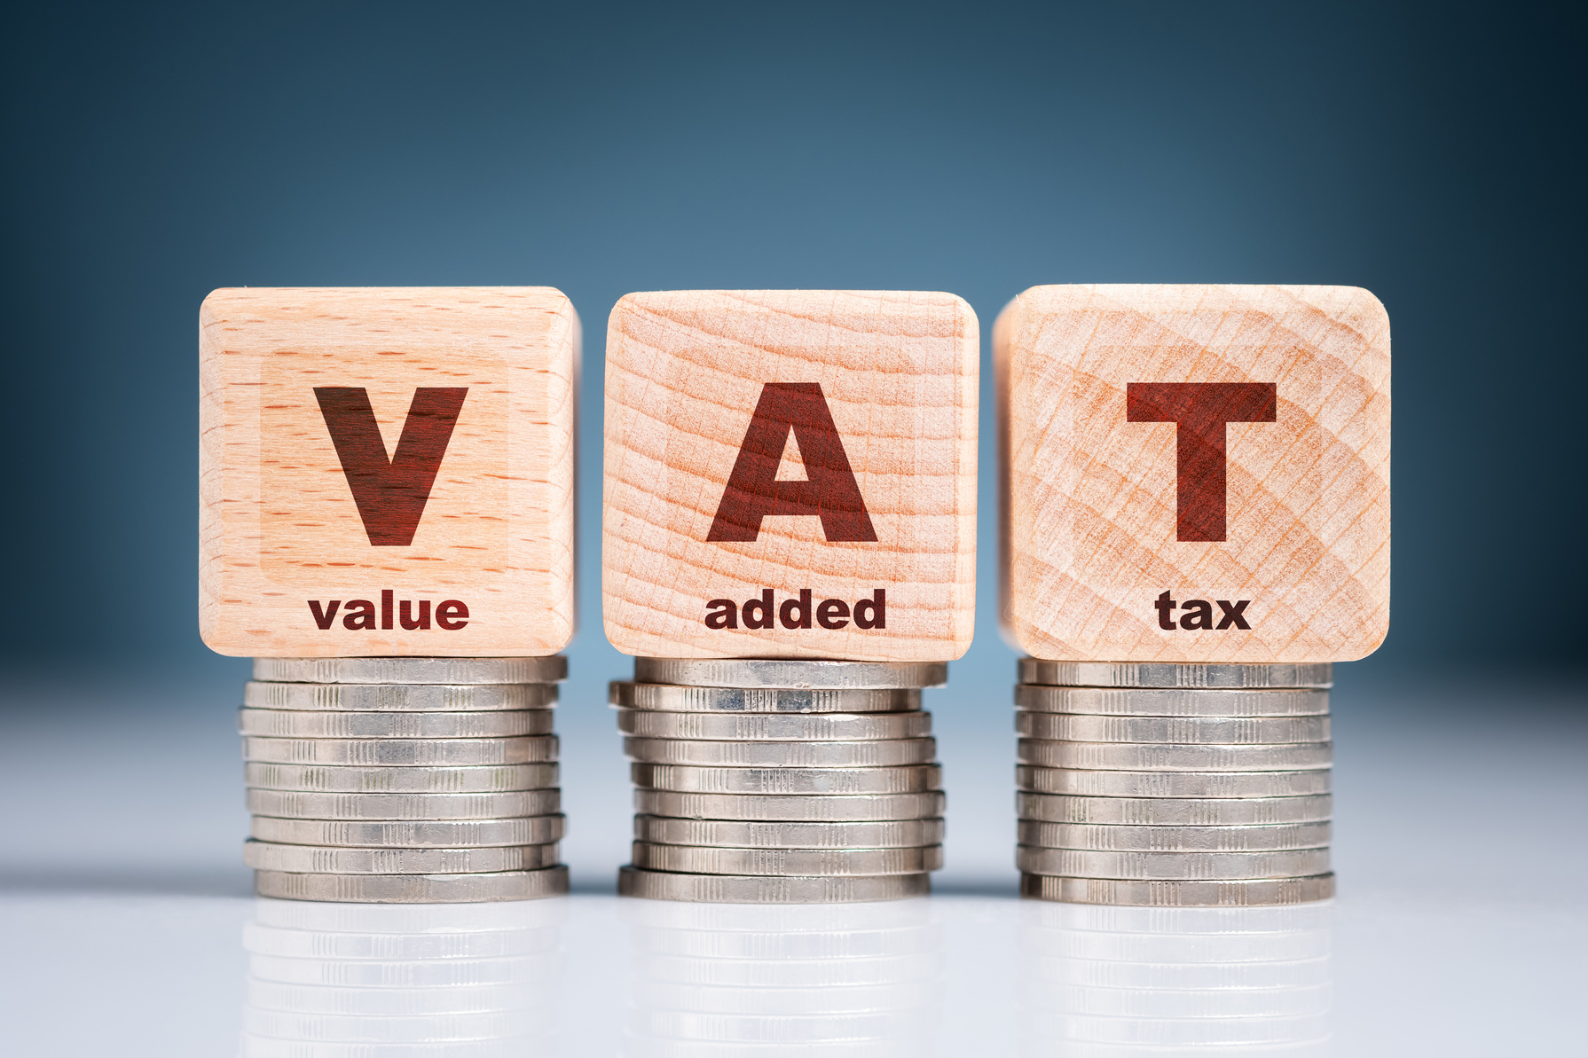
Do I Have To Register For VAT?
✅ Must Register if turnover > £90,000​
✅ Then deregister if < £88,000​
⚠ Must issue VAT invoices & file digitally​
⚠ Be aware of different rates of VAT i.e. 10% / 20% rates on different goods​
Having a physical record is great, but I would highly recommend a digital backup stored securely on a ‘Cloud Drive’ of some description
Notes:
Overview / Snapshot VAT (Value Added Tax) applies once your business turnover passes certain thresholds. For 2024/25, you must register if your rolling 12-month taxable turnover is over £90,000, or if you expect to exceed that in the next 30 days. You can deregister when turnover falls below £88,000. VAT registration brings new admin — charging VAT, issuing VAT invoices, and submitting returns digitally under Making Tax Digital. Getting this right avoids penalties and can even improve credibility with bigger clients.
When do I need to register?
Problem: Many SMEs only check turnover at year-end, not rolling 12 months.
Solution: Track turnover monthly. If you exceed £90,000 in any 12-month period, you must register. If you expect to pass it in the next 30 days, register immediately.
Example: A decorator invoices £8,000 per month. By the 12th month, turnover totals £96,000 — they must register straight away.
Can I deregister?
Problem: Some stay registered even when turnover drops below the threshold, which can be unnecessary.
Solution: You can deregister voluntarily if taxable turnover drops below £88,000. This reduces admin and stops you charging VAT unnecessarily.
Example: A small online retailer’s turnover falls to £70,000. They deregister and simplify their pricing for customers.
How do I charge VAT?
Problem: Some businesses forget they must adjust invoices after registration.
Solution: Once registered, you must: • Add VAT at the correct rate (standard 20%, reduced 5%, zero or exempt where relevant) • Include your VAT number on invoices • Keep VAT invoices from suppliers if you want to reclaim input VAT
Example: A web designer bills £1,000 → invoice must now show £1,000 + £200 VAT (20%).
How do I file VAT returns?
Problem: Old habits like spreadsheets and copy-and-paste don’t meet HMRC’s MTD rules.
Solution: All VAT returns must be submitted using Making Tax Digital compatible software, with digital records and digital links. Bridging software is allowed if you use spreadsheets.
Example: A plumber uses a spreadsheet → connects it to bridging software → submits digitally without breaking MTD rules.
Engagement activity Ask: “Who here is close to the £90,000 turnover mark?” Then walk through a simple example of how to calculate rolling 12-month turnover, showing why it’s not just about year-end accounts.
Summary of Slide 7 VAT registration kicks in at £90,000 turnover, and deregistration is possible below £88,000. Once registered, you must issue VAT invoices, charge the right rate, and file digitally under MTD. By tracking turnover monthly and preparing early, you can avoid surprise registration and stay compliant while keeping customer trust.

Slide 36
VAT Obligations- Mandatory Registration
Must register if turnover exceeds £90,000 (2024/25 threshold)​
Register within 30 days of passing the limit​
Charge 20% VAT on most goods/services once registered​ Submit VAT returns, usually quarterly, via Making Tax Digital software​
Keep VAT records for at least 6 years
Notes:
Overview / Snapshot
VAT (Value Added Tax) applies when your business turnover (not profit) exceeds the registration threshold — £90,000 from April 2024.
Once you cross that line, you must register within 30 days and begin charging VAT.
VAT is collected on behalf of HMRC, so it isn’t your money — you’re the “collector.”
“When must I register?”
Rule: Register within 30 days if your taxable turnover in the last 12 months goes over £90,000, or if you expect to in the next 30 days.
Example: A café hits £91,000 turnover in July 2024 → must register by 30 August 2024. VAT then applies from 1 September.
“What happens when I register?”
You must: • Add VAT (usually 20%) to sales invoices. • Submit VAT returns, typically every 3 months. • Pay HMRC the VAT you’ve collected, minus VAT you’ve paid on business purchases (input tax).
Example: Invoice £100 → now £120 with VAT. If £20 VAT was spent on supplies, you reclaim it.
“What if I don’t register?”
HMRC can backdate registration, charge penalties, and add interest on unpaid VAT.
Deliberate avoidance can lead to serious fines.
“What are the VAT rates?”
Standard rate = 20% (most goods/services).
Reduced rate = 5% (domestic fuel, children’s car seats).
Zero rate = 0% (food, books, children’s clothing).
Some services are VAT exempt (rent, insurance, medical services).
Example: A children’s bookshop sells books (0% VAT) and toys (20%).
“How do I file returns?”
VAT returns must be filed digitally through Making Tax Digital (MTD) compatible software (e.g. QuickBooks, FreeAgent, Xero, Zoho, QuickFile).
Paper returns are no longer allowed except in very limited circumstances.
“How long do I keep VAT records?”
Minimum 6 years.
Must include invoices, credit notes, VAT return calculations, and import/export paperwork.
Pitfalls
Forgetting to track turnover → late registration.
Mixing exempt and standard-rated items incorrectly.
Not using MTD-compliant software.
Summary of Slide 7 If your turnover goes above £90,000, VAT registration is mandatory. You must register within 30 days, charge VAT, and file returns digitally. Keep records for 6 years and treat VAT as money you’re collecting for HMRC.

Slide 37
Can I Voluntarily Register for VAT?
✅ Allowed if turnover < £90,000​
​
PROS: ​
Reclaim VAT, ​
boost business credibility​
​
CONS: ​
more admin​
higher prices for some clients​
Stricter rules. likely need an accountant for this (more cost)​
BEST FOR:​
VAT-registered clients, high business expenses
Notes:
Overview / Snapshot You do not have to wait until you hit £90,000 turnover to register for VAT. Any business can register voluntarily. This can be a smart move for some, but a burden for others. The decision depends on your customers, your suppliers, and your growth plans.
Why might I register early?
Problem: Some businesses pay lots of VAT on supplies but cannot reclaim it if not registered.
Solution: Voluntary registration lets you reclaim input VAT and can make your business look more professional to larger clients.
Example: A photographer buys expensive cameras and software with VAT added. By registering, they can reclaim this VAT. A B2B consultant with corporate clients may seem more credible if VAT-registered, as many large companies expect to deal with VAT suppliers.
What are the downsides?
Problem: VAT adds 20% to your prices for customers who are not VAT registered (most consumers, many sole traders). This can make you less competitive. It also adds more admin.
Solution: Only register if your client base is mostly VAT-registered businesses (who can reclaim it) or if your input VAT costs are high.
Example: A hairdresser charging £40 for a cut would need to add VAT → £48. Most customers cannot reclaim VAT, so they may lose trade.
Financial considerations
Problem: Some see VAT registration as free money but forget about cash flow.
Solution: VAT collected is not yours — you are holding it for HMRC. Poor cash flow management can cause problems.
Example: A builder collects £10,000 VAT in a quarter. If not managed, spending that money before the VAT return is due can cause a cash crisis.
Other considerations
VAT schemes can ease the admin: • Flat Rate Scheme simplifies calculations, though you may not reclaim VAT on purchases. • Cash Accounting Scheme lets you pay VAT only when customers pay you.
Registering early can smooth growth if you expect to pass £90,000 soon, avoiding a scramble later.
Engagement activity Ask: “Who here sells mainly to other businesses? Who sells mainly to the public?” Use a show of hands to demonstrate how VAT impacts different customer bases.
Summary of Slide 8 Voluntary VAT registration can help reclaim input VAT and enhance credibility, especially with B2B clients. But it can also raise your prices for customers and add admin. The right choice depends on your customer base, your costs, and your growth plans.

Slide 38

Making Tax Digital
HMRC are looking to move away from the old style ‘Paper Tax Returns’​
​
✅ MTD [Making Tax Digital] Already applies to VAT​
⚠ From April 2026: income > £50,000​
⚠ From April 2027: income £30,000–£50,000​
⚠ More access from HMRC App as well as online
Notes:
Overview / Snapshot Making Tax Digital (MTD) is HMRC’s move to a fully digital tax system. It already applies to VAT-registered businesses. Over the next few years, it will also apply to Income Tax for sole traders and landlords with higher incomes. MTD means keeping digital records and sending updates using HMRC-approved software.
What is MTD for VAT?
Problem: Many businesses think spreadsheets or copy-and-paste are enough.
Solution: All VAT returns must be filed through MTD-compatible software with digital records and digital links. Bridging software is allowed if you still use spreadsheets.
Example: A tradesperson keeps records in Excel → links it to bridging software → files digitally without breaking rules.
When does MTD for Income Tax start?
Problem: Some sole traders assume it applies to everyone immediately.
Solution: MTD for Income Tax is being phased in: • From April 2026 if qualifying income is over £50,000 • From April 2027 if qualifying income is £30,000–£50,000 • Under £30,000 — no date yet confirmed
Example: Sarah earns £60,000 as a self-employed designer. She must join MTD from April 2026. Ben earns £32,000 as a plumber — he must join from April 2027.
What does MTD involve?
Problem: Many fear it means more paperwork.
Solution: Instead of one annual Self Assessment, you submit quarterly updates and a final end-of-year statement. Digital record keeping becomes mandatory.
Example: A shopkeeper submits four simple updates through software during the year, then finalises figures at year-end.
What are the benefits?
Problem: SMEs often see MTD only as admin.
Solution: It can help with cash flow forecasting and reduce errors. Many software providers offer free or low-cost tools. Filing quarterly can also help you spot tax bills earlier and save gradually.
Example: Anna sees her tax liability building each quarter via her software, so she saves money monthly instead of facing a surprise bill.
Engagement activity Ask: “Who here already keeps their records digitally?” Follow up: “What do you use — spreadsheets, apps, or software?” This leads into a demo of HMRC’s MTD-compatible software list.
Summary of Slide 9 MTD is already live for VAT and will extend to Income Tax from 2026 for incomes above £50,000, and from 2027 for £30,000–£50,000. It means digital record keeping and quarterly updates, but it can also help you plan better and reduce surprises. Preparing now with simple software makes the transition smoother.

Slide 39
Making Tax Digital
HMRC are looking to move away from the old style ‘Paper Tax Returns’​
​
✅ MTD [Making Tax Digital] Already applies to VAT​
⚠ From April 2026: income > £50,000​
⚠ From April 2027: income £30,000–£50,000​
⚠ More access from HMRC App as well as online
Notes:
Overview / Snapshot Making Tax Digital (MTD) is HMRC’s move to a fully digital tax system. It already applies to VAT-registered businesses. Over the next few years, it will also apply to Income Tax for sole traders and landlords with higher incomes. MTD means keeping digital records and sending updates using HMRC-approved software.
What is MTD for VAT?
Problem: Many businesses think spreadsheets or copy-and-paste are enough.
Solution: All VAT returns must be filed through MTD-compatible software with digital records and digital links. Bridging software is allowed if you still use spreadsheets.
Example: A tradesperson keeps records in Excel → links it to bridging software → files digitally without breaking rules.
When does MTD for Income Tax start?
Problem: Some sole traders assume it applies to everyone immediately.
Solution: MTD for Income Tax is being phased in: • From April 2026 if qualifying income is over £50,000 • From April 2027 if qualifying income is £30,000–£50,000 • Under £30,000 — no date yet confirmed
Example: Sarah earns £60,000 as a self-employed designer. She must join MTD from April 2026. Ben earns £32,000 as a plumber — he must join from April 2027.
What does MTD involve?
Problem: Many fear it means more paperwork.
Solution: Instead of one annual Self Assessment, you submit quarterly updates and a final end-of-year statement. Digital record keeping becomes mandatory.
Example: A shopkeeper submits four simple updates through software during the year, then finalises figures at year-end.
What are the benefits?
Problem: SMEs often see MTD only as admin.
Solution: It can help with cash flow forecasting and reduce errors. Many software providers offer free or low-cost tools. Filing quarterly can also help you spot tax bills earlier and save gradually.
Example: Anna sees her tax liability building each quarter via her software, so she saves money monthly instead of facing a surprise bill.
Engagement activity Ask: “Who here already keeps their records digitally?” Follow up: “What do you use — spreadsheets, apps, or software?” This leads into a demo of HMRC’s MTD-compatible software list.
Summary of Slide 9 MTD is already live for VAT and will extend to Income Tax from 2026 for incomes above £50,000, and from 2027 for £30,000–£50,000. It means digital record keeping and quarterly updates, but it can also help you plan better and reduce surprises. Preparing now with simple software makes the transition smoother.

Slide 40
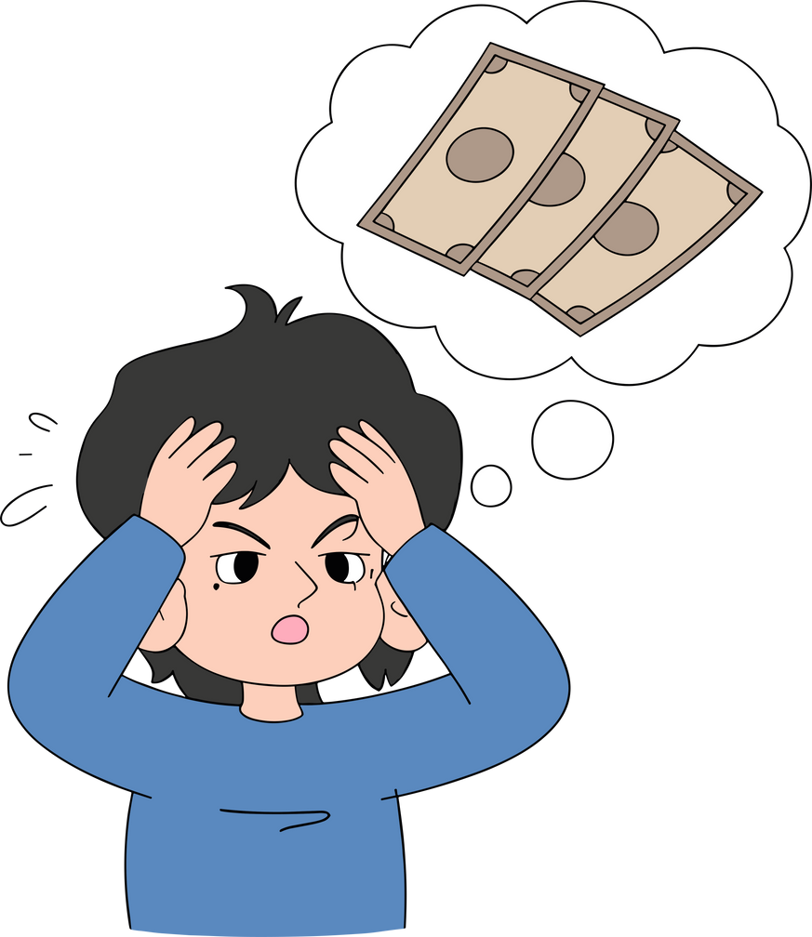
What If I can’t Afford To Pay My Tax Bill?
✅ Always file on time​
✅ Contact HMRC sooner rather than later to discuss options (Spread the bill with a Time to Pay plan)​
✅ Honesty, can often be the best policy​
⚠ Burying your head in the sand won’t make it go away​
⚠ Longer you leave it, more you could be racking up payments in overdue fines​
⚠ Can impact your own personal assets, if you’re a sole trader
Notes:
Overview / Snapshot Not every business can pay their tax bill in full and on time. HMRC understand this and offer “Time to Pay” arrangements. The key is to act quickly — file your return, then speak to HMRC before penalties mount. These plans let you spread the cost, but you must stick to the terms.
Why is filing on time still important?
Problem: Some people think if they cannot pay, there’s no point filing.
Solution: Filing on time avoids automatic late filing penalties. You can then focus on agreeing a payment plan.
Example: Jane owes £2,500 but cannot pay it all. She files by 31 January anyway, so avoids the £100 late filing fine. She then arranges a plan.
Pitfall: Failing to file creates two problems — late filing penalties and late payment penalties.
What is a Time to Pay plan?
Problem: Many SMEs do not realise HMRC will negotiate.
Solution: Time to Pay lets you pay in instalments. You can apply online if: • You owe £30,000 or less • You’re within 60 days of the deadline • You have no other payment plan in place
Example: Mike owes £4,000. He sets up a plan online to pay £400/month over 10 months.
Pitfall: Interest still applies. Defaulting on payments cancels the plan.
What if I owe more than £30,000 or miss the 60-day window?
Problem: Online plans only cover smaller debts.
Solution: Call HMRC to negotiate directly. They may agree a bespoke plan if you can show you’ll stick to it.
Example: A construction business owes £45,000. They call HMRC, share cash flow forecasts, and agree staged repayments.
Pitfall: Ignoring letters or calls can lead to enforcement action — debt collectors, court action, or freezing of bank accounts.
Why act early?
Problem: Many wait, hoping things improve.
Solution: The earlier you contact HMRC, the more flexible they are. Proactive communication builds trust and prevents escalation.
Engagement activity Ask: “Who here has ever felt nervous about calling HMRC?” Then reassure the group — HMRC would rather agree a plan than chase debt.
Summary of Slide 11 If you cannot pay in full, always file your return, then act quickly. Contact HMRC early or use the online Time to Pay system (if eligible). You can spread costs, avoid penalties, and reduce stress. Delay only makes the problem worse.

Slide 41
How Will I Know What To Pay In Tax?
HMRC has a free online Ready Reckoner tool
​
Enter your estimated profit for the year
​
It shows how much tax and NIC to set aside​
Only a guide – exact bill depends on your full circumstances​
Best practice: Use the next slide to work out percentage
Notes:
Overview / Snapshot
One of the biggest worries for sole traders is not knowing how much their tax bill will be.
HMRC provides a free online calculator called the Ready Reckoner. It estimates how much Income Tax and National Insurance you’ll owe based on your profit.
This makes it easier to plan ahead and avoid the “January shock.”
How it works
You go to GOV.UK and search for “HMRC Ready Reckoner.”
Enter your estimated annual profit (after business expenses).
The tool uses current year tax bands and NIC rates to show how much to set aside.
It will also suggest a monthly savings amount.
Example: If your expected profit is £25,000, the Ready Reckoner might suggest saving about £270 per month.
Important notes
It’s only a guide — the actual bill can differ if you have other income (employment, rental, dividends), student loans, or claim reliefs.
It doesn’t account for payments on account (where HMRC ask you to pre-pay some of next year’s tax).
It also doesn’t include VAT, which is separate.
Best practice
Even without the Reckoner, aim to save 20–25% of your profit each month into a separate “tax pot.”
This covers most sole traders and gives you a safety buffer.
Encourage participants to use a separate bank account or savings space for tax so they don’t dip into it.
Reflection question for the audience Ask: “How many of you have ever guessed your tax bill and been shocked when the real one came in?” → Use this to highlight why tools like the Ready Reckoner (and a consistent saving habit) are so valuable.
Summary of Slide 14 The HMRC Ready Reckoner is a free tool to estimate your tax and NIC. Use it alongside a disciplined savings routine — ideally 20–25% of profit each month — to stay in control and avoid surprises.

Slide 42
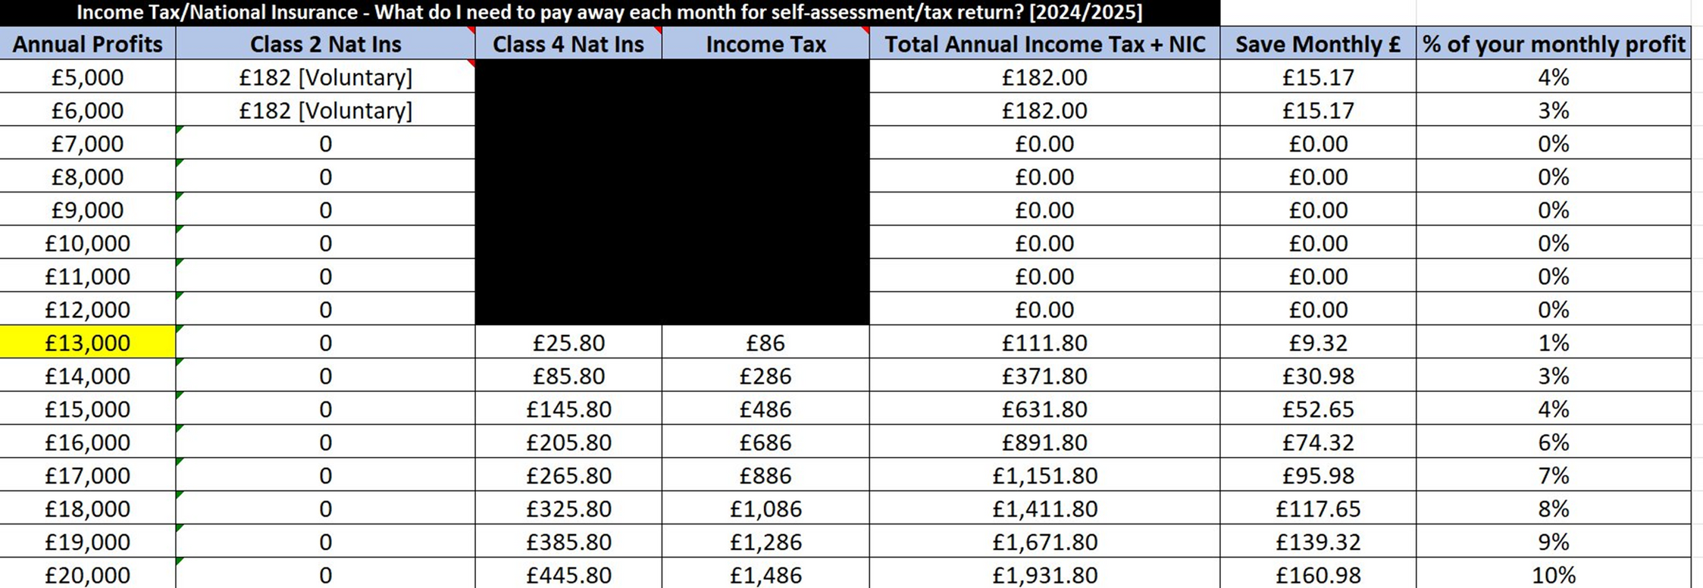
How Will I Know What To Pay In Tax?
Notes:
Overview / Snapshot
One of the biggest worries for sole traders is not knowing how much their tax bill will be.
HMRC provides a free online calculator called the Ready Reckoner. It estimates how much Income Tax and National Insurance you’ll owe based on your profit.
This makes it easier to plan ahead and avoid the “January shock.”
How it works
You go to GOV.UK and search for “HMRC Ready Reckoner.”
Enter your estimated annual profit (after business expenses).
The tool uses current year tax bands and NIC rates to show how much to set aside.
It will also suggest a monthly savings amount.
Example: If your expected profit is £25,000, the Ready Reckoner might suggest saving about £270 per month.
Important notes
It’s only a guide — the actual bill can differ if you have other income (employment, rental, dividends), student loans, or claim reliefs.
It doesn’t account for payments on account (where HMRC ask you to pre-pay some of next year’s tax).
It also doesn’t include VAT, which is separate.
Best practice
Even without the Reckoner, aim to save 20–25% of your profit each month into a separate “tax pot.”
This covers most sole traders and gives you a safety buffer.
Encourage participants to use a separate bank account or savings space for tax so they don’t dip into it.
Reflection question for the audience Ask: “How many of you have ever guessed your tax bill and been shocked when the real one came in?” → Use this to highlight why tools like the Ready Reckoner (and a consistent saving habit) are so valuable.
Summary of Slide 14 The HMRC Ready Reckoner is a free tool to estimate your tax and NIC. Use it alongside a disciplined savings routine — ideally 20–25% of profit each month — to stay in control and avoid surprises.

Slide 43


Slide 44
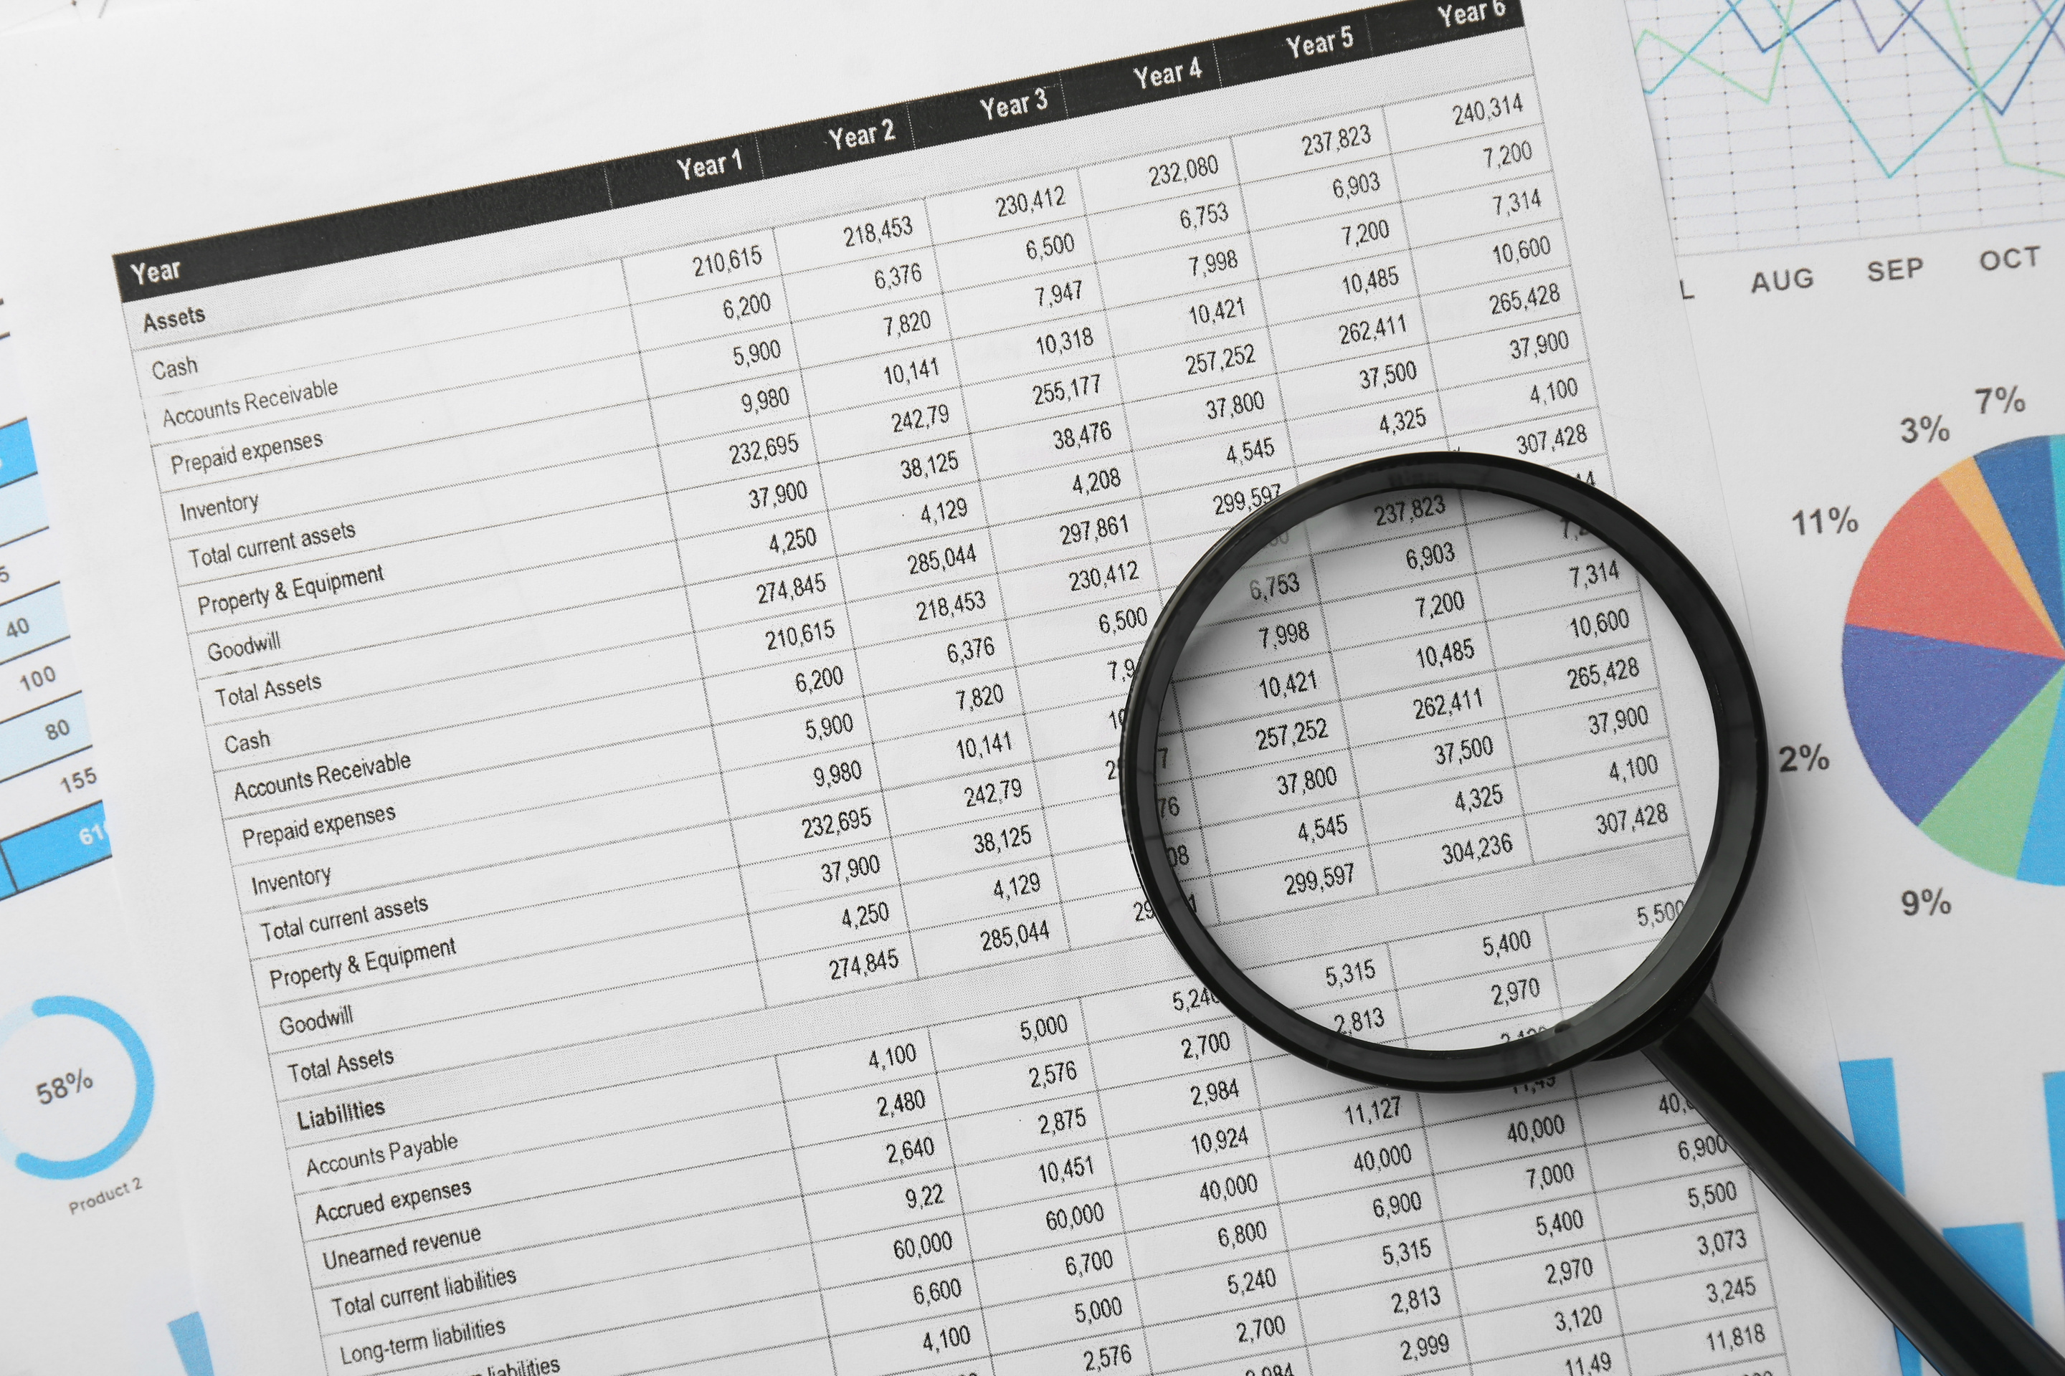
Bookkeeping

Slide 45
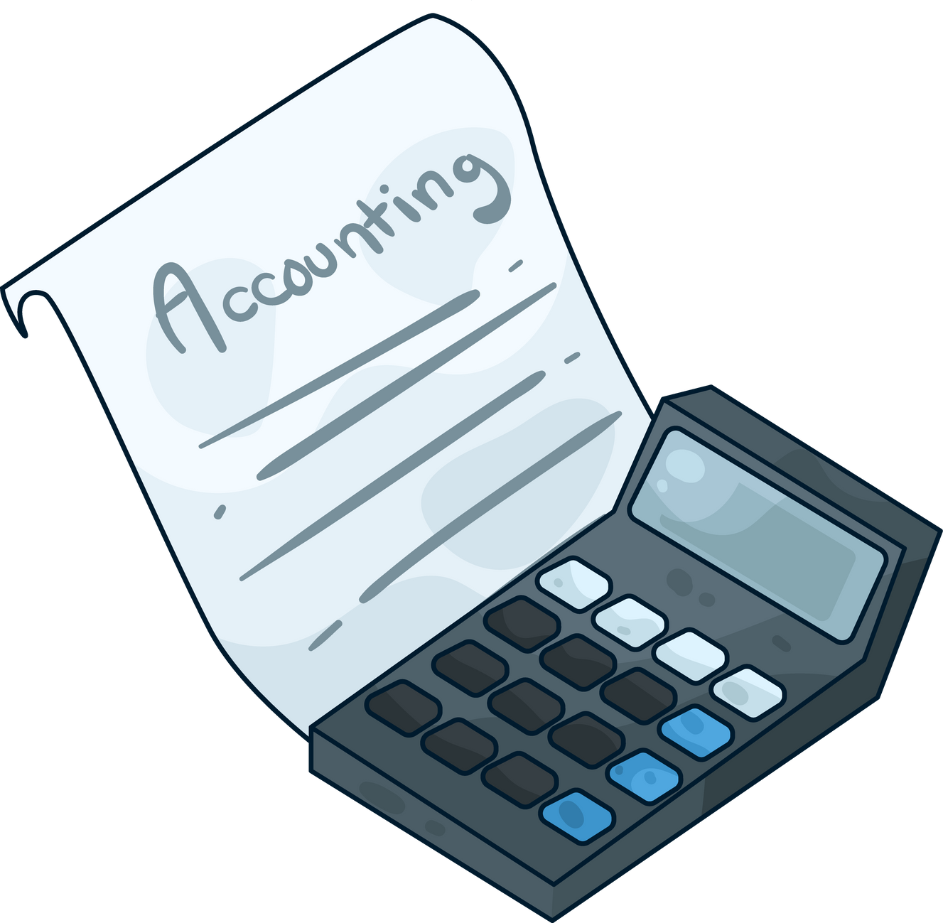
What is Bookkeeping ?
The process of tracking all of your business transactions so you can see where your business is spending money, where your revenue is coming from and which tax deductions you’ll be able to claim

Slide 46

Why Bookkeeping Matters - Beyond HMRC Compliance
Not just about tax – it shows how your business is really doing​
Clear books help you make better decisions​
Essential for funding, loans, and grants​
Protects cash flow and reduces financial stress

Slide 47
What is Bookkeeping ?
Basic vs. In-depth: Bookkeeping focuses on the basics—recording transactions in ledgers and journals. It's like keeping track of every penny spent and earned.
Accounting goes deeper, analysing those records to understand trends, performance, and to create financial reports like profit and loss statements and balance sheets.

Slide 48
What is Bookkeeping ?
Helps you catch more tax deductions
Helps you get loans or investment
Helps catch financial mistakes made by you and others (i.e. bank)
Gives a clear picture of where the money is going

Slide 49
More On Bookkeeping
Separate personal and business expenses:​
​
Not a legal requirement. This is good practice.​
Helps keeps business figures clear.​
Stops “leakage”. ​
Makes self assessment easier.​
If you are a sole trader you can use a current account for the business. ​
If you are a Ltd company you will need a business account.

Slide 50
More On Bookkeeping
Choose the system you will use:​
​
a)Paper and Pencil​
b)Spreadsheet​
c)Software​
a)Quickbooks​
b)Xero​
c)Wave​
d)Ember, etc.​
Worth remembering that, whichever system you use, you will still need to do the basics.​
A system will make your long-term accounting / book keeping needs much easier to manage. pen and paper can get messy and lost over the years.

Slide 51
More On Bookkeeping
Get ready for storage​
​
You must be able to “prove the expense”.​
​
You must store all records for 6 full tax years and they must be logical, legible and available.​
​
How and where you store is entirely up to you, but it must be accessible by you if asked.​
​
Scanners, The App Adobe Scan and taking photos of evidence will be useful!

Slide 52
More On Bookkeeping
Start to categorise expenditure:​
​
The sooner you start to split your expenditure up the better.​
​
For example: ​
Business Rent​
Business Phone​
Mileage​
Stock​
Etc, etc.

Slide 53

Key Takeaways
HMRC expects timely registration, filing, and payment — admin matters as much as finance​
Sole traders pay Income Tax & NI directly; Ltd companies pay Corporation Tax first, then personal tax on withdrawals​
Good bookkeeping is not just for HMRC — it helps you run and grow your business​
Weekly habits and tax saving routines prevent surprises and give peace of mind

Slide 54
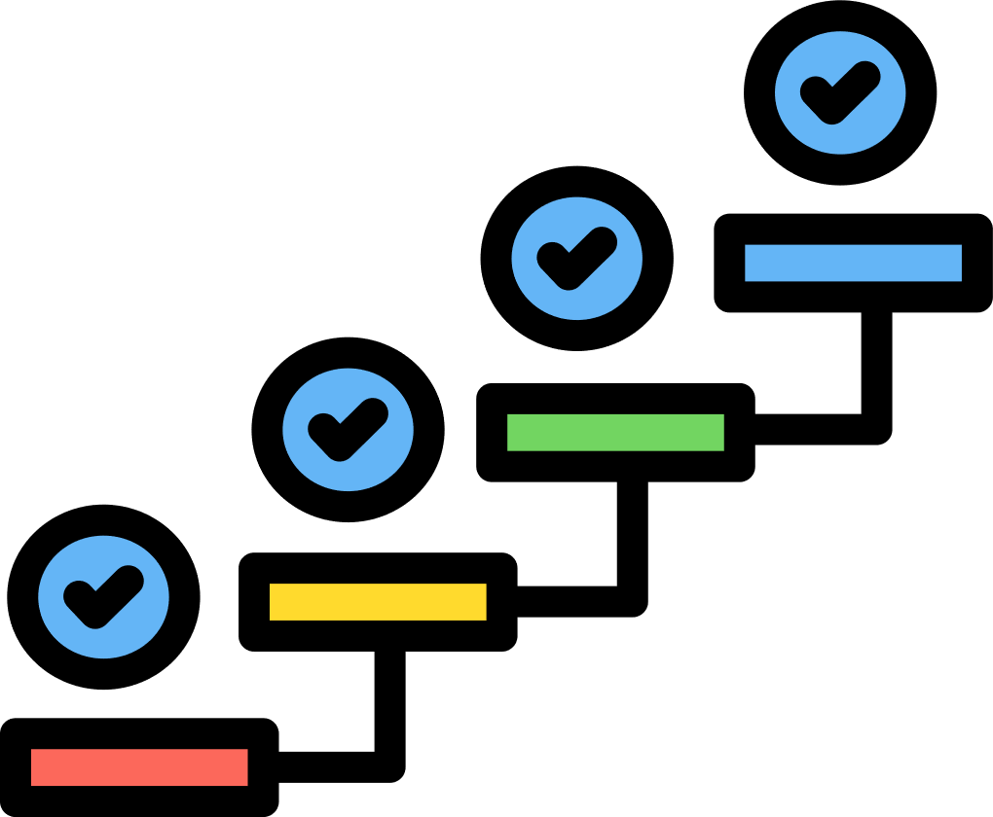
Key Considerations/ Next Steps
Choose a record keeping method you’ll actually use (paper, spreadsheet, or app)​
Commit to a routine: 30–60 minutes each week on your books​
Use the HMRC Ready Reckoner to estimate and save for tax​
Ask for help early — accountant, HMRC helpline, or local support network​
Remember: staying on top of admin gives you more time to focus on growing your business
Notes:
Overview / Snapshot This final slide is about action. Knowledge is useful, but only if you put it into practice. These steps are designed to be realistic and practical — things you can start doing today, not six months from now.
Choose a method you’ll actually use
Don’t worry about the “best” system — the best one is the one you’ll actually keep up with.
If you’re comfortable with pen and paper, use it. If you like spreadsheets, set one up. If you want automation, pick an app.
Consistency is more important than technology.
Commit to a weekly routine
Block out 30–60 minutes once a week for your books. Treat it like an appointment with yourself.
Use this time to log income, capture expenses, and check bank reconciliation.
Doing it weekly means you’ll never face a mountain of admin.
Use the HMRC Ready Reckoner
Go online, enter your estimated profit, and see how much tax and NI to set aside.
Use this figure to move money into a separate “tax pot” each month.
Example: If it says £270/month, transfer that as soon as you pay yourself.
Ask for help early
If you’re unsure, don’t wait until January. Call HMRC, speak to an accountant, or tap into local business support.
Problems grow when ignored — but HMRC is more flexible if you contact them early.
Remember the bigger picture
Staying on top of admin frees you up to focus on running and growing your business.
Admin is a foundation — it’s not the exciting part, but it enables everything else to work.
Closing reflection “Think about one step you can commit to today. Is it choosing your record keeping method? Setting up a weekly slot? Opening a separate tax savings account? Small steps make big changes over time.”
Summary of Slide 20b Next steps are simple: pick a method, build a weekly routine, use the Ready Reckoner, and ask for help early. By staying on top of admin, you give yourself the freedom to grow your business with confidence.
“Running a business can feel overwhelming, especially when it comes to tax and bookkeeping. But what we’ve seen today is that it doesn’t have to be complicated.
If you register properly, keep on top of deadlines, and build a simple weekly routine for your records, you’ll stay in control. HMRC stops being something to fear, and bookkeeping becomes a tool to help you run your business smarter.
Remember — you don’t need to be perfect. You just need to be consistent. Do the little things regularly, ask for help early, and your admin will never get the better of you. That gives you the freedom to focus on what really matters — growing your business and enjoying the rewards.”

Slide 55

Questions?
Thank you

Slide 56


Feedback and Next Steps
We want to hear from you!
Please use the QR code to send us your thoughts .

Slide 57
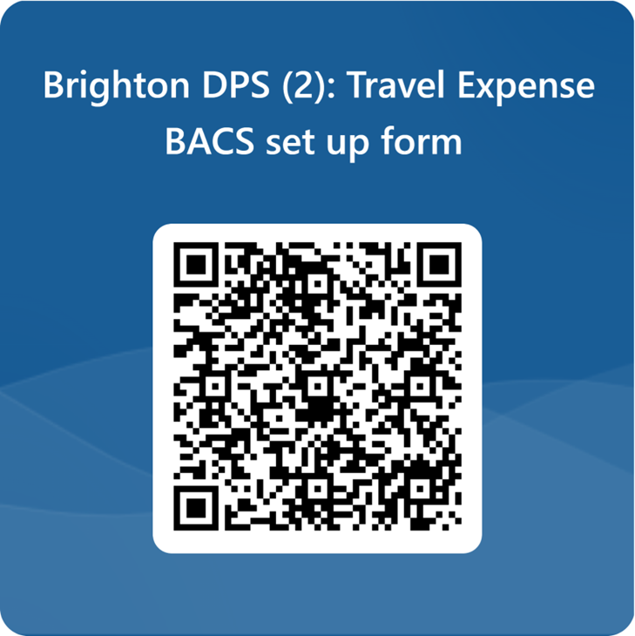
Travel Expenses
If you require travel expenses, use the QR code to claim. You can claim mileage and public transport but not parking unfortunately.

