Slide 1


Websites
& Your Business

Slide 2

Ways Of Working
100% confidentiality
No multi-tasking – be fully present
Arrive on time and stay for the whole meeting
Commit to asking questions, listening & being non-judgemental
Sharing the air space
Implement agreed actions (Do what you say you will do)
Feedback at the following session
Complete all participant surveys at the end of each session
Philosophy –
“The knowledge is in the room, let’s learn from others and share”

Slide 3

Disclaimer
The information in this presentation is focused on websites and is based on our own knowledge and research from a variety of online sources. While we have taken care to ensure the information is accurate and current, we cannot guarantee it is error-free or that it will remain accurate over time. We cannot be held liable for any mistakes, omissions, or inaccuracies in what is presented. We encourage you to conduct your own research and verify the information before making decisions based on it. We are business advisers, not website developers or technical specialists.
The content we share today is for educational and demonstration purposes only. Our insights come from business experience, general observations, and publicly available resources. Because the online landscape evolves quickly—whether in terms of platforms, tools, design trends, regulations, or user expectations—some examples we provide may already be outdated, modified, or discontinued. Certain features we mention may only be available in paid versions of services, or may later become restricted. Free tools and platforms can also change their terms, pricing, or availability without notice.
Nothing in this presentation should be taken as absolute fact, legal advice, or technical instruction. Before making decisions for your business or website, always check details with trusted, up-to-date sources and consult professional experts when needed. The aim of this session is to build awareness, spark ideas, and encourage exploration—not to provide definitive answers. Responsibility for how you apply these insights rests with you as the business owner or decision-maker.

Slide 4
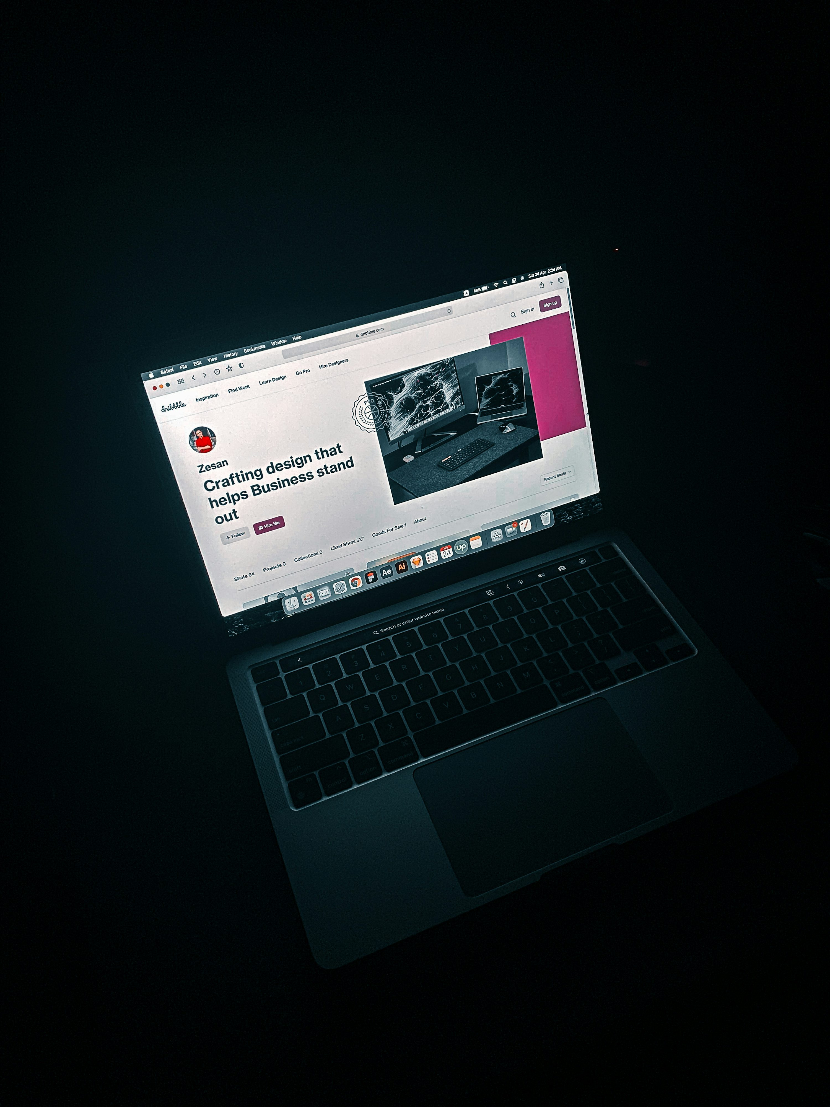
What We Will Cover
Why Websites Matter
The Basics
Different Types of Websites
Website Best Practices
Looking at Competitors
Search Engine Optimisation (SEO)
Keywords and Activities
Technical Touches
DIY vs Professional Build

Slide 5
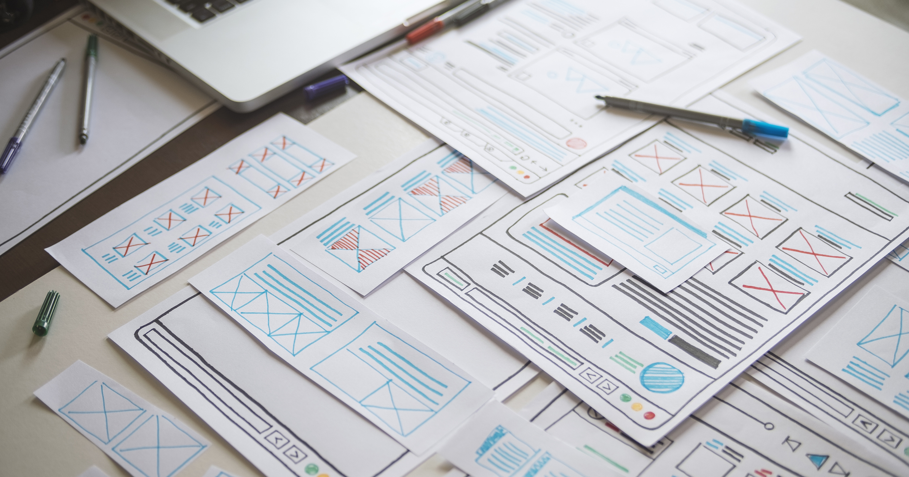
The Importance
78% of small business owners in the UK have a website and nearly 84% of those say it plays a big part in their success.
Over 80% of consumers conduct online research before making a purchase.
Notes:
Key Points:
Most businesses have websites.
Customers research online.
Websites are vital.
Talking Points:
Share that 78% of small business owners in the UK now have a website, showing how mainstream and essential they have become.
Note that of those business owners, over 80% believe their website plays a big part in their success.
Highlight that customers are increasingly relying on the internet — over 80% of consumers research online before making a purchase decision.
Stress that without a website, businesses miss out on being visible at the very moment potential customers are searching.
Position the website as a foundation of modern business credibility — if you don’t have one, people may not take your business as seriously.

Slide 6

Websites
Explained
Notes:
Key Points:
Your online space.
You control it.
It’s your hub.
Talking Points:
Define a website as your one online space that belongs entirely to your business.
Unlike social media accounts, which are controlled by outside platforms, your website is yours to design and manage however you like.
You control the information, how it looks, and how it functions.
Explain that your website acts as a central hub, bringing together all other marketing and communication channels.
Stress that it’s the single most reliable place for customers to find accurate, up-to-date information about your business.

Slide 7

Websites
The Basics
A website is the one singular online space that belongs entirely to you and your business.
Your website is a space where you decide what information appears, how it works and how it looks.
It is a central hub for everything regarding your business.

Slide 8



Behind Your Website
Hosting
Domain
The place where your websites files, images and text are stored
Provided by a hosting company, usually paid monthly or yearly
Recommendations:
Ineos.co.uk
Godaddy.co.uk
Siteground.co.uk
The address people type in to visit your website; www.website.co.uk
Registered with a domain provider, usually paid for yearly
Recommendations:
Godaddy.co.uk
Names.co.uk
Notes:
Key Points:
Hosting = storage.
Domain = address.
Both needed.
Talking Points:
Introduce the concept of hosting: the place where all the files that make up your website are stored.
Compare hosting to the physical location of a shop — it’s where everything sits, even if customers can’t see it directly.
Explain that a domain is the website’s address, such as www.business.co.uk, that people type into their browser.
Use the analogy: the domain is the street address, and the hosting is the actual building. You need both for people to visit.
Remind the audience that both services are usually paid for separately, either monthly or yearly, and are essential for being online.

Slide 9
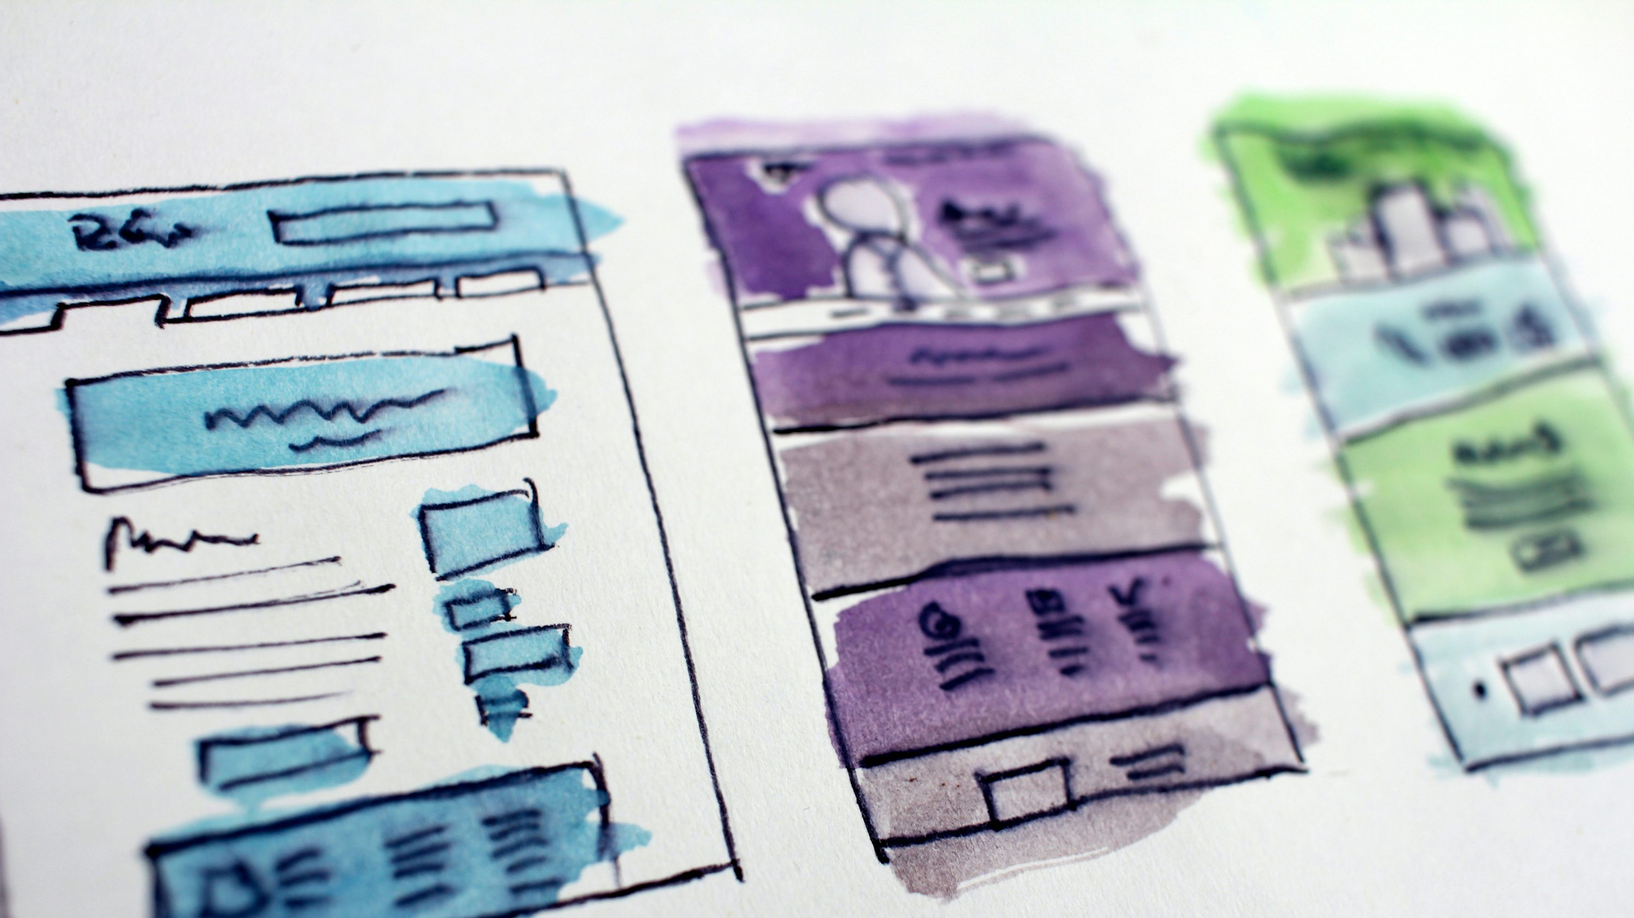




How It Works
User
Domain
Hosting
Website
The domain directs traffic to the hosting server which is where your site lives, both hosting and domain are needed to have a visible website online.
Notes:
Key Points:
Users type your domain.
Domain points to hosting.
Hosting shows your site.
Talking Points:
Walk through the process step by step: a user types in your web address.
The domain then directs them to the server where your website is hosted.
The hosting server delivers the files — text, images, and layout — to their screen.
This happens instantly and seamlessly from the user’s perspective.
Without both hosting and a domain working together, your site cannot be visible online.

Slide 10

Domains
Your domain name is your digital address — it’s how people find you online.
Choose something short, memorable, and easy to spell.
Whenever possible, use your business name or a clear variation of it.
Stick with trusted extensions like .com, .co.uk, or industry-specific options (.studio, .store).
Keep it consistent with your brand to build recognition and trust.
Notes:
Your domain is your digital address.
Think of your domain like your business’s street address on the internet. It’s where customers find you, and it sets the tone for your brand online. If your domain looks professional, people are more likely to trust your website before they even click.
2. Keep it short, simple, and memorable.
You want something that’s easy to say, spell, and remember. Avoid hyphens, complicated spellings, or long names. If someone hears your business name in conversation, they should be able to type it in without confusion.
3. Use your business name or a clear variation.
Ideally, your website domain matches your business name — for example, yourbusinessname.com.
If that’s not available, try adding a simple, relevant word — like yourbusinessnameonline.com or yourbusinessnameuk.co.uk.
4. Choose the right extension.
“.com” is still the most recognized globally, but local or industry extensions can work too:
.co.uk if your audience is mostly UK-based.
.store, .studio, .agency, etc. if it fits your business type.
It’s more about what feels authentic and credible to your audience.
5. Stay consistent with your brand.
Make sure your domain matches your business identity across all platforms — your logo, social media handles, and email. For example, if your brand is “BrightStudio,” you’d want brightstudio.com and hello@brightstudio.com — that consistency builds trust.
Optional Add-on Talking Point:
If you have time, mention that owning multiple variations (like .com and .co.uk) can protect your brand and prevent confusion or impersonation later on.

Slide 11
Understanding Website Hosting Platforms
Shared Hosting: Budget friendly option where multiple websites share one server - good for small sites but slower during peak times.
Cloud Hosting: Scalable, reliable, and fast - your website runs across multiple servers, reducing downtime and improving performance.
Dedicated/Physical Hosting: You get a full server for your site - ideal for large businesses needing maximum control and speed.
Platform-Specific Hosting: Builders like Shopify, Wix, Squarespace, WordPress.com include hosting - easy setup, automatic updates, and less tech management.
Choose based on your goals: Prioritise speed, security, scalability, and how hands-on you want to be.
Notes:
Hosting = your website’s home. It’s where your files, images, and data live so people can access your site 24/7.
Shared hosting is like renting a room in a big house — it’s cheap, but you share resources with others.
Cloud hosting is like living in multiple connected apartments — if one has an issue, another picks up the slack.
Dedicated/physical hosting gives you full control and speed, but it’s more expensive and requires management.
Platform-specific hosting (like Wix or Shopify) includes everything in one package — great for non-technical users who want convenience.
Remind them: Hosting affects speed, reliability, and security, all of which directly impact customer trust and SEO.

Slide 12



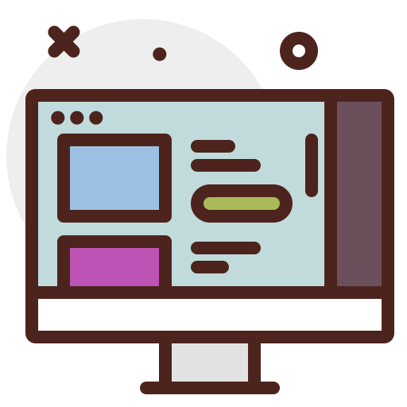



Different Types of Websites
Promotional Website
Ecommerce Website
Portfolio Website
Personal Brand Website
Booking Website
Blog/News Website
Notes:
Key Points:
Different purposes.
Examples: shop, portfolio, blog.
Pick based on goals.
Talking Points:
Explain that not all websites are the same — they serve different business purposes.
A promotional website works like an online brochure, giving basic information about your business.
An ecommerce site allows businesses to sell products directly online.
Portfolios are often used by creatives to showcase their work, while booking websites are popular with service businesses.
Blogs and news sites are for sharing regular updates and insights, helping businesses stay relevant and visible.

Slide 13

Websites
Understanding your ‘Why?’
Notes:
What is their reason for the website?
What are they trying to achieve through it?
What are they pushing visitors to do?

Slide 14
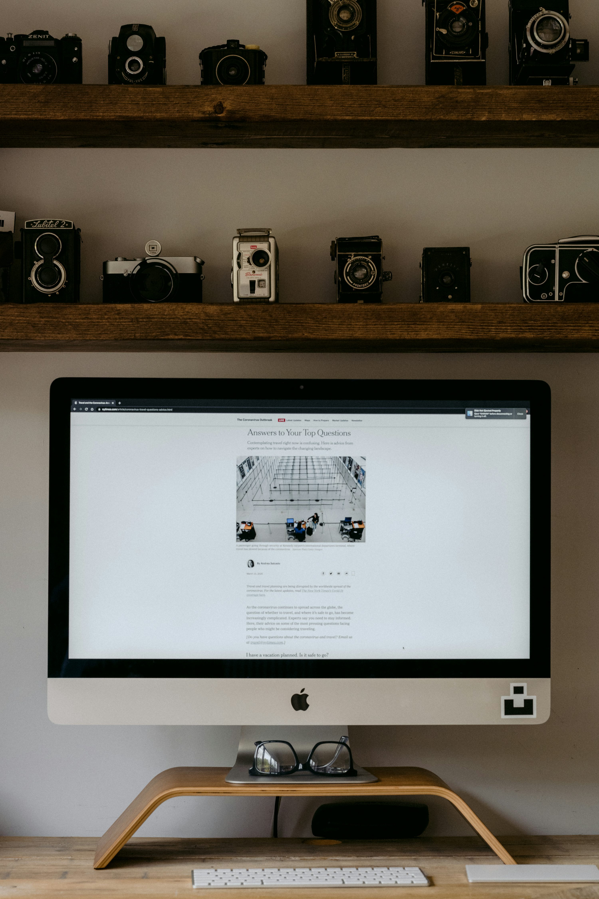
The Purpose of Your Website
Every website should have a clear purpose.
Knowing your “why” guides design, content, and functionality.
Aligns your website with your overall business objectives.
Helps convert visitors into customers or leads.

Slide 15
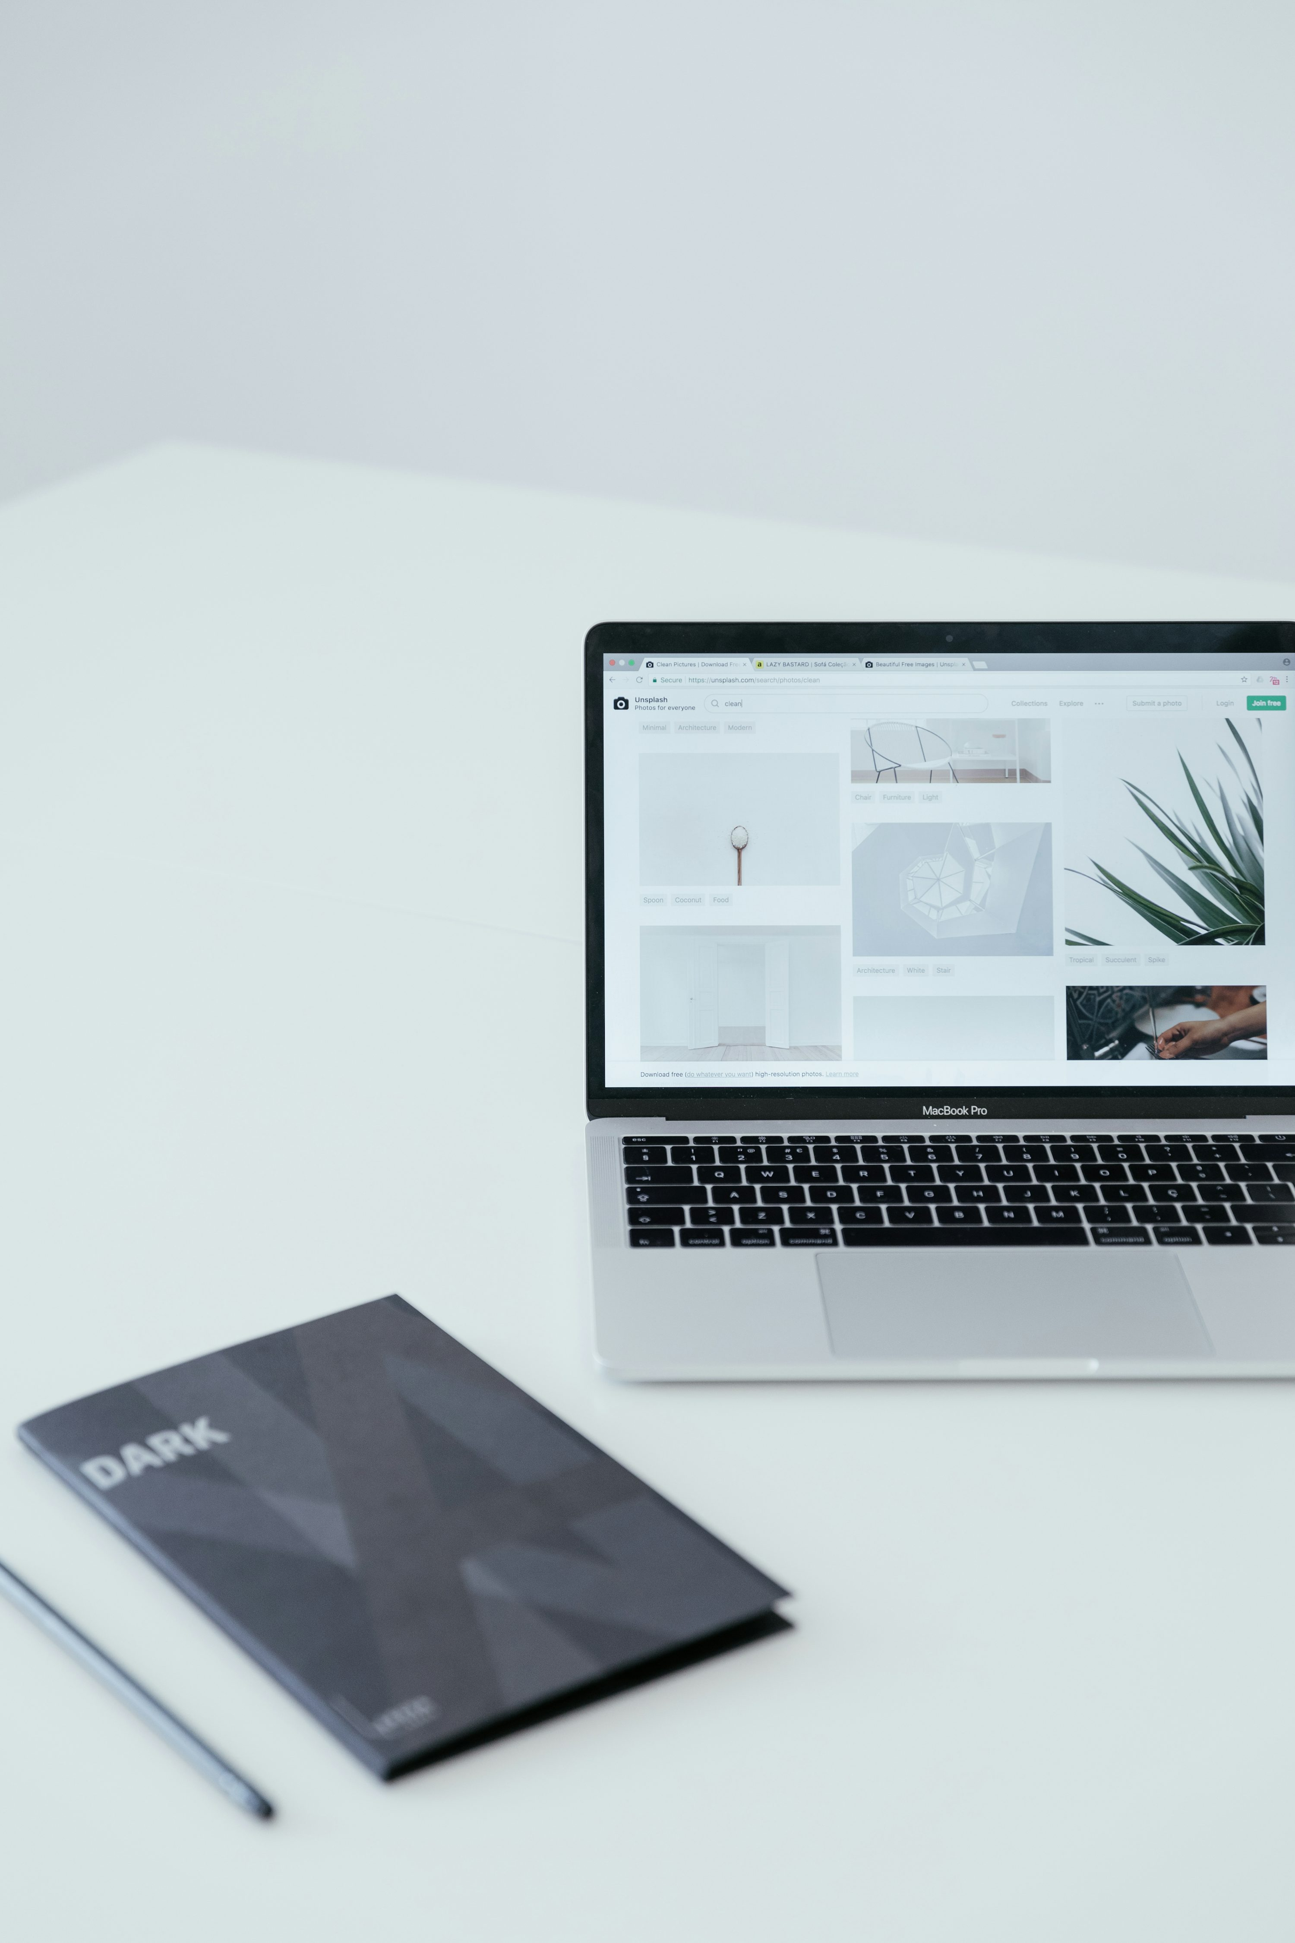
Common Reasons Business
Owners Have Websites
Increase brand awareness and credibility.
Generate leads or sales.
Share information about products or services.
Build an audience or community.
Demonstrate expertise in your industry.

Slide 16

Define Your Website Goals
Identify the main action you want visitors to take.
Examples: Make a purchase, book a consultation, sign up for a newsletter.
Every page should support your main goal.
Goals guide content, design, and call to actions.
Clear goals improve engagement and conversions.

Slide 17

Understanding Visitor Intent
Visitors come with different needs: learn, solve a problem, buy, or contact you.
Guide them with clear navigation and content.
Align website structure with visitor goals.
Anticipate questions or obstacles for smoother conversions.
A purposeful website leads visitors to take action.

Slide 18

Self Assessment
Why do I need a website for my business?
What is the main action I want visitors to take?
How does the website support business goals?
Are visitors guided toward my desired actions?
Am I measuring results based on my “why”?

Slide 19




Website Builders & Their Popularity
As of 2025, here’s how much of the web is powered by the following website builders:
WordPress – 43 %
Wix – 4 %
Shopify – 5 %
Squarespace – 3 %
Notes:
Activity:
Has anyone used any of these before?
Run through pros and cons of each
WordPress
Pros:
Very flexible and customisable
Thousands of themes and plugins
Great for long-term growth
Cons:
Requires more setup and updates
Can feel technical for beginners
Hosting and domain bought separately
Squarespace
Pros:
Stylish, professional designs
All-in-one package (hosting, tools included)
Easy to manage
Cons:
Less flexible than WordPress
Limited custom features
Smaller choice of templates
Wix
Pros:
Very beginner-friendly
Drag-and-drop design
Quick to set up
Cons:
Not ideal for large or complex sites
Can look less professional if not designed well
Harder to switch away later
Shopify
Pros:
Excellent for ecommerce
Built-in sales, payments, and shipping tools
Secure and reliable
Cons:
Monthly fees can be higher
Less flexible for non-shop websites
Customisation beyond ecommerce is limited

Slide 20
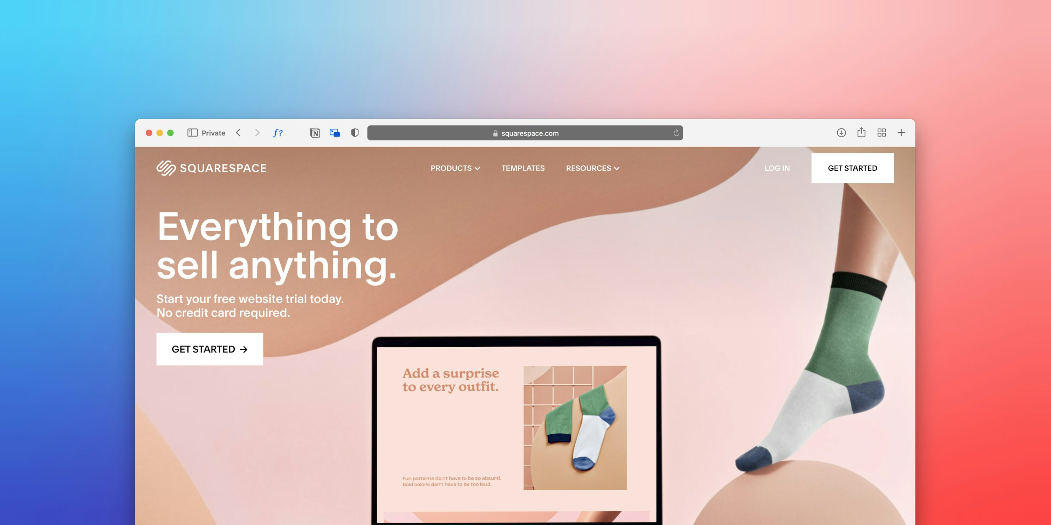
Website Tips

Slide 21




Tips For Websites
Quality Content
Relevant Information: Valuable and appropriate to your audience.
Regular Updates: Keep content fresh and current
Engaging Content: High quality images, videos and infographics
Example 1
Example 2
Example 3
Notes:
Key Points:
Relevant and fresh.
Engaging visuals.
Avoid stale text.
Talking Points:
Content is at the heart of a successful website — it needs to be relevant and useful to your audience.
Regularly updating your content keeps your site fresh and shows your business is active.
Stale or outdated information can make people think your business is inactive or unreliable.
High-quality visuals such as photos, videos, and infographics help bring your site to life.
Well-written, clear text builds confidence in your brand and encourages customers to take the next step.

Slide 22

The Power of Visuals
People process visuals 60,000x faster than text - first impressions matter.
Use authentic, high quality images that reflect your brand and audience.
Real photos > stock photos - they build trust and relatability.
Incorporate videos, icons, and infographics to explain complex ideas simply.
Keep visuals consistent in style, colour, and tone to strengthen your brand identity.
Notes:
First impressions happen in seconds.
When someone lands on your site, their brain decides almost instantly whether they trust you or not — and that’s largely based on what they see. Visuals are processed much faster than text, so your design and imagery often communicate your brand message before a visitor even reads a word.
2. Use authentic, high-quality imagery.
Your visuals should feel real and true to your brand. If you’re a local business, show your team, your workspace, or your real customers. It helps potential clients imagine themselves engaging with your business.
3. Avoid overused stock photos.
Generic stock images can make your brand look impersonal or unoriginal. They’re fine as placeholders, but ideally, use custom photography or at least carefully chosen stock that fits your tone and audience.
4. Go beyond photos — use video, icons, and graphics.
Visual storytelling doesn’t just mean pictures. Short videos, product demos, and explainer graphics can quickly show what you do or how you solve a problem. Icons and infographics are great for simplifying complex information, especially on service pages.
5. Keep your visuals consistent.
Consistency builds brand recognition. Use the same colour palette, style, and tone across your website, social media, and marketing materials. When everything looks and feels unified, your business appears more professional and trustworthy.

Slide 23
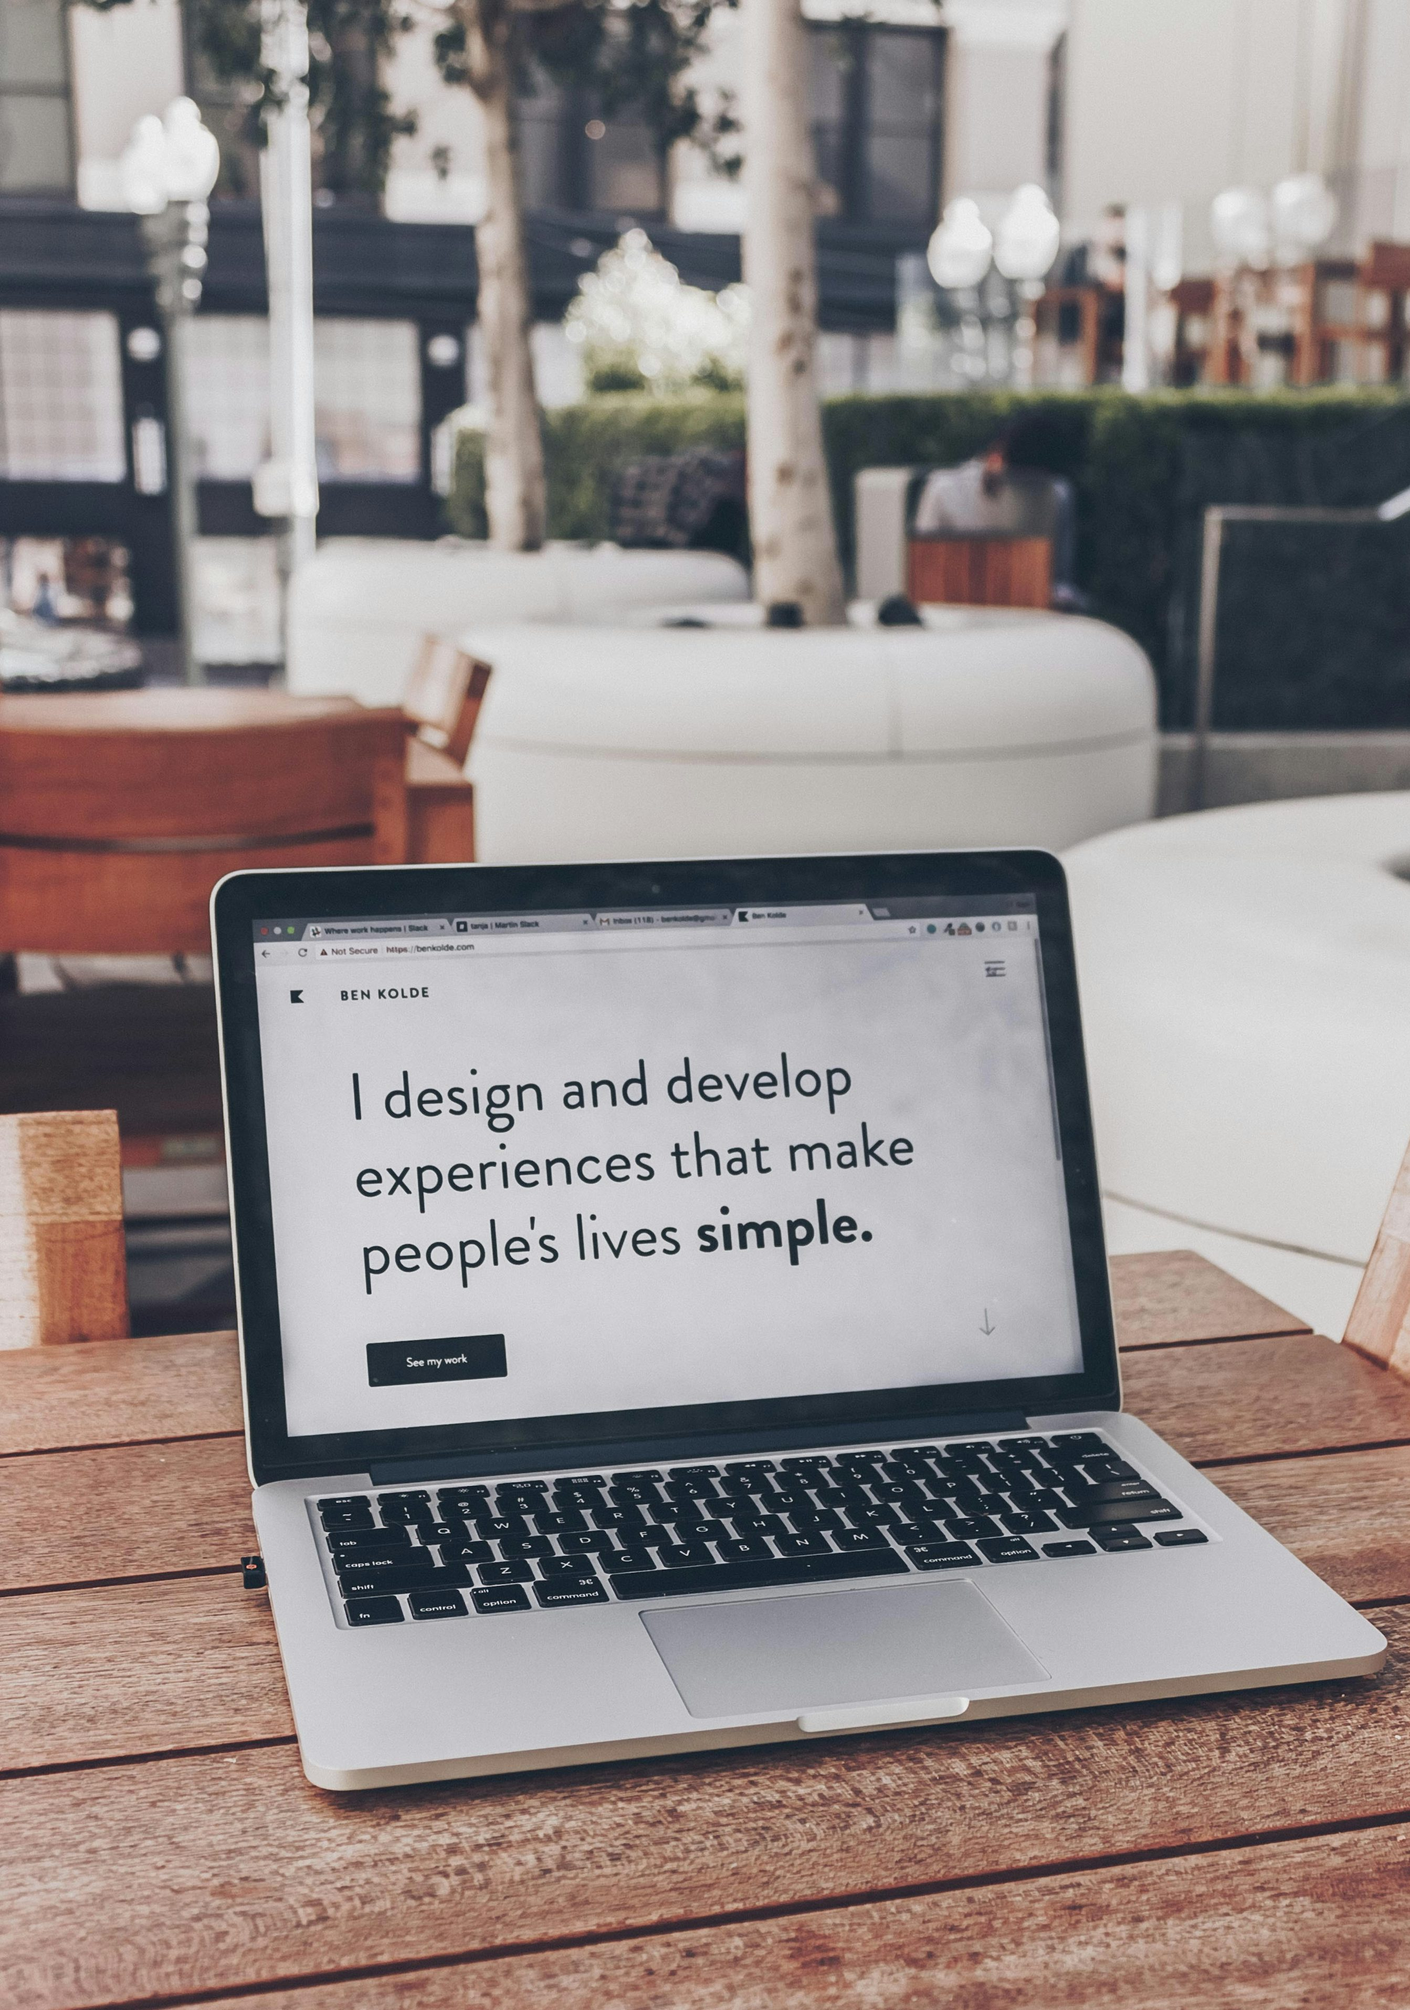

Tips For Websites
User Friendly Design
Simple Navigation: Intuitive menus and links
Responsive Design: Mobile-friendly and cross-device compatibility
Consistent Layout: Cohesive experience throughout the site
Readable Fonts: Legible and appropriately sized with good contrast
Notes:
Key Points:
Simple and intuitive.
Mobile-friendly.
Readable and consistent.
Talking Points:
A user-friendly design is crucial because if people can’t navigate your site quickly and easily, they will leave.
Keep menus simple, layouts consistent, and make sure visitors can find what they need in just a few clicks.
Your website must work across devices, because most people now browse on phones and tablets.
Using consistent design elements builds trust and makes your business look professional.
Readable fonts and strong contrast are important so that text is clear to everyone.

Slide 24


Tips For Websites
Call To Actions (CTA)
Consistency & Branding
Brand Identity: Consistent logos, colors, and messaging
Professional Appearance: Trustworthy and professional look
Clear CTAs: Prominent placement and clear wording
Limit Choices: Guide users towards desired actions without overwhelming them
Notes:
Key Points:
Clear CTAs guide visitors.
Branding builds trust.
Professional look matters.
Talking Points:
Calls to Action, such as “Book Now” or “Contact Us,” are prompts that guide visitors to do something specific.
CTAs should stand out visually, be clear in their wording, and appear in the right places on your website.
Branding ensures your site feels consistent, using the same colours, logos, and style across all pages.
Strong branding builds recognition and makes customers feel more confident in your professionalism.
A well-branded, professional-looking site makes people far more likely to trust and engage with your business.

Slide 25
Competitors
Google one of your competitors and look at their website.
Ask yourself:
What do you like?
What would you change?
Notes:
Key Points:
Review competitor sites.
Spot strengths and gaps.
Learn by comparison.
Talking Points:
Encourage participants to look at competitor websites to see how they present themselves.
Ask them to consider what they like about the competitor’s site — perhaps it is easy navigation, strong visuals, or clear information.
Also encourage them to think critically about what could be improved or what doesn’t work well.
Explain that this exercise is about learning from others, not copying, and using those insights to improve your own site.
Remind them that reviewing competitors can highlight both opportunities and potential risks.

Slide 26
Building Trust Online
Include social proof — reviews, testimonials, logos.
Have clear contact info and an About page.
Show certifications, partnerships, or awards if relevant.
Use professional images and clear branding.
Display privacy policy, terms, and secure checkout (if applicable).
Notes:
People buy from people (and brands) they trust.
When someone lands on your website for the first time, they’re asking: “Can I trust this business?” Your job is to answer that question quickly through design, content, and transparency. Without trust, even the best-looking website won’t convert visitors into customers.
2. Social proof builds credibility.
Testimonials, client logos, reviews, or case studies show that other people have worked with you and had positive experiences. It’s the digital equivalent of a personal recommendation — and it’s incredibly powerful. If possible, include photos, names, or business names to make testimonials more authentic.
3. Be open and approachable.
Make it easy for visitors to contact you — clear phone number, email, or contact form. Include an About page that tells your story: who you are, what you stand for, and why you do what you do. People connect with stories, not just services.
4. Professional presentation matters.
High-quality images, consistent branding, and a clean layout send a signal that your business is legitimate and established. Poor visuals or typos can make even a great business look unprofessional. Think of your website as your storefront — it should make a good first impression.
5. Show you’re secure and reliable.
If you collect any customer data or take payments, display trust badges or SSL (the little padlock in the browser). Add a privacy policy and terms of service — not only is it professional, it’s also a legal requirement in many cases. Security gives visitors peace of mind.

Slide 27
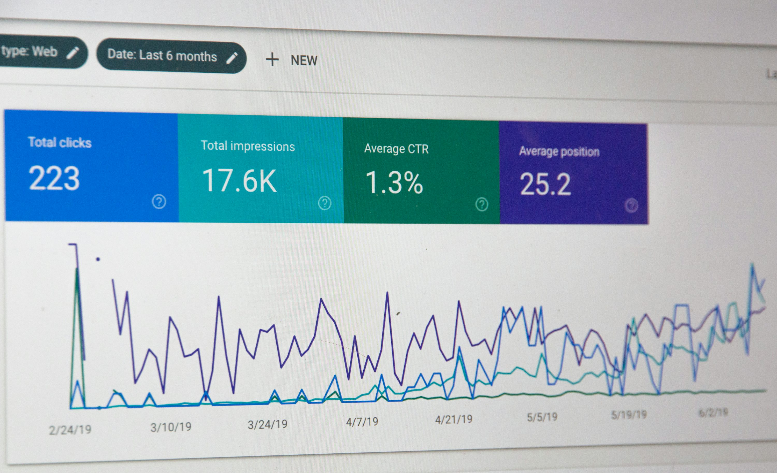
Search Engine Optimisation (SEO)
Explained

Slide 28

Search Engine
Optimisation
What is SEO?
The process of making your website easier to find on Google and search engines
Helps your website to appear higher when people search for your services or areas related to your business
It assists with bringing in visitors to your website who are already looking for what you offer
Notes:
Key Points:
SEO = findability.
Higher search rankings.
Attracts ready customers.
Talking Points:
Search Engine Optimisation, or SEO, is about making your website easier to find on Google.
When someone searches for a service you provide, SEO helps your site appear higher in the results.
A higher position in search rankings means more visibility and more visitors to your site.
Importantly, the people who find you this way are actively looking for what you offer.
This makes SEO one of the most effective ways to attract ready-to-buy customers.

Slide 29
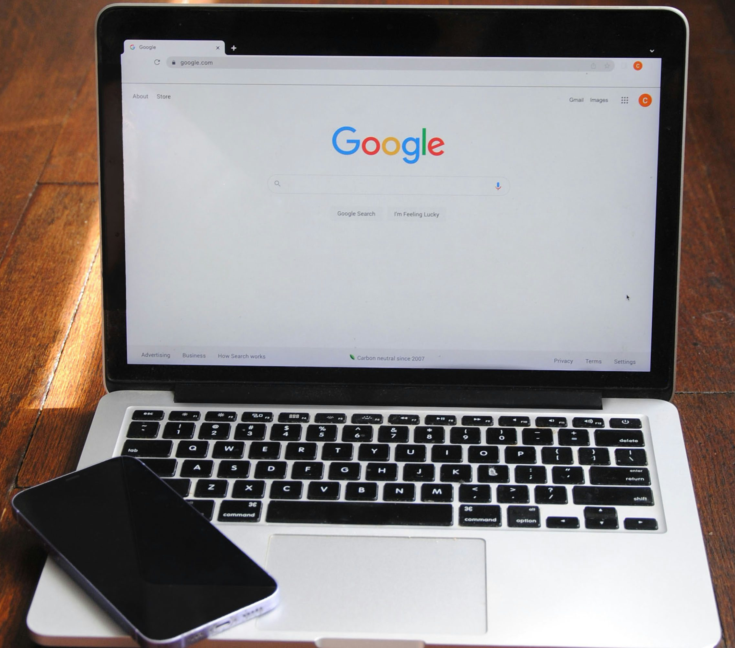
Why SEO Matters
SEO Benefits
More visibility for your business online
Brings in free traffic rather than paid advertising
Builds trust, people often trust higher ranking websites
Works 24/7 to bring in potential customers
Notes:
Key Points:
More visibility.
Free traffic.
Builds trust.
Talking Points:
SEO increases your visibility online and helps your business stand out in search results.
Unlike paid advertising, SEO can bring in free traffic without ongoing costs.
Websites that rank highly are often seen as more trustworthy and credible by customers.
SEO works around the clock, bringing in potential customers even while you’re not actively promoting.
Investing in SEO builds long-term value for your business, not just short-term results.

Slide 30
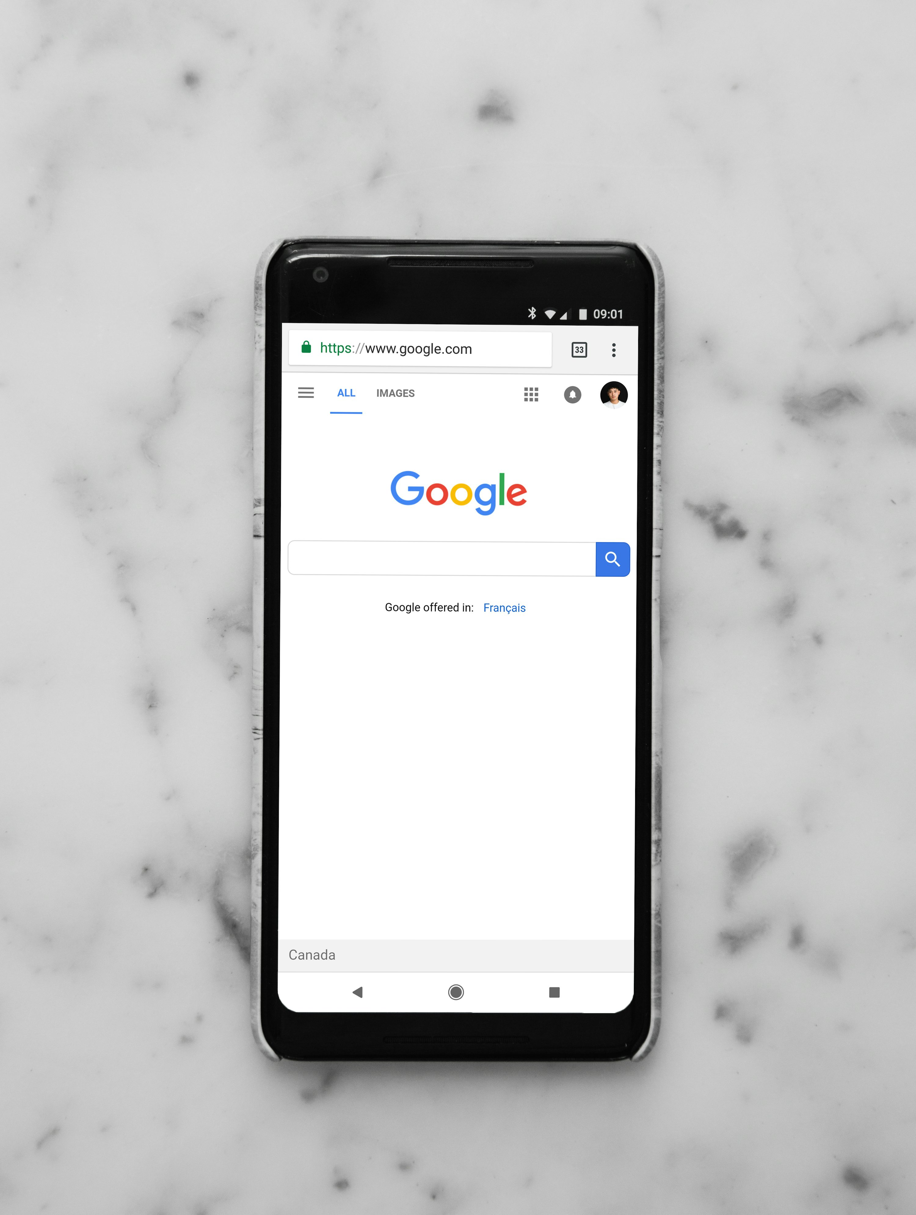
Best Practices
Simple solutions that work
Use short – descriptive website address slugs (e.g website.co.uk/services)
Add alt text to images, this allows the search engines to understand them
Link your pages to guide visitors
Gather reviews and testimonials – they help local search rankings
Stay on top of current SEO trends, SEO is an ongoing practice – don’t fall behind
Notes:
Key Points:
Short page addresses.
Alt text for images.
Links and reviews.
SEO is ongoing.
Talking Points:
Keep your page addresses short and descriptive, for example yourbusiness.co.uk/services rather than long strings of numbers or symbols.
Add alt text to your images so search engines can understand them and improve your visibility.
Link your pages together internally to guide visitors and help Google crawl your site more effectively.
Collect reviews and testimonials, as they not only build trust but also improve your local search rankings.
Remember that SEO is an ongoing practice — you can’t just set it up once and forget it.

Slide 31
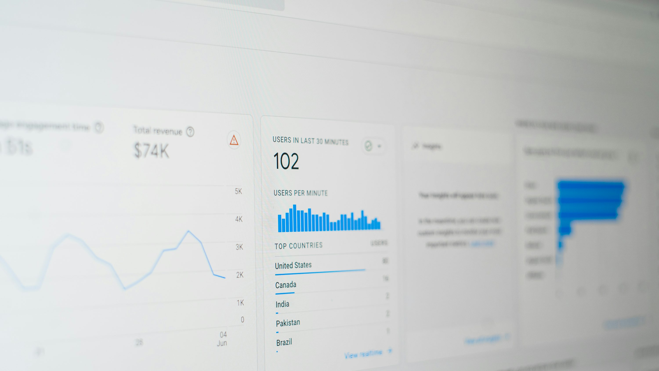
Key Areas To Focus On
Use clear and simple page headings and titles
Add keywords your customers would type into Google
Keep content relevant, accurate & up to date
Make sure your website loads quickly and works on mobile
Notes:
Key Points:
Clear headings.
Use keywords.
Keep content current.
Fast and mobile-friendly.
Talking Points:
Use simple and clear headings so visitors and search engines understand what each page is about.
Include keywords that your customers would type into Google when looking for your services.
Keep your content accurate, relevant, and up to date to show your business is active.
Make sure your website loads quickly because slow sites drive people away.
Check that your website works properly on mobile devices, as most browsing now happens on phones.

Slide 32
Keywords & SEO
In groups, make a list of keywords you would expect a customer would type in when looking for your service/business
Notes:
Key Points:
Brainstorm search terms.
Think like a customer.
Use results in content.
Talking Points:
This activity is about identifying the keywords your customers would actually use in search engines.
Think like your customers — they may not use the same technical words that you use in your business.
For example, a plumber might think “pipe repair,” but most people will type “fix leaking tap.”
Once identified, these keywords should be used naturally in your website content.
This ensures your website matches what customers are really searching for.

Slide 33

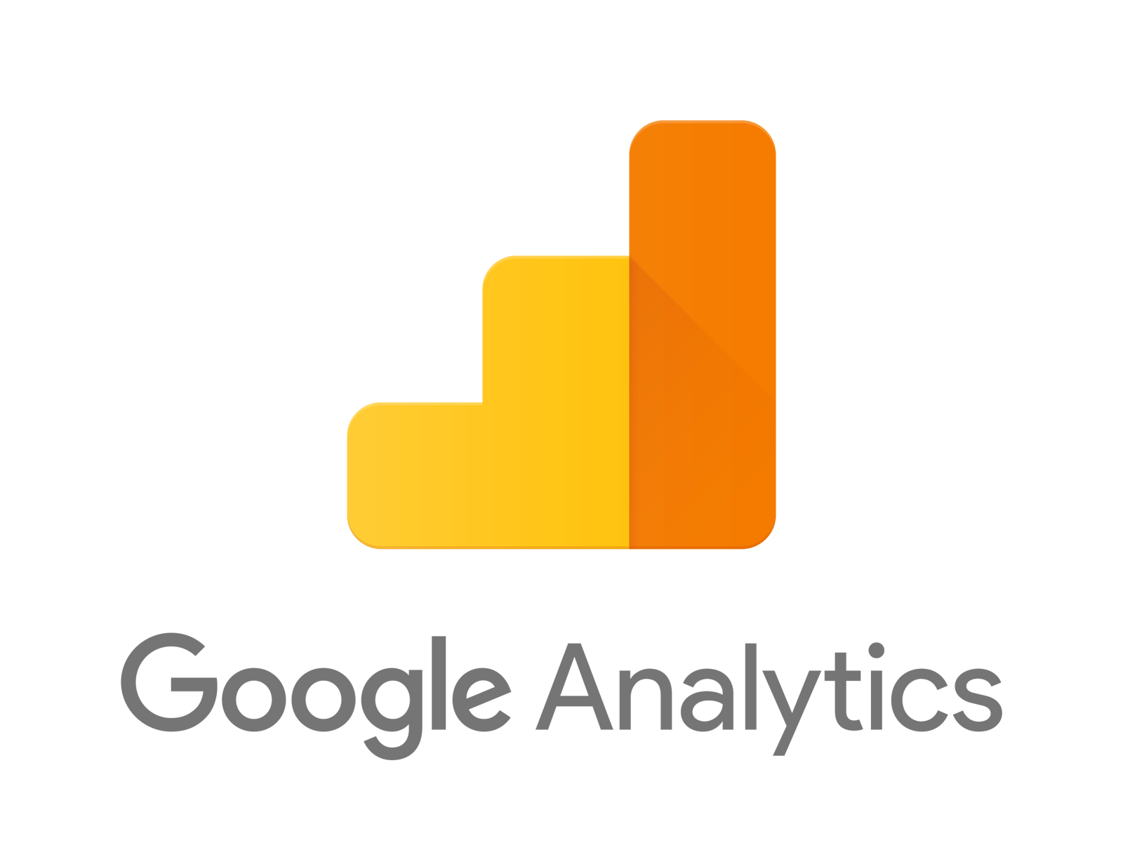
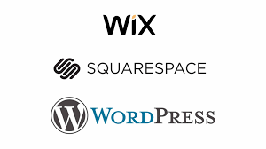
Best Analytics Tools
Notes:
Key Points:
Track visitor behaviour.
See what works.
Free tools available.
Talking Points:
Analytics tools let you see how visitors interact with your website.
They show which pages are most popular and where people are leaving the site.
This information helps you understand what’s working well and what needs improvement.
Free tools such as Google Analytics give small businesses powerful insights without cost.
Using data means you can make decisions based on evidence, not guesswork.

Slide 34
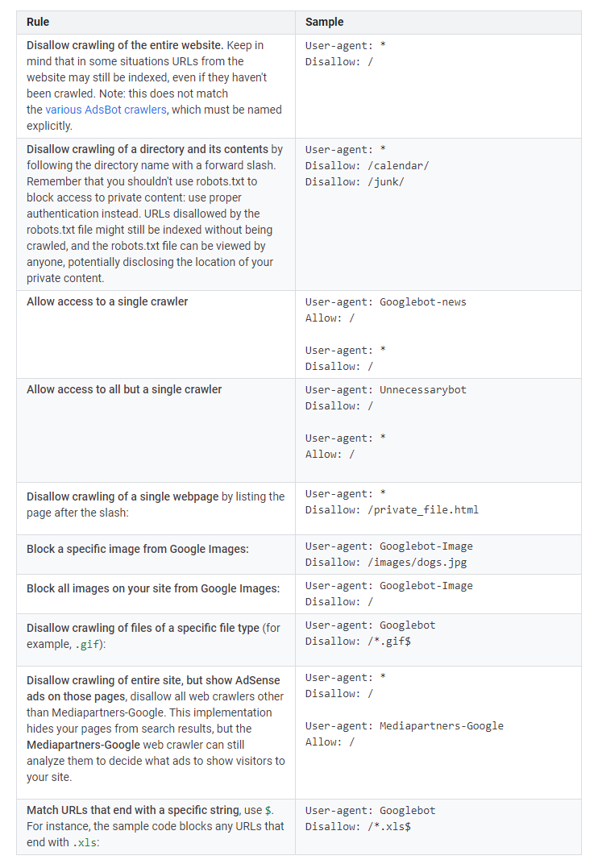
Robots.txt
What is robots.txt?
A text file that sits in the background of your website
Search engines look at it before scanning your pages
Here you can decide which pages search engines can include or ignore
Most used to stop search engines from showing admin pages or test pages
Helps search engines focus on your most important content
Notes:
Key Points:
Guides search engines.
Hides irrelevant pages.
Focuses on key content.
Talking Points:
Robots.txt is a small file that sits in the background of your website and tells search engines what to scan.
It helps you block pages you don’t want showing in search results, such as admin or test pages.
By filtering out the unnecessary, it helps Google and other search engines focus on your important content.
Most business owners won’t need to edit robots.txt, but it’s useful to know it exists.
Understanding this gives you another small tool to manage your online presence.

Slide 35
DIY or Developer?
DIY
Made For You
Pros:
Lower cost to get started
Easy to use drag and drop builders
Full control to make quick changes for yourself
Cons:
Can look less professional if not designed well
Limited features compared to custom sites
Takes time to build, learn, and manage
Pros:
Tailored design that fits your business
Expert setup
Saves you time to focus on your business
Cons:
Higher cost upfront
Can take longer to build and launch
Less control over small changes
Notes:
Key Points:
Open for questions.
Reflect on relevance.
Websites are essential tools.
Talking Points:
Now is your opportunity to ask questions or raise points that felt most relevant to your business.
Encourage participants to reflect on what stood out and how it applies to their own situation.
Reinforce that websites are essential for credibility, visibility, and growth in today’s market.
Even small improvements to your website can have a meaningful impact on your results.
Thank everyone for their time and participation, and remind them to keep exploring and experimenting with their online presence.

Slide 36
Thank You!
Any Questions?

Slide 37
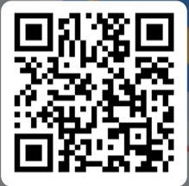
Feedback & Next Steps
Please complete the short feedback form on the QR code to the right.

